Slide 1
Strategic Planning Workshop
Strategic Planning
for the 21st Century
Rick L. Souza

Slide 2
The Value of Strategic Planning
Why wait for the crisis to plan? First things first!

Slide 3
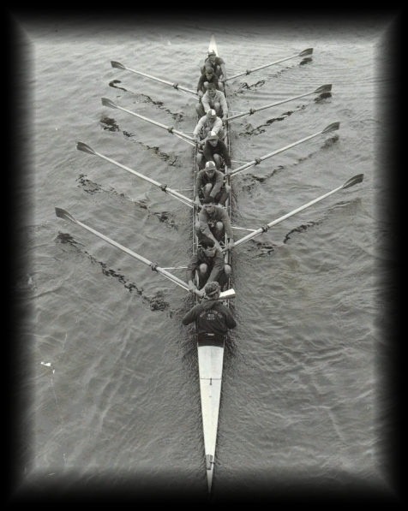
Teamwork
“If you wish to go quickly, go alone. If you wish to go far, go together.” - African Proverb

Slide 4
The Big Picture
The GOAL is more important than the ROLE.

Slide 5
Determine the Direction You are Headed
Direction gives the team members vision and confidence.
Imagine a labyrinth; the Holy Spirit sees and will direct.

Slide 6
Counting the Cost
price tag.
Every idea has a

Slide 7
Leadership
The difference between success and failure is often leadership.

Slide 8
The Common Purpose
Differences don’t mean unity is not achieved.

Slide 9
Mission & Vision Statements, Core Values
An organization must know its target in order to hit it.

Slide 10
The Music
Learn to listen to the music.

Slide 11
Gather Information
In order to make good decisions, you have to have good information.

Slide 12
Thinking Outside the Box
Look beyond your own nose.

Slide 13
Six-Hat Thinking
Different hats for different occasions:
WHITE HAT – Facts & Figures
RED HAT – Emotions & Feelings
BLACK HAT – Cautious & Careful
YELLOW HAT – Speculative & Positive
GREEN HAT – Creative Thinking
BLUE HAT – Focused Thinking

Slide 14
The Mind is a Fox
Scenario planning – alternative strategies.

Slide 15
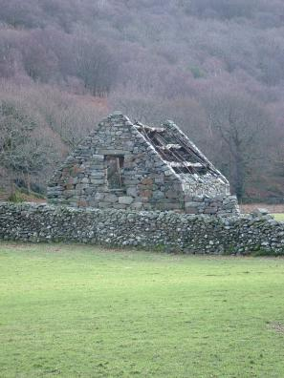
Identify the Need
What are the real needs vs. the perceived needs?

Slide 16
Develop a Course of Action
An unsatisfied need leads to discouragement & dissatisfaction.

Slide 17
Implement the Course-of-Action Plan
What is it?
Who is responsible for making sure it is completed?
When will it be done?
Where will the action take place?
How will it be accomplished?
What will it cost in finances, resources, manpower, time and energy?
Who will do the follow up?

Slide 18
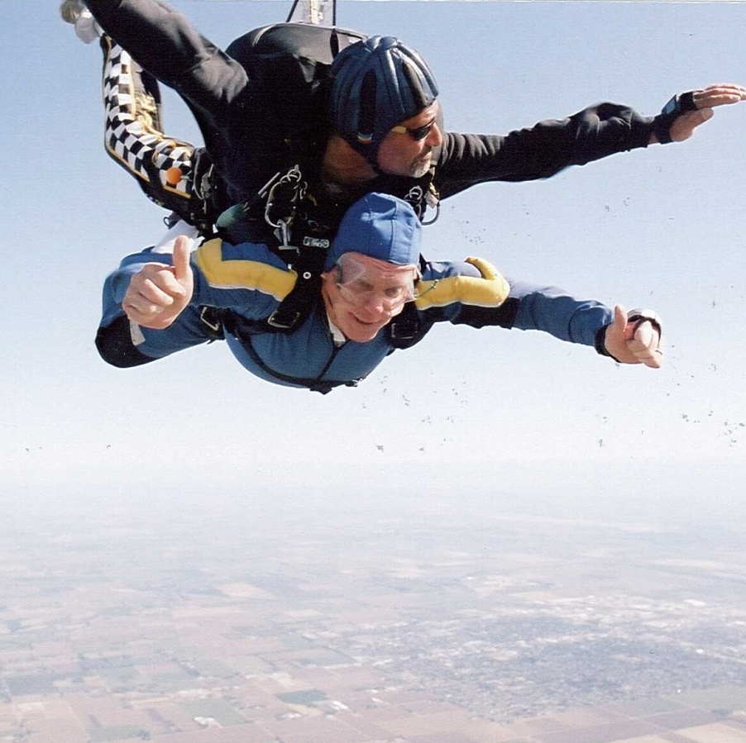
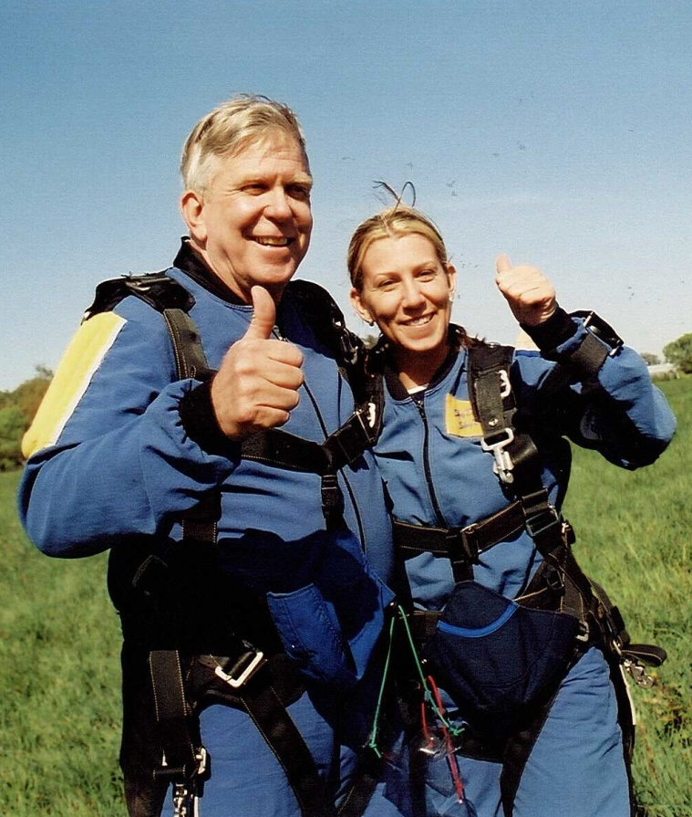
Celebrate Your Successes
Everyone needs encouragement.

Slide 19
Discuss Your Challenges
A challenge does not have to be viewed as a problem.

