Slide 1
Hope
Reach
Within
Of Every Addict

Slide 2
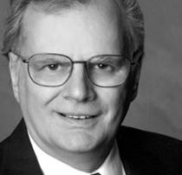
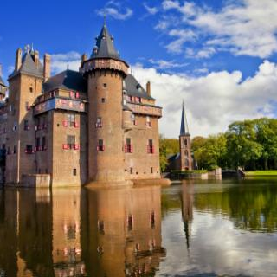
Our History
1958
1969
1971
1995
2006
2009
2016
2007
TC started
New York
Teen Challenge
International
Fellowship
Over 1,400
programs
in 115 nations
TC in
82 countries
TC in
25 nations
Jerry Nance
Becomes CEO
First
International TC
established
Launched
Netherlands
Notes:
Evangelistic emphasis—
David Wilkerson’s initial call took him to the streets of New York City. It was only later that the need for long-term discipleship led workers to adopt a residential approach. The residential rehabilitation model has been so successful that it has at stymied our ability to consider alternative methods. The Unleash the Hope Initiative once again emphasizes the need to take hope where its needed.
Worldwide growth—
The growth of TC in the years immediately following its start in 1958 came as individuals gripped by the needs of addicted youth and encouraged by the example of David Wilkerson launched ministries to offer hope to addicts, first in the U.S. and later abroad. This “organic growth” has proved to be both a blessing and a hindrance.
GTC development—
GTC was established in 1995 to provide fellowship for existing TC ministries as well as to help with the requests from individuals and churches that wanted to start TC ministries in their own country.

Slide 3
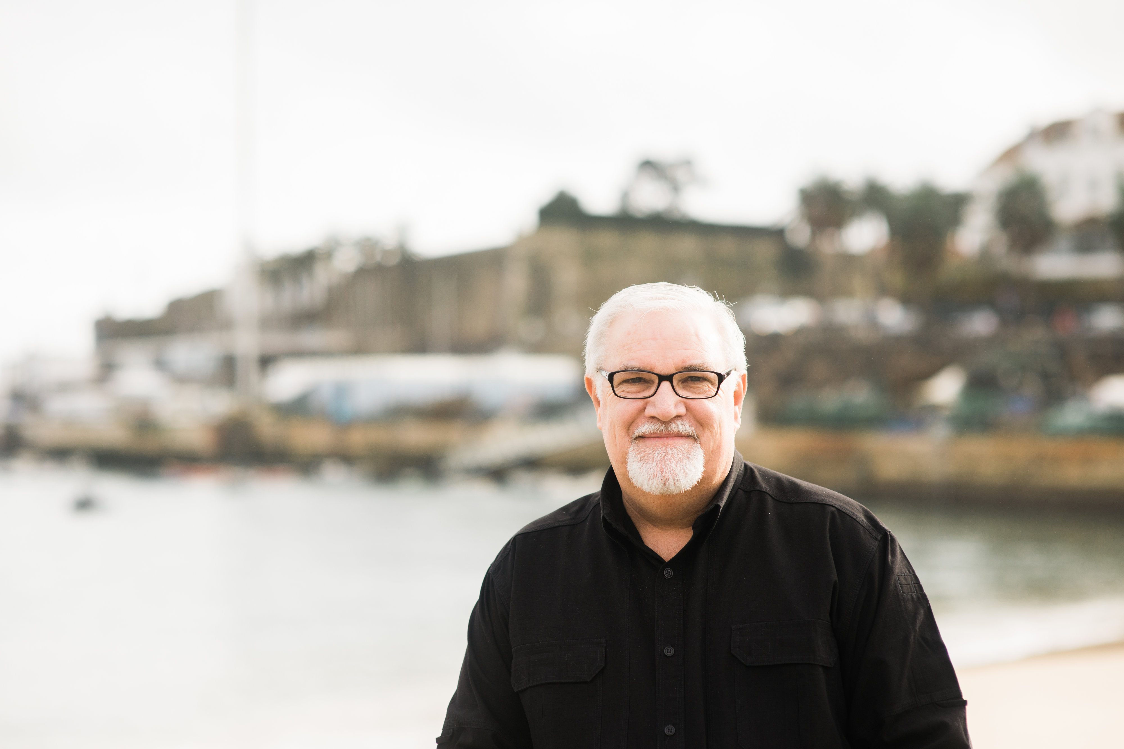
A New Mission
Assist in the development and implementation of TC programs worldwide.

Slide 4
Approach
1. Organize our team into seven regions
Europe
N. America
Eurasia
N. Asia
Africa
Latin America and Caribbean
Asia Pacific
Created strategic ministries teams

Slide 5
Strategies
How do we help TC
achieve greater success?
New programs
Training
Communication tools
Sustainability
Promote standards

Slide 6
What has been accomplished?
God has been faithful, and he has blessed our efforts over the past 9 years!

Slide 7
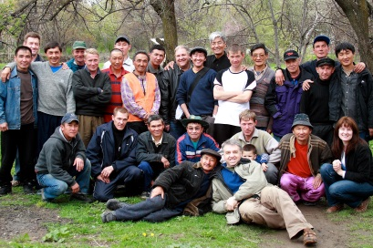
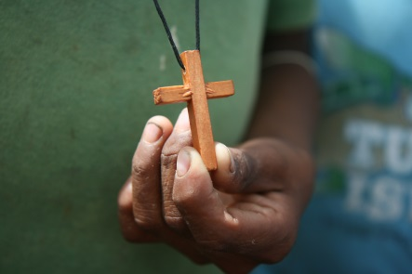
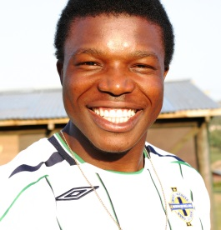
Strategy 1 New Programs
31 new countries
Botswana
Burkina Faso
Burundi
Cameroon
Ghana
Madagascar
Tanzania
Togo
Fiji
Myanmar
N. Mariana Is
S. Korea
Thailand
Armenia
Lebanon
Turkey
Albania
Bulgaria
Greece
Iceland
Malta
Spain
N. Asia
Belize
Colombia
Grenada
Guyana
Nicaragua
Panama
Peru
Name Withheld

Slide 8
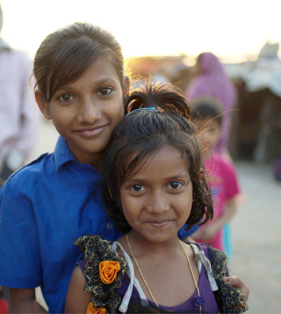
Strategy 1 New Programs
Awareness Meeting
(recruiting leaders & partners)
Evangelism
(partnering in outreach efforts)
Internships
(sending interns to TC programs)
Living Free
(non-residential groups)
Women and Children
(consulting to start new programs)

Slide 9
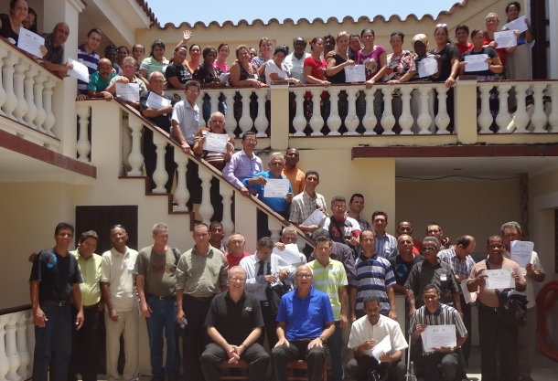
Strategy 2 Training
200 conferences and training events (2014 & 2015)
8,800+ individuals participated
Scholarships were provided to help hundreds of leaders attend
iTeenChallenge.org launched
Leadership Training
Latin America & Caribbean Region

Slide 10
Strategy 3 Communication Tools
Curriculum (GSNC & PSNC)
Teaching manuals
The Cross and the Switchblade
HOPE
Equip / John Maxwell
Lead Like Jesus
希
أمل
Joyce Meyer Ministries
matumaini
आशा
умед
ümid
ελπίδα
гэдэгт найдаж байна

Slide 11
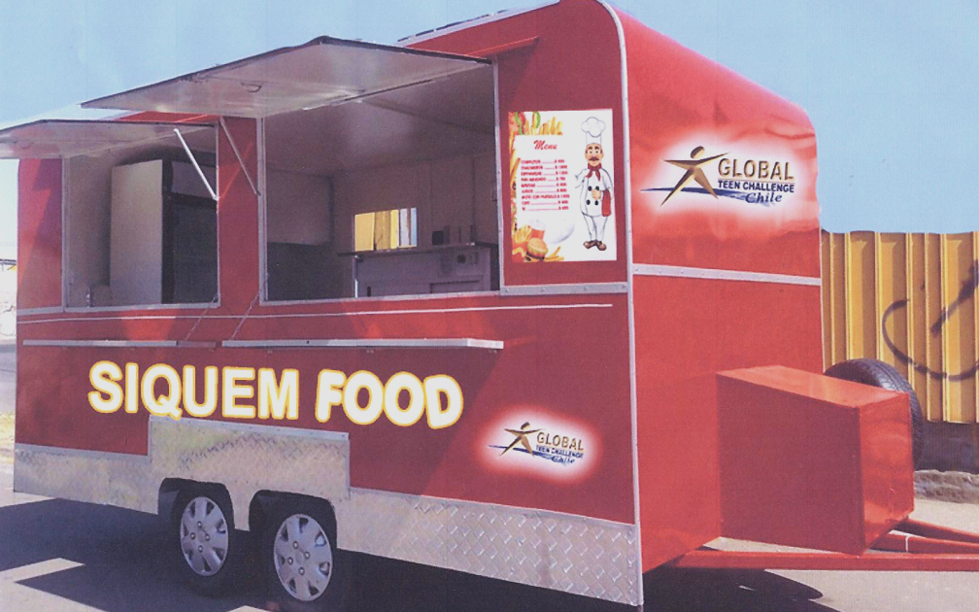
Strategy 4 Sustainability
Farm, Jamaica
Launched sustainability department, consulting, and invest forward program
Pallet Business
Czech Republic
Invested over $272,000 to help start 13 businesses that are helping fund local TC programs
Egg / Chicken Farm
Kyrgyzstan
Food Truck, Chile

Slide 12
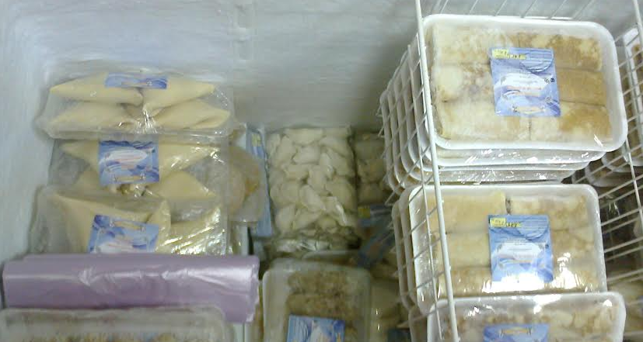
Strategy 4: Sustainability
Invest Forward
Project
Country
Food Truck
Tree Planting
Chicken Coop
Car Wash
Hair Salon
Chicken (eggs)
Green House
Bakery
Shuttle Business
Refrigerated Truck
Water (Well)
Wall Panel
Guest House
Chile
Czech Republic
Jamaica
Kansk
Kenya
Kyrgyzstan
Kyrgyzstan
Peru
New Delhi
Novokuznetsk
Tajikistan
Tartarstan
Siberia Maima
Shuttle
New Delhi
Refrigerator
Truck, Siberia

Slide 13
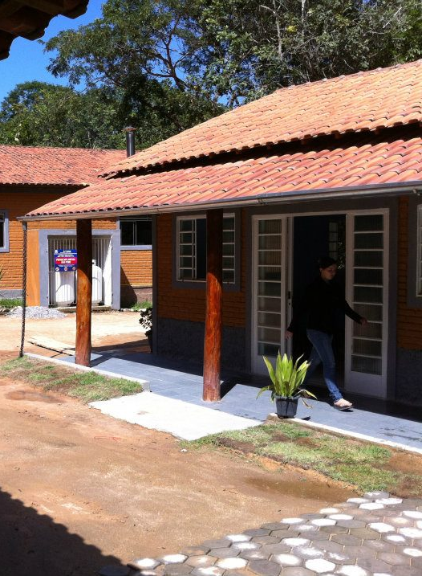
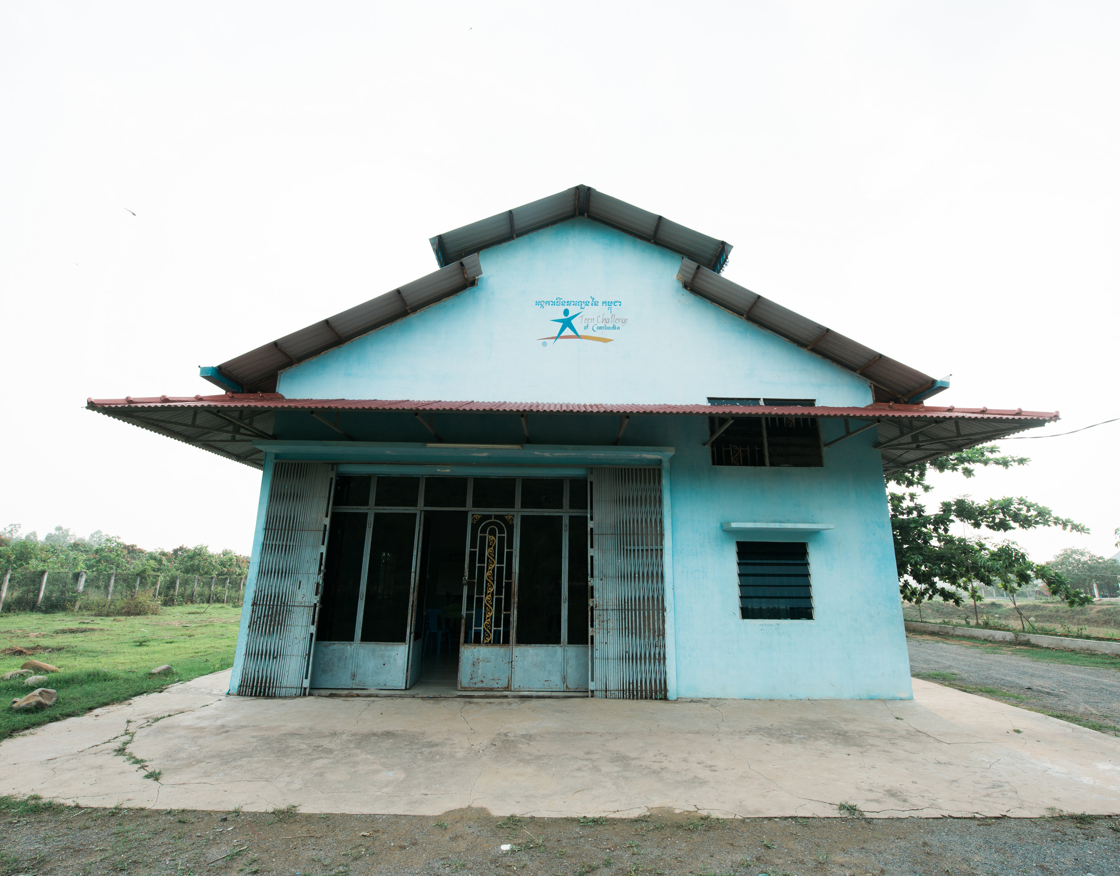
Strategy 5 Standards
Guidelines and standards are now in use in every region of the world

Slide 14
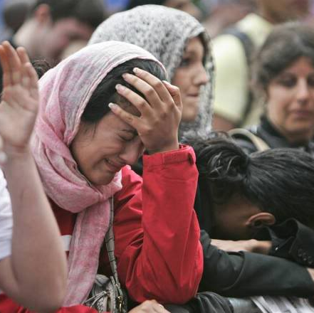
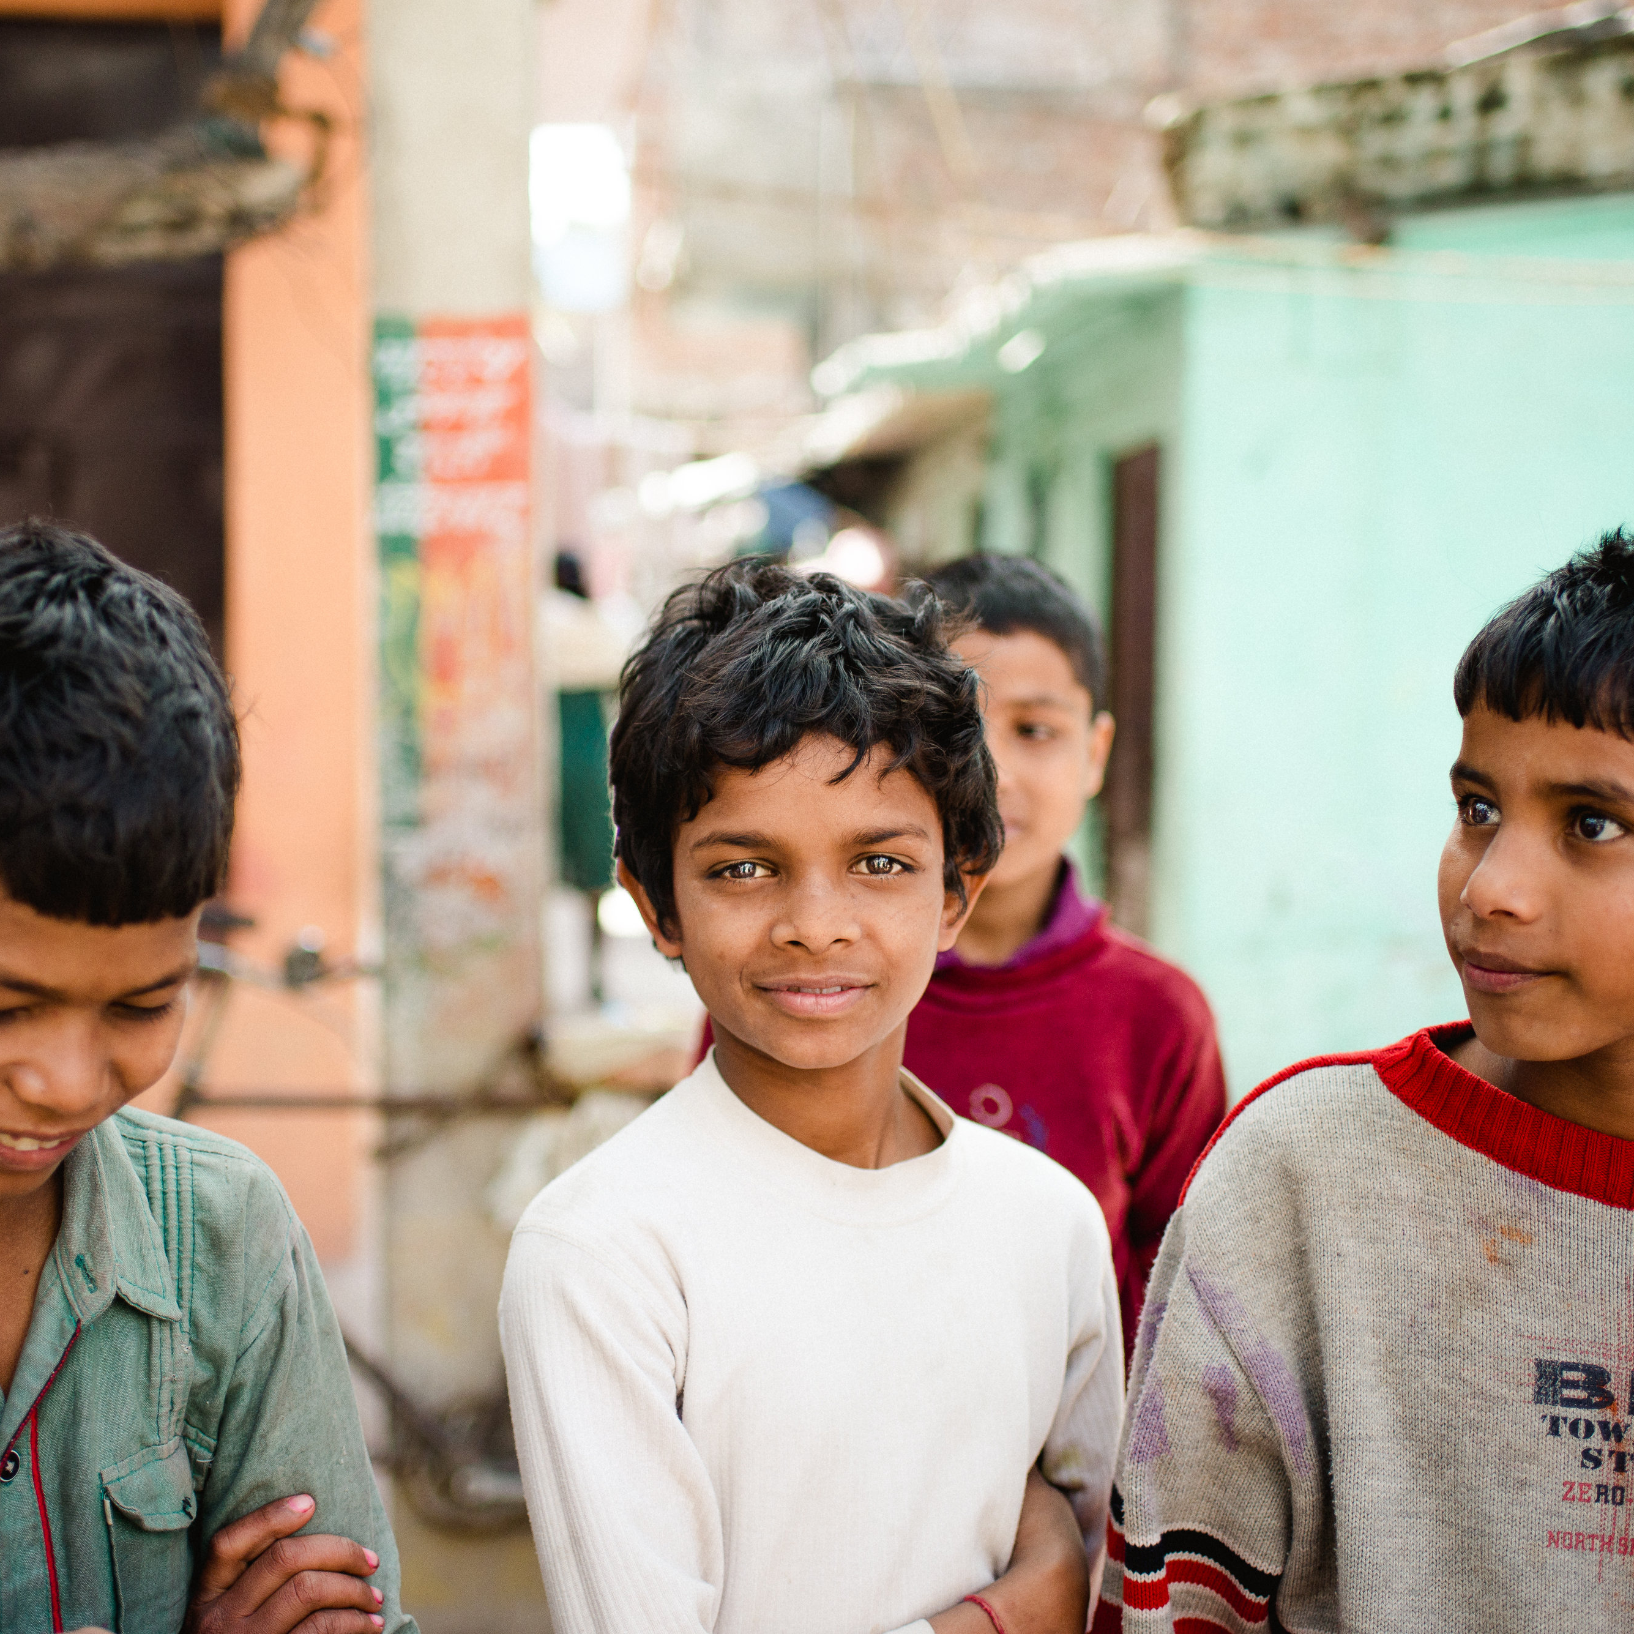
A World In Need
Great
Need
Urgency
Opportunity
Commission

Slide 15
Vision God’s Heart for the People
“Declare his glory among the nations, his marvelous deeds among all the peoples”
Psalm 96:3 (NIV)
Notes:
In Psalm 96, the Psalmist admonished Israel to declare God’s glory and marvelous deeds to all the nations. His intention was to encourage the nations to forsake their idols and worship the Lord. In essence, the Psalmist’s message of hope was, “what God has done for Israel—He will do for you.”
For almost 60 years Teen Challenge has been proclaiming the glory of God and his salvation to those trapped by addiction. Teen Challenge students and graduates share their personal stories of transformed lives countless times in varied venues in the hope that others will turn from their addictions to God. Like the Psalmist, their simple message of hope is, “if God did it for me—He will do it for you.”

Slide 16
Vision God’s Heart for the People
Mark 16:15
He said to them, “Go into all the world and preach the gospel to all creation.
Therefore go and make disciples of all nations, baptizing them in the name of the Father and of the Son and of the Holy Spirit
Matt 28:19
“But you will receive power when the Holy Spirit comes on you; and you will be my witnesses in Jerusalem, and in all Judea and Samaria, and to the ends of the earth.”
Acts 1:8

Slide 17
Vision God’s Heart for the People
Put HOPE within Reach of EVERY Addict

Slide 18
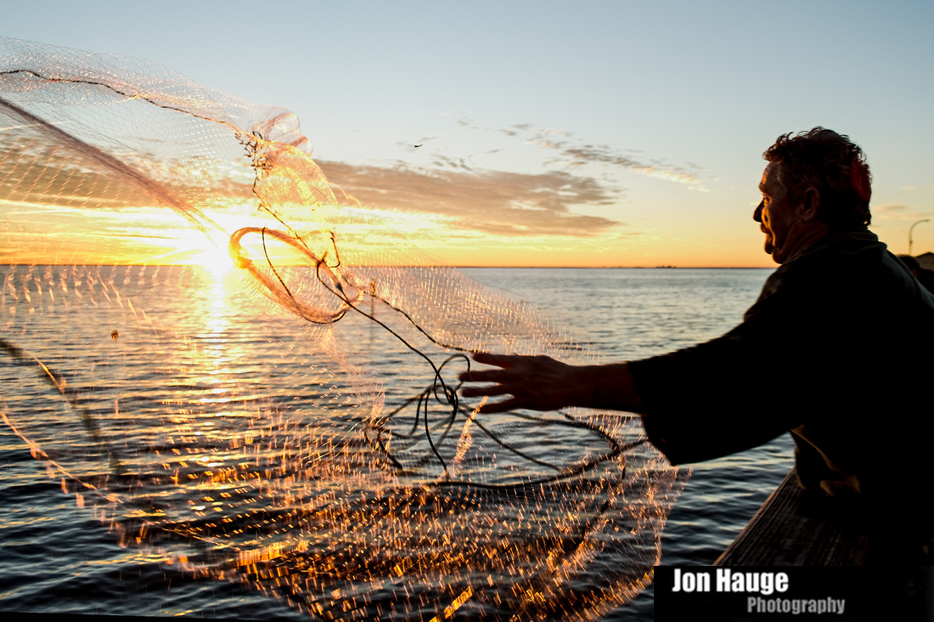
Vision God’s Heart for This Ministry
"Throw your net on the right side of the boat and you will find some." When they did, they were unable to haul the net in because of the large number of fish.
John 21:6 (NIV)
Notes:
In Psalm 96, the Psalmist admonished Israel to declare God’s glory and marvelous deeds to all the nations. His intention was to encourage the nations to forsake their idols and worship the Lord. In essence, the Psalmist’s message of hope was, “what God has done for Israel—He will do for you.”
For almost 60 years Teen Challenge has been proclaiming the glory of God and his salvation to those trapped by addiction. Teen Challenge students and graduates share their personal stories of transformed lives countless times in varied venues in the hope that others will turn from their addictions to God. Like the Psalmist, their simple message of hope is, “if God did it for me—He will do it for you.”

Slide 19
Vision God’s Heart for This Ministry
New Methods
Catch More Fish

Slide 20
Vision Igniting Ministry
Cuba
Africa

Slide 21
Vision Inspiring Leaders
Phil Hills
CEO, Teen Challenge United Kingdom

Slide 22
Break Out Session

Slide 23
Break Out Session
Instructions
No one at the table is the “leader”
Select a person to take notes
Select someone who will share/ report your group’s insights and answers when the groups reunite.

Slide 24
Break Out Session
Questions
Hearing about Cuba, Africa and the UK, what could putting HOPE within reach of EVERY addict look in your country?
What would you need in order to put HOPE within reach of EVERY addict in your nation?
Do you think this vision is achievable? Why? Why not?

Slide 25
Break Out Session
Your Thoughts?

Slide 26
Thank You!

