Slide 1

TEEN CHALLENGE
CORE VALUE 4
Vision
By
Stephen Storms

Slide 2
1. What is vision?
Vision is seeing in our mind or spirit something that could happen in the future.
For Christians vision is seeing and acting on what God wants to do.
God gives leaders and staff spiritual vision to know what God wants to do in our ministry.
Sometimes vision comes as a burden from God or divine guidance.

Slide 3
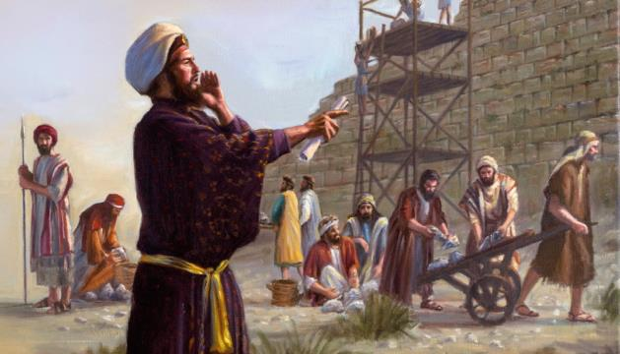
Why is vision important?
Vision gives us direction.
Vision gives us perseverance.
Nehemiah is our key example.

Slide 4
Why is vision important?
Vision gives us passion.
Vision inspires us to grow.
Vision gives us hope.

Slide 5
3. How do we get God’s vision?
Seek God for His will, His vision, and His direction.
Realize sometimes the vision comes in small pieces.
The vision may come from different sources: the Bible, other people, times of prayer, or something in our everyday lives.
Sometimes there is the death of a vision.

Slide 6
4. How does addiction affect vision?
Addiction destroys hope.
An addict’s only vision is for more drugs.
Addiction limits vision to today.
Addiction destroys the vision of family and friends.

Slide 7
5. How do we develop vision in our students?
Instruct them that God has a plan for their lives. Jeremiah 29:11
Teach them the ways God reveals His will for our lives.
Give them examples from the Bible and today of God’s direction in the lives of His people.
Encourage them to ask God for His vision/goals for their lives.

Slide 8

Core Value 4
Vision
seeing
and acting on
what God wants to do
Example: Nehemiah

Slide 9

6. What is one goal for your ministry or personal life that you need to work on? How can you help fulfill the vision of your local Teen Challenge ministry?
Write down
at least one idea.

Slide 10

For further study we recommend you read chapter 4, “Vision,” in the book Our Core Values, by Dr. Jerry Nance (available from Teen Challenge USA and Global Teen Challenge).

Slide 11


Global Teen Challenge
www.globaltc.org
Training materials for this course are available at the following address:
www.iTeenChallenge.org

