Slide 1
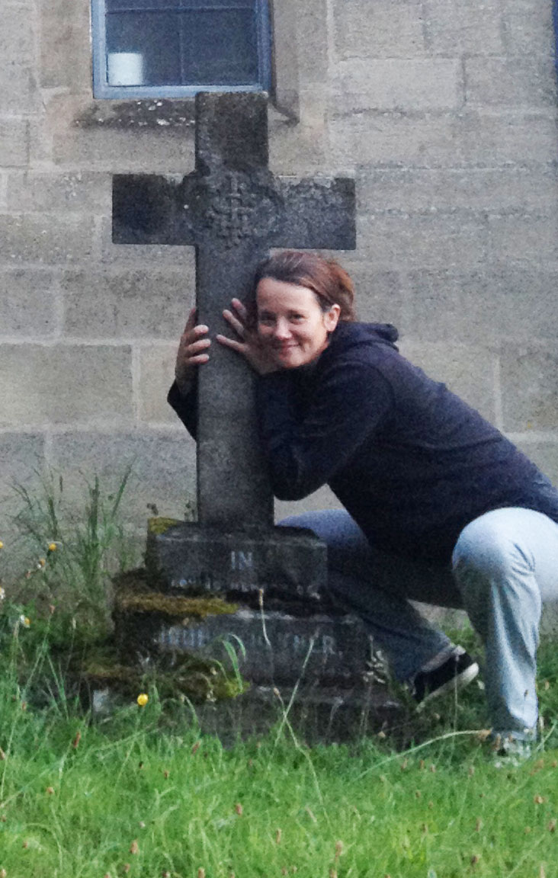

Developing a
Biblical Mindset of
Christian Discipleship
By Dave Batty

Slide 2
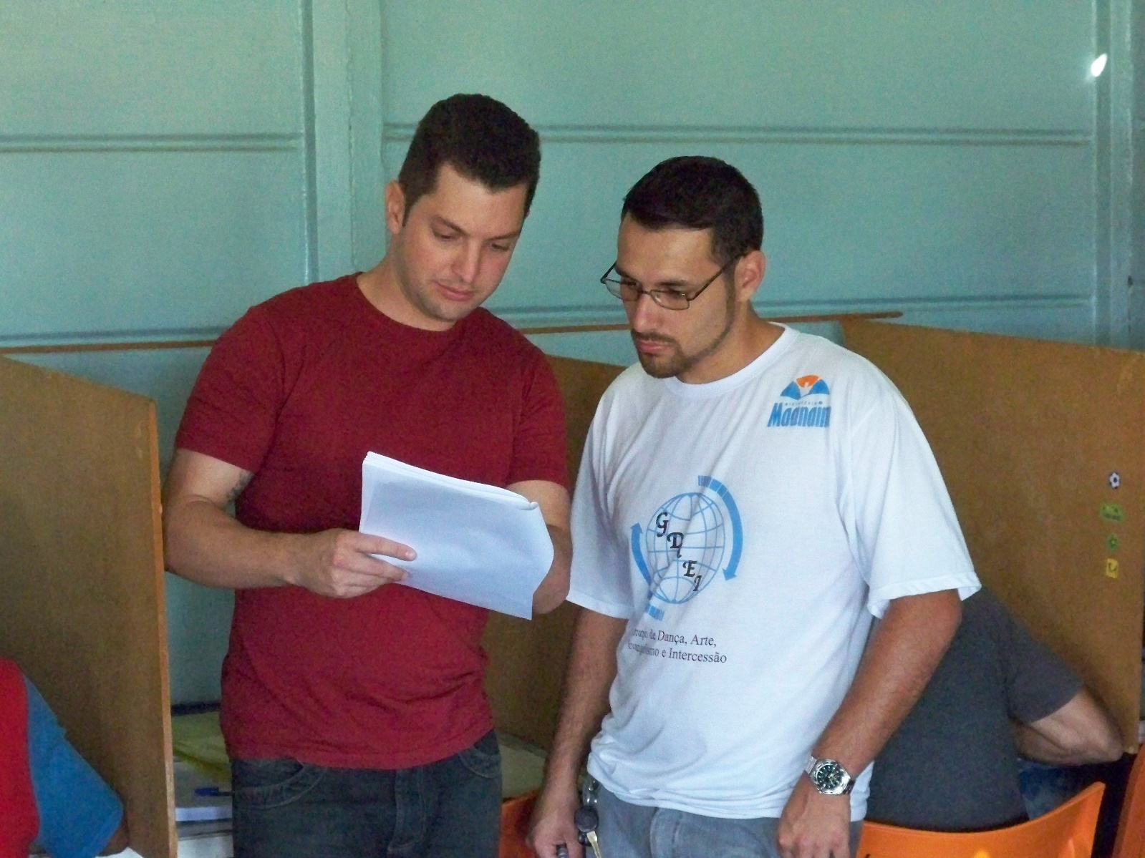
If Teen Challenge is first and foremost a Great Commission ministry, then as staff we must see our primary role is to
make disciples.
This needs to dominate our thinking as we approach every area of our ministry.

Slide 3
The Power of Discipleship
1. The power of Choice

Slide 4
The Power of Discipleship
2. The power of Sacrifice

Slide 5
The Power of Discipleship
3. The power of Service

Slide 6
The Power of Discipleship
4. The power of Fruitfulness

Slide 7
Small Group Activity
Look up scripture and see what it says about being a disciple.
1. Mark 1:14-20, 2:13-17 Matthew 4:18-22, John 1:34-43
2. Matthew 10:34-42
3. Luke 14:25-35
4. Luke 18:18-30; Mark 10:17-31, Matthew 19:16-30
5. Matthew 16:21-28, Mark 8:31-38, Luke 9:18-27
6. Matthew 28:16-20
7. John 12:20-26, John 13:34-35
8. Matthew 8:14-22, Luke 9:57-62
9. John 21:15-22

Slide 8
Conclusion
1. How do we make Christian discipleship the dominant approach in our mindset as we do our work at Teen Challenge?

Slide 9
Conclusion
2. How do we make Christian discipleship the primary therapeutic method (model, strategy) used in our ministry?

Slide 10
Conclusion
3. How do we make the Great Commission our primary standard for daily operation in our ministry?

Slide 11

My Big Idea

Slide 12
Questions for discussion

Slide 13

Contact Information
Global Teen Challenge
www.GlobalTC.org
www.iTeenChallenge.org
706-576-6555

