Slide 1
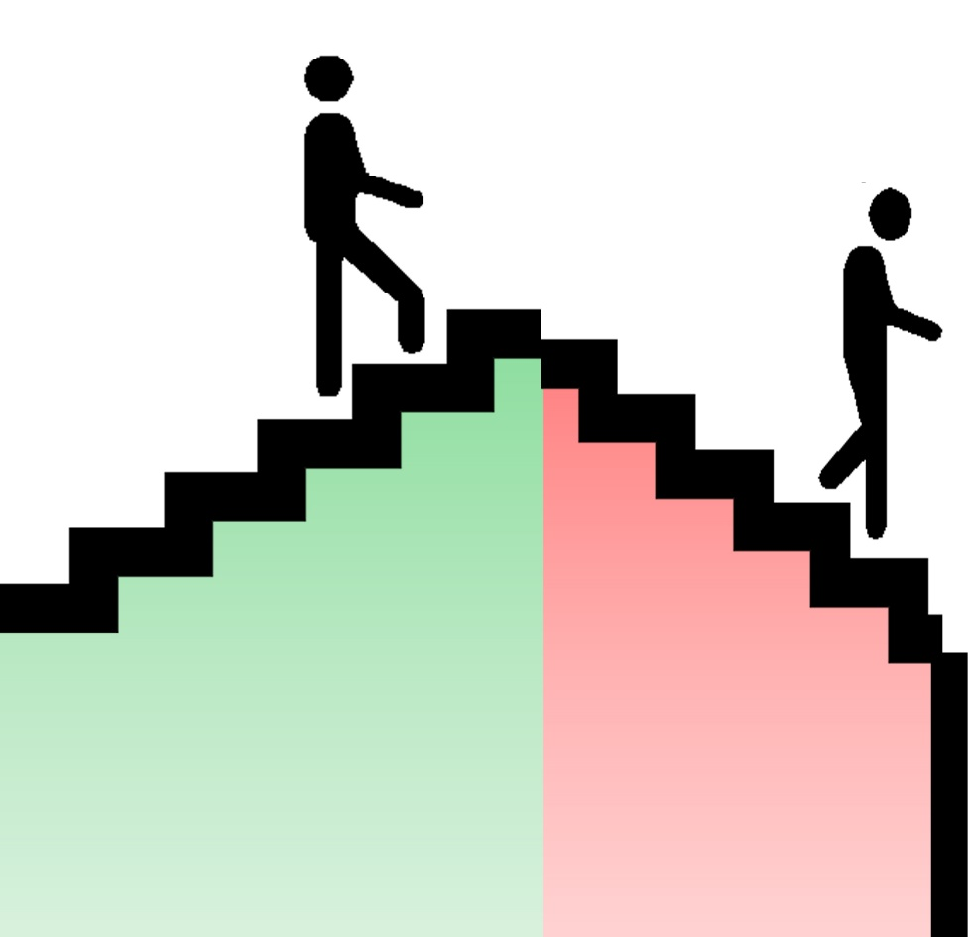
Understanding the Steps to Relapse
Spelling Recovery Backwards
Edition 2.4
By Dave Batty

Slide 2
Personal Application Ideas
1
2
3
4
5
6
7

Slide 3
Relapse and recovery are like trying to put a puzzle together
>It is complicated
>We need help to put the pieces together
>Not all relapse and recovery the same
>Principles of relapse and recovery similar

Slide 4
Chapter 1
Introduction to Relapse
Four major issues in understanding relapse
Relapse
Addiction
Recovery
Healthy living

Slide 5
1. Relapse
What is relapse?
What are the early warning signs of relapse?
How can you prevent relapse?
What should you do if relapse occurs?
To understand relapse, you must also understand what is recovery.

Slide 6
2. Recovery
You can’t relapse if you have never been in recovery.
What are the steps to recovery?
To understand recovery you need to understand 2 more major issues: Addiction and healthy living

Slide 7
3. Addiction
What is the path to addiction?
Why do people get caught up in life controlling problems?
Family patterns of addictions
For any temptation or bad habit—the principles are very similar

Slide 8
4. Healthy Living
What is the path to maturity?
What is God’s plan for “normal” living?

Slide 9
Relapse has 2 major stages
1. Dry relapse
I am on the path to relapse, but I have not yet returned to physical use of the substance of my addiction.
2. Wet Relapse
I am back to using the substance of my addiction—alcohol, drugs, or whatever.

Slide 10
Seven reasons why recovery quickly turns into relapse
1. Magical thinking—My problems are all fixed. I’m fine.
I can handle this on my own. I have been delivered.
2. Environmental abstinence vs. real change on the inside.
3. My old friends are still my friends today.
4. When facing new problems, I am still using my old strategies for “problem solving.”
5. I fail to take hold of God’s power and use it appropriately in my daily living.
6. Unresolved problems of my past are still affecting me.
7. Compartmentalizing my life.

Slide 11
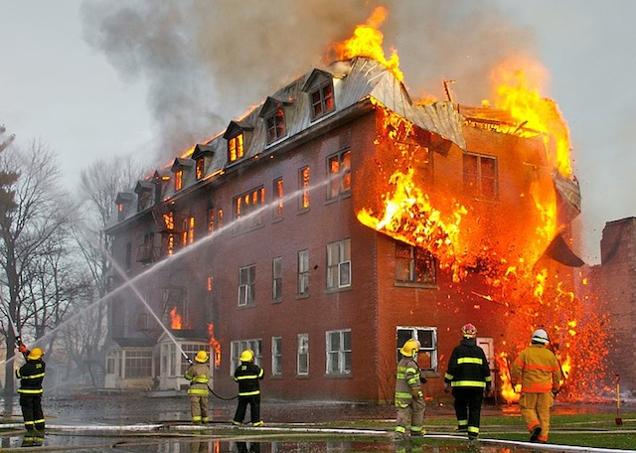
Does all relapse cause the same damage?
Relapse can be small.
Relapse can be
catastrophic.
Relapse is like a
burning building.

Slide 12
God’s ideal for our lives
Path of recovery
Before addiction
Path of recovery
Path of addiction
I
I
Living in incomplete recovery
I
I
I
Relapse

Slide 13
Chapter 2
Relapse
The damage of relapse is proportional to the level of recovery
Relapse is very serious: now opening self up to deeper damage.
What causes relapse?

Slide 14
Seven reasons why recovery quickly turns into relapse
1. Magical thinking—My problems are all fixed. I’m fine.
I can handle this on my own. I have been delivered.
2. Environmental abstinence vs. real change on the inside.
3. My old friends are still my friends today.
4. When facing new problems, I am still using my old strategies for “problem solving.”
5. I fail to take hold of God’s power and use it appropriately in my daily living.
6. Unresolved problems of my past are still affecting me.
7. Compartmentalizing my life.

Slide 15
One of the most common patterns in relapse is the person failed to deal with issues that were not the primary addiction. But these often were related to the addiction.
Could even be parallel addictions.

Slide 16

Surface Problems
Root Problems

Slide 17
The importance of facing our fears
The importance of facing our pain
The myth of leprosy
  The truth of leprosy

Slide 18
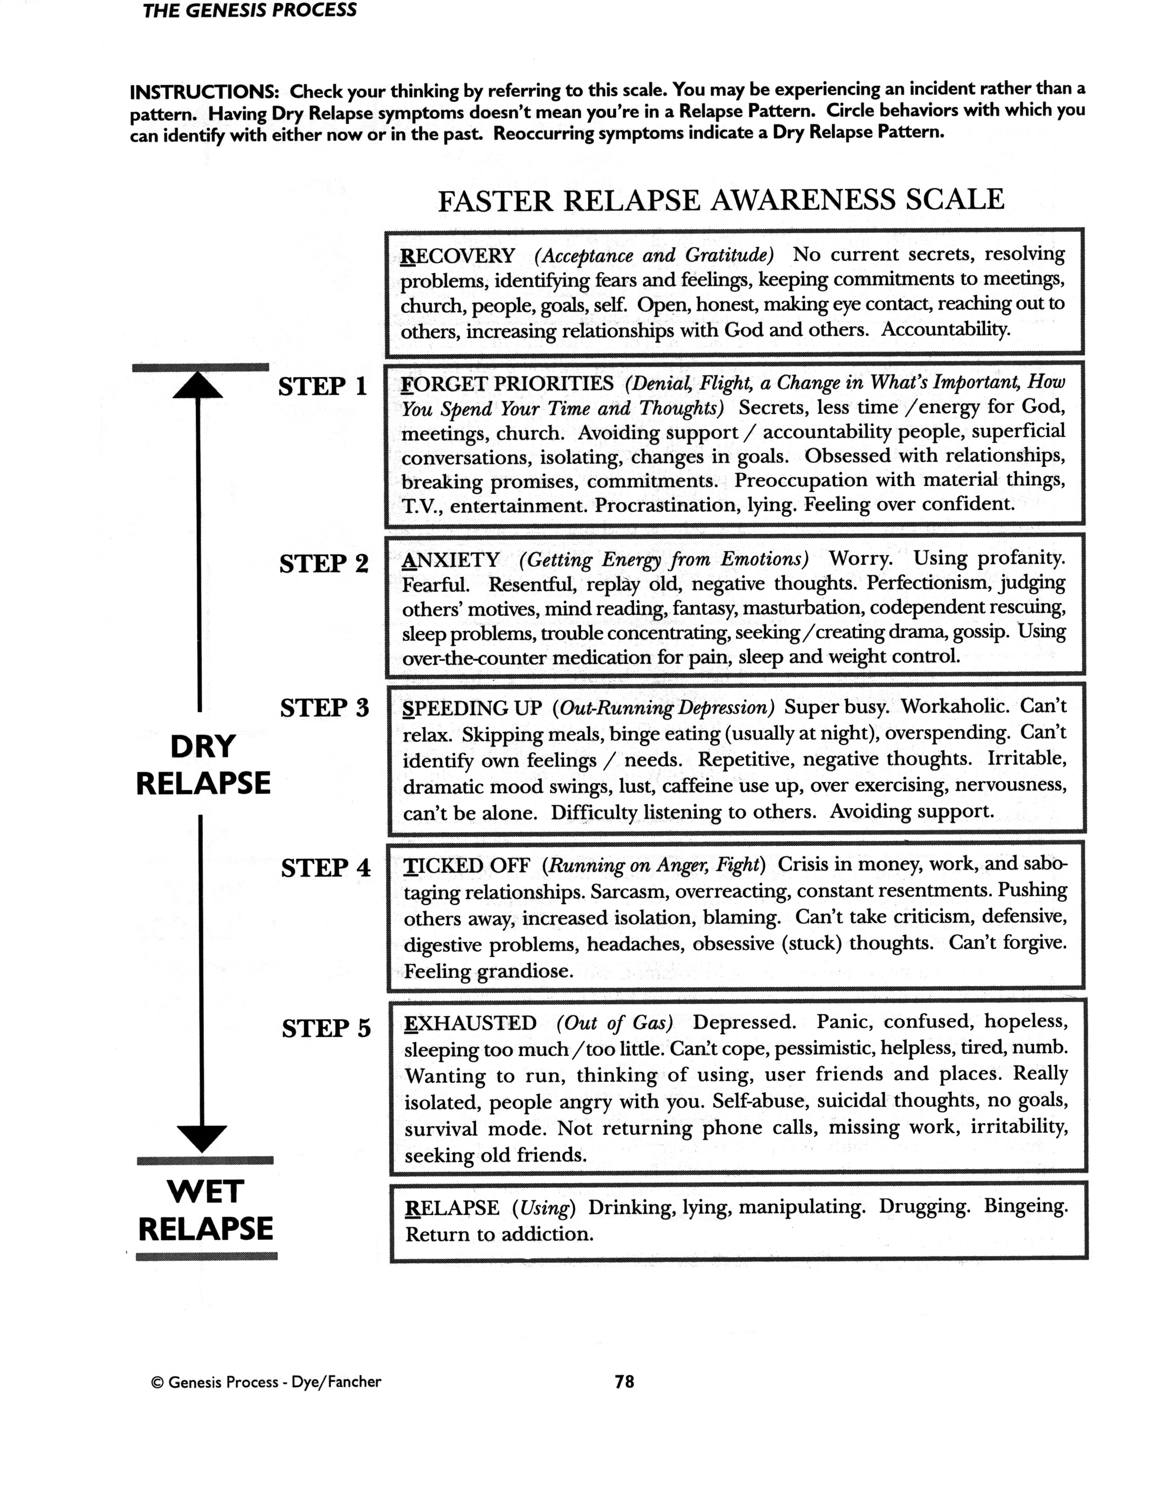

Slide 19
A closer look at relapse
A person must have experienced recovery to some degree to be able to relapse.
Three dimensions of relapse
1. Physical
2. Mental
3. Spiritual

Slide 20
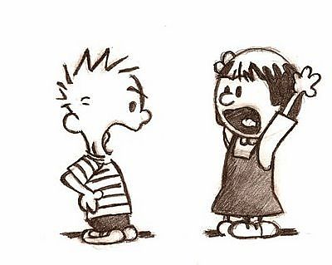
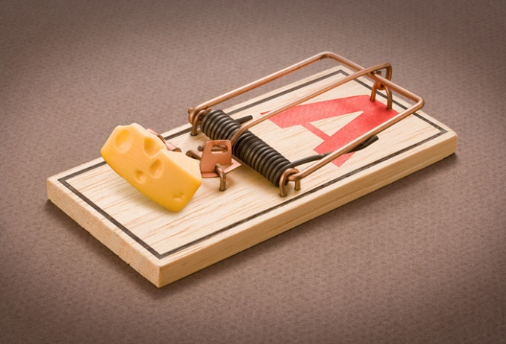
What are your triggers?

Slide 21
“Relapse does not begin with the first drink. Relapse begins when a person reactivates patterns of denial, isolation, elevated stress, and impaired judgment.”
--quote from Counseling for Relapse Prevention by Terence T. Gorski & Merlene Miller

Slide 22
37 Symptoms of Relapse from Counseling for Relapse Prevention by Terence T. Gorski & Merlene Miller
 | Relapse Symptom |  | Recovery Strategies
1 | Apprehension about well being (Feeling inadequate about myself) | 1
2 | Denial | 2
3 | Adamant commitment to sobriety | 3

Slide 23
37 Symptoms of Relapse
 | Relapse Symptom |  | Recovery Strategies
4 | Compulsive attempts to impose sobriety on others | 4
5 | Defensiveness | 5
6 | Compulsive behavior | 6

Slide 24
37 Symptoms of Relapse
 | Relapse Symptom |  | Recovery Strategies
7 | Impulsive behavior | 7
8 | Tendencies toward loneliness | 8
9 | Tunnel vision | 9

Slide 25
37 Symptoms of Relapse
 | Relapse Symptom |  | Recovery Strategies
10 | Minor depression | 10
11 | Loss of constructive planning | 11
12 | Plans begin to fail | 12

Slide 26
37 Symptoms of Relapse
 | Relapse Symptom |  | Recovery Strategies
13 | Idle daydreaming & wishful thinking | 13
14 | Feeling that nothing can be solved | 14
15 | Immature wish to be happy | 15

Slide 27
37 Symptoms of Relapse
 | Relapse Symptom |  | Recovery Strategies
28 | Feelings of powerlessness & helplessness | 28
29 | Self-pity | 29
30 | Thoughts of social drinking | 30

Slide 28
37 Symptoms of Relapse
 | Relapse Symptom |  | Recovery Strategies
31 | Conscious lying | 31
32 | Complete loss of self-confidence | 32
33 | Unreasonable resentments | 33

Slide 29
37 Symptoms of Relapse
 | Relapse Symptom |  | Recovery Strategies
34 | Discontinuing all treatment | 34
35 | Overwhelming loneliness, frustration, anger, & tension | 35
36 | Start of controlled drinking | 36

Slide 30
37 Symptoms of Relapse
 | Relapse Symptom |  | Recovery Strategies
37 | Loss of control | 37

Slide 31
Relapse & recovery
These are predictable symptoms or warning signs that precede return to alcohol (or other addictions)
We need to develop intervention strategies to address these symptoms immediately to prevent the slide toward relapse.

Slide 32
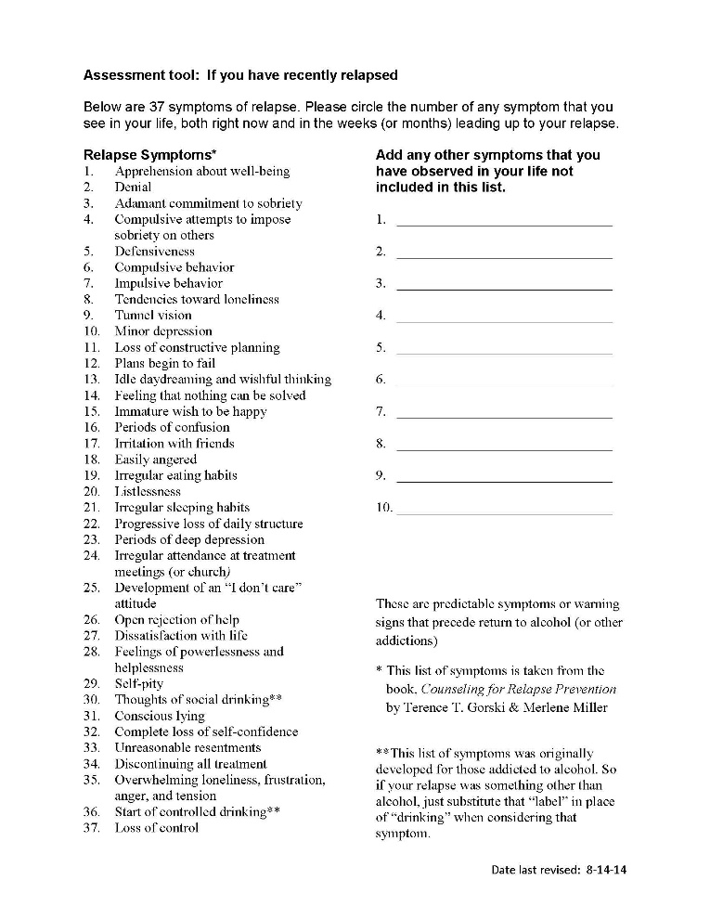
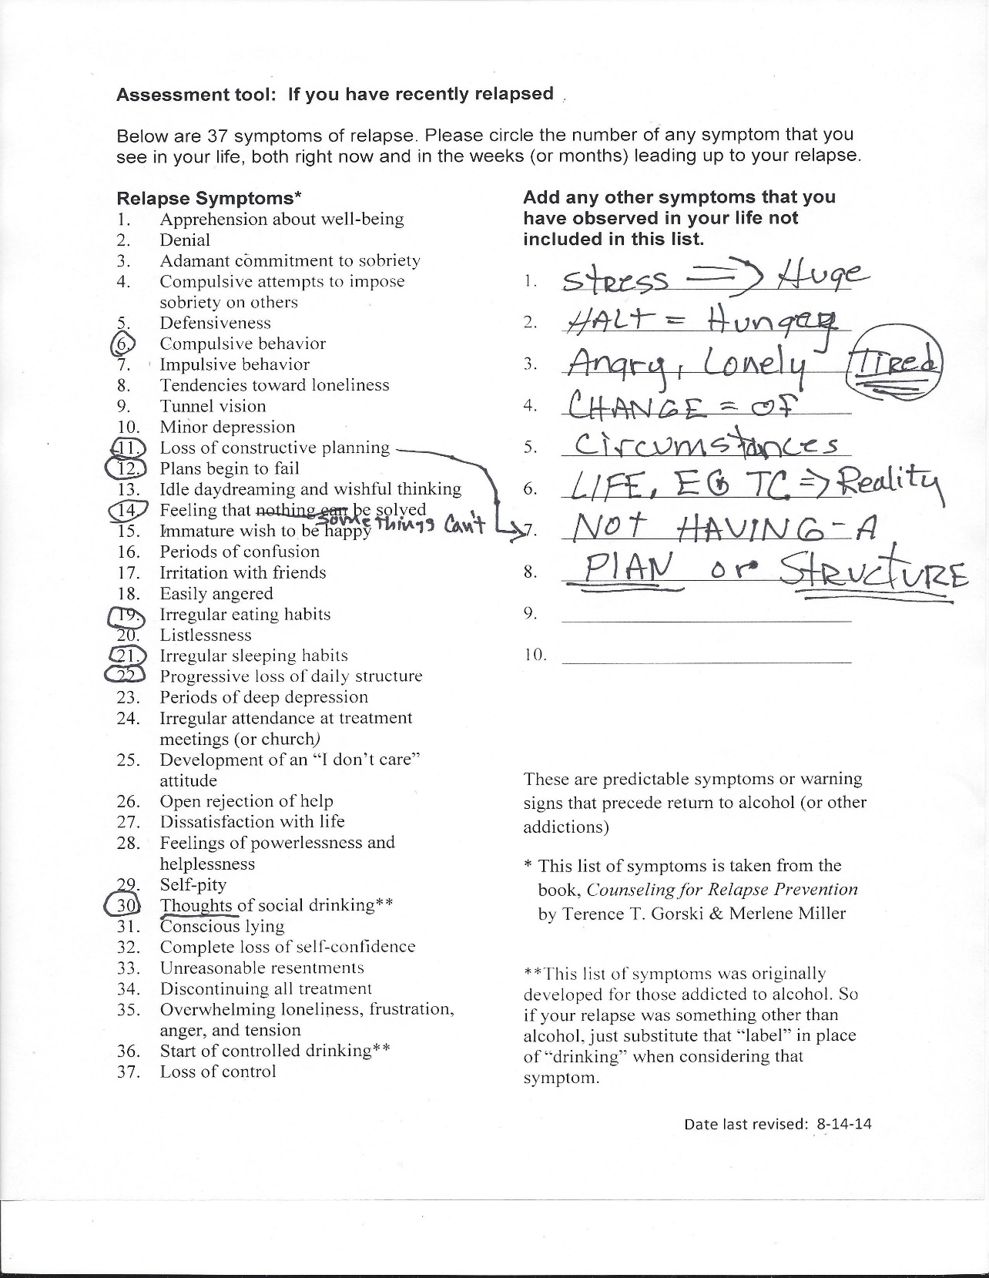

Slide 33
37 Symptoms of Relapse
 | Relapse Symptom |  | Recovery Strategies
1 | Apprehension about well being | 1 | See myself as a child of God. Accept the way God made me. Develop attitude of gratefulness. Thank God for daily provision.

Slide 34
37 Symptoms of Relapse
 | Relapse Symptom |  | Recovery Strategies
2 | Denial | 2 | Live in the truth. Memorize scripture Self inventory of false beliefs. Accountability person who will speak the truth.

Slide 35
37 Symptoms of Relapse
 | Relapse Symptom |  | Recovery Strategies
3 | Adamant commitment to sobriety | 3 | Healthy commitment to sobriety. Honesty about potential to relapse. Need for boundaries. Understand triggers in my life.

Slide 36
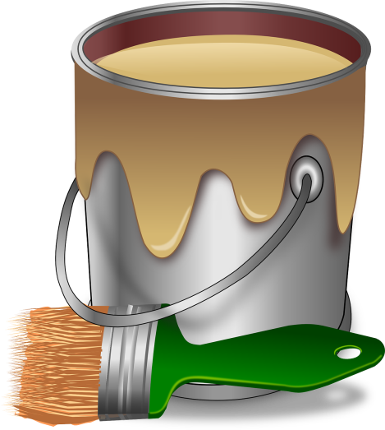
Chapter 3
The path to addictions and life–controlling problems

Slide 37
3 major characteristics of those on the path to addictions
1. They are living with false beliefs
2. They are not handling problems the way God wants them to
3. They are living with dysfunctional relationships

Slide 38
What is an addiction?
Term “dependency” basically the same as “addiction”
Jeff Van Vonderan
Chemical dependency is the state
that results from the process of increasingly turning to chemical use to meet life’s needs.

Slide 39
God dependency is the state
that results from the process
of increasingly turning to God
to meet life’s needs.

Slide 40
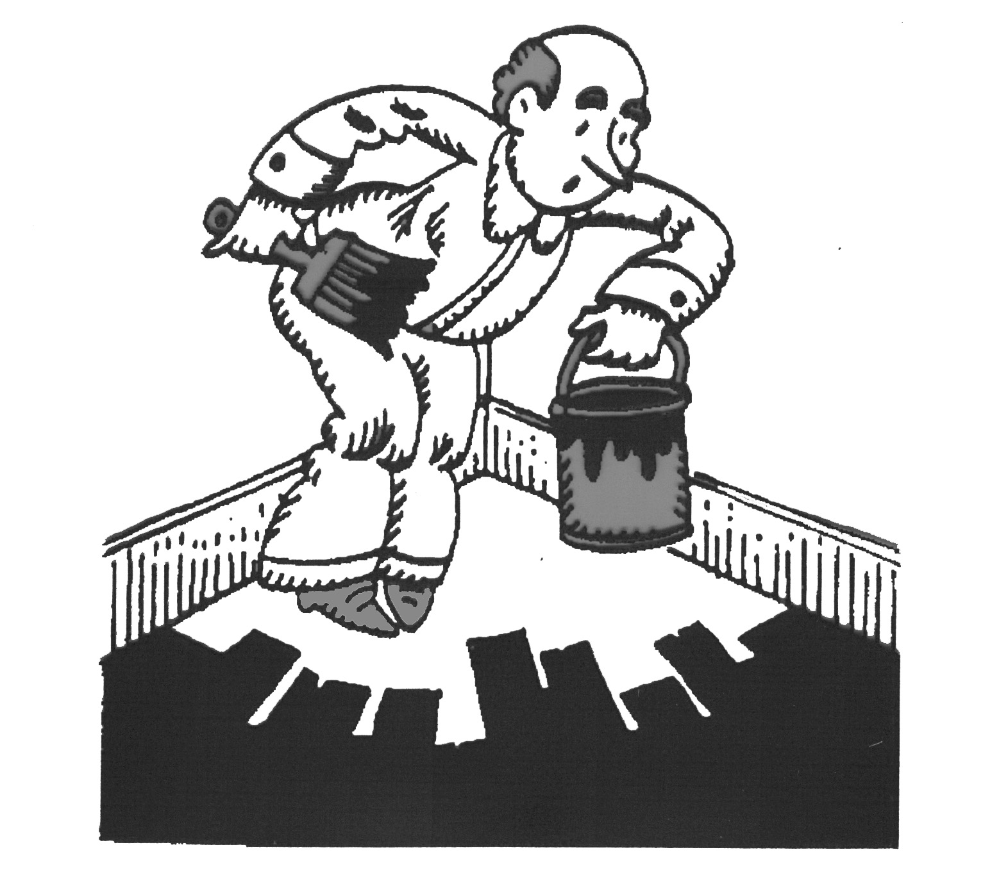
How does one get caught in an addiction?

Slide 41
Four stages of an addiction
1. Experimentation
2. Social use
3. Harmful Abuse (Daily Preoccupation)
4. Uses to feel normal

Slide 42
They are physically and psychologically addicted to this substance or behavior.
They only feel normal when they are high.
When they are not high they feel sick—physically or emotionally they feel out of place unless they are high.
They only feel peace when they are high.

Slide 43
Two types of damage that can set up a person to go down the path of addiction
1. Damage from neglect.
2. Damage from bad things happening.
The person goes down the path of addiction to “self medicate” the pain.

Slide 44
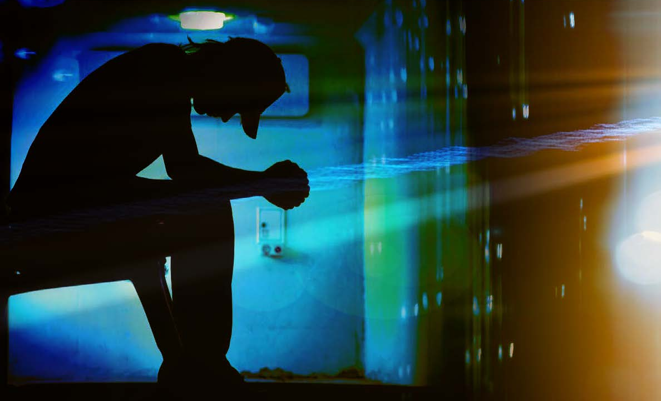
The issue of taking personal responsibility for your actions

Slide 45
Chapter 4
Recovery
The myth of “hitting the bottom”
before they can get help.
Pain motivates change!

Slide 46
The foundation for Recovery
1. Stop addictive behavior
2. Communicate hope for real change
3. Establish a personal relationship with Jesus
4. What is God’s attitude toward hurting people?
Psalm 145:14

Slide 47
Difference between restoring your relationship with Jesus and being restored to ministry work position
1. Jesus—immediate!
2. Intern or junior staff
3. Spiritual Leader

Slide 48
Restoration to ministry work position
1. Make restoration process so difficult that they do NOT want to do it.
2. Why?
3. We only want them to do it if they are 100% committed to the restoration process
4. If restoration process is too simple, they will likely only make superficial changes, not deep heart changes.

Slide 49
4 Keys to Recovery
1. Commitment to change
2. Commitment to accountability
3. Commitment to the promises of God
4. Key to recovery—gratefulness

Slide 50
Recovery often involves 4 phases
1. Intervention
2. Detox
3. Learning steps to healthy living
4. Transition back into society—healthy
living becomes the norm

Slide 51
1. Intervention
Family meets with the person to motivate them to get help.
They stop enabling the person with the problem. (offering the wrong kind of help)
Instead of waiting for the person to “hit bottom,” they “raise the bottom.”
See course, “How to Help a Loved One Who Doesn’t Want Help,” for greater detail on this.
Resource on www.iTeenChallenge.org: When they don’t want help —by Dave Batty

Slide 52
2. Detox
Detox is not recovery.
It is only one of the first steps to recovery.
It simply gets the person past the major physical sickness of withdrawing from the physical addiction.
In reality—the person is still an addict.

Slide 53
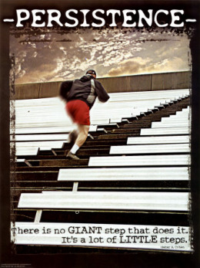
3. Learning steps to healthy living
Recovery is more than living drug free (addiction free)
This part—learning steps to
healthy living—is the major
part of recovery.

Slide 54
Problem with recovery
How desperate are they?
“Those who beg for help and then refuse the discipline of change”
--Bob Dunstan, Life Challenge, Amarillo, TX

Slide 55
1. Intervention 2. Detox 3. Steps to Healthy Living
1 hour 3-5 days 6-12 months or more

Slide 56
Recovery involves the 3 basics of healthy living
1. Living in truth
2. Learning healthy problem solving skills
3. Developing healthy relationships with healthy people

Slide 57
Spiritual foundation & process for change
2 Peter 1:3-11 NIV
God’s power and promise
³His divine power has given us everything we need for life and godliness through our knowledge of him who called us by his own glory and goodness. ⁴Through these he has given us his very great and precious promises, so that through them you may participate in the divine nature and escape the corruption in the world caused by evil desires.

Slide 58
The transformation process 2 Peter 1:5-7
Add to your Faith ….
Goodness
Knowledge
Self-control
Perseverance
Godliness
Brotherly kindness
Love

Slide 59
2 Peter 1:8-11 NIV
⁸For if you possess these qualities in increasing measure, they will keep you from being ineffective and unproductive in your knowledge of our Lord Jesus Christ. ⁹But if anyone does not have them, he is nearsighted and blind, and has forgotten that he has been cleansed from his past sins.
¹⁰Therefore, my brothers, be all the more eager to make your calling and election sure. For if you do these things, you will never fall, ¹¹and you will receive a rich welcome into the eternal kingdom of our Lord and Savior Jesus Christ.
(Emphasis added)

Slide 60
Recovery is growing in the Lord—reaching the full potential God has for us.

Slide 61
God’s ideal for our lives
Path of recovery
Before addiction
Path of recovery
Path of addiction
I
I
Living in incomplete recovery
I
I
I
Relapse

Slide 62
Christian Discipleship in Recovery
God dependency is the state that results from the process of increasingly turning to God to meet life’s needs. Jeff Van Vonderan

Slide 63
This relationship with Jesus provides:
The path to change
The motivation to change
The power to change

Slide 64
Group Studies for New Life
14 courses for basic Christian discipleship.
Easily used in local church setting
Available at www.TeenChallengeUSA.com
Resources section
Contact Global Teen Challenge if outside the USA or visit the website: www.iteenchallenge.org

Slide 65
Putting off old way of living
Putting on the new way of living
Colossians 3:1-17
Vs 5—Put to death, therefore, whatever belongs to your earthly nature: sexual immorality, impurity, lust, evil desires and greed, which is idolatry. ⁶Because of these, the wrath of God is coming. ⁷You used to walk in these ways, in the life you once lived.

Slide 66
Colossians 3:8-9
⁸But now you must rid yourselves of all such things as these: anger, rage, malice, slander, and filthy language from your lips. ⁹Do not lie to each other, since you have taken off your old self with its practices

Slide 67
Colossians 3:12-14 NIV
¹²Therefore, as God's chosen people, holy and dearly loved, clothe yourselves with compassion, kindness, humility, gentleness and patience. ¹³Bear with each other and forgive whatever grievances you may have against one another. Forgive as the Lord forgave you. ¹⁴And over all these virtues put on love, which binds them all together in perfect unity.

Slide 68
Colossians 3:15-17 NIV
¹⁵ Let the peace of Christ rule in your hearts, since as members of one body you were called to peace. And be thankful.
¹⁶ Let the word of Christ dwell in you richly as you teach and admonish one another with all wisdom, and as you sing psalms, hymns and spiritual songs with gratitude in your hearts to God.
¹⁷ And whatever you do, whether in word or deed, do it all in the name of the Lord Jesus, giving thanks to God the Father through him.

Slide 69
What does recovery mean?
A. Recovery means mastering the steps to maturity (Chapter 6)
B. Recovery means resolving hurts of the past.
C. Recovery means rebuilding healthy relationships in the family.

Slide 70
Recovery often involves 4 phases
1. Intervention
2. Detox
3. Learning steps to healthy living
4. Transition back into society—healthy living becomes the norm

Slide 71
What does a healthy transition look like?
1. Person of accountability
2. Local church connection
3. Work or educational plans
4. Support group
5. Personal devotions—prayer and Bible study
time.
6. Family relationships

Slide 72
What does recovery look like?
Recovery (Acceptance & Gratitude)
No current secrets, resolving problems, identifying fears and feelings, keeping commitments to meetings, church, people, goals, self. Open, honest, making eye contact, reaching out to others, increasing relationships with God and others. Accountability. from the Faster Relapse Awareness Scale, from The Genesis Process.

Slide 73
Recovery is hard work.
Recovery is like walking a tight rope across a deep pit.

Slide 74
Person in recovery may feel very uncomfortable in feelings and behavior patterns. Why?
Because they never lived this way before. It is new territory—out of their comfort zone.
It feels scary.

Slide 75

What is in your toolbox for recovery?
Write down where you will be
5 years from now if you don’t change.
List 30 reasons why you never want to go back to that old way.

Slide 76
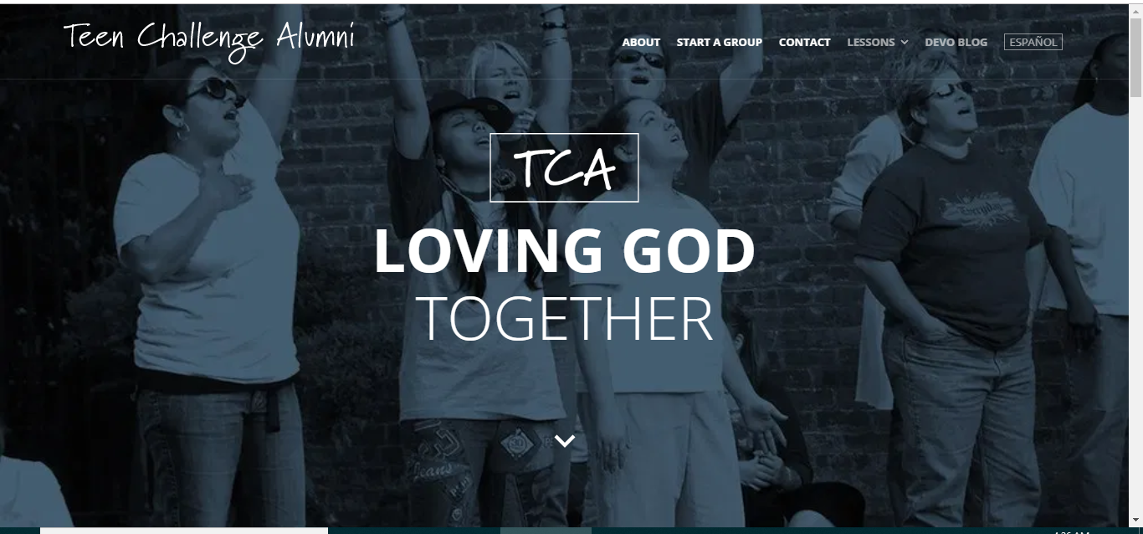
www.TeenChallengeAlumni.com
52 Bible studies for Teen Challenge alumni

Slide 77
Chapter 5
Healthy living
path to maturity
path to freedom
path to fullness
path to meaning in life
path to fulfillment
path to real life—goals beyond myself

Slide 78
Path to maturity has
3 characteristics
1. The path to maturity starts with living in the truth
John 14:6 “I am the way, the truth and the life.”
Learn to live the life Jesus gave you.

Slide 79
John 8:32 “You will know the truth and the truth will set you free.”
2 Greek words for “know”
Know information
Know through personal experience

Slide 80
James 1:22 NIV
Do not merely listen to the word, and so deceive yourselves. Do what it says.
If you have been living with false beliefs, then the truth may feel like a lie, and the lie feels like the truth.

Slide 81
2. The path to maturity goes through problems
John 16:33 NIV
“I have told you these things, so that in me you may have peace. In this world you will have trouble. But take heart! I have overcome the world.”
Every problem is an opportunity to live in the truth.
Every problem offers a choice—to follow God or to follow Satan’s way—our way.

Slide 82
How does God want us to respond to problems?
James 1:2-5 NIV
“²Consider it pure joy, my brothers, whenever you face trials of many kinds, ³because you know that the testing of your faith develops perseverance. ⁴Perseverance must finish its work so that you may be mature and complete, not lacking anything.
⁵If any of you lacks wisdom, he should ask God, who gives generously to all without finding fault, and it will be given to him.

Slide 83
Paul’s response to his “thorn in the flesh.”
2 Corinthians 12:7-10
⁷To keep me from becoming conceited because of these surpassingly great revelations, there was given me a thorn in my flesh, a messenger of Satan, to torment me. ⁸Three times I pleaded with the Lord to take it away from me. ⁹But he said to me, "My grace is sufficient for you, for my power is made perfect in weakness." Therefore I will boast all the more gladly about my weaknesses, so that Christ's power may rest on me. ¹⁰That is why, for Christ's sake, I delight in weaknesses, in insults, in hardships, in persecutions, in difficulties. For when I am weak, then I am strong.

Slide 84
3. Path to maturity is through relationships.
God’s path to maturity requires relationships.
Healthy living is not possible all by yourself.
Healthy living requires healthy relationships with other people.
There is no substitute for healthy relationships.
Relationships are an absolute requirement for healthy living.

Slide 85
God’s response
—2 greatest commands
—both deal with relationships.
1. Greatest: Love God with all your heart
2. 2nd greatest: Love other people
We need to develop relationships with safe people.

Slide 86
It is God’s desire for each one of us to be born into a healthy family, where in this safe and loving setting, we learn how to live a healthy life and move toward maturity.

Slide 87
Chapter 6
A second look at
Healthy living—Steps to maturity

Slide 88


Slide 89
Each step to maturity lists what the person needs to master to achieve maturity at that stage in life.
With each stage, the rest of the family members need to help this person along.
If the family does not provide the right kind of help, then it will be much harder for that child to achieve maturity.
Failing to master each step to maturity creates problems.

Slide 90
Stages of Life
1. The Infant Stage Birth to 3
2. The Child Stage Age 4 - 12
3. The Adult Stage Age 13 – to birth of 1st child
4. The Parent Stage Birth of 1st child until youngest child has become an adult
5. The Elder Stage Beginning when youngest child has become an adult

Slide 91
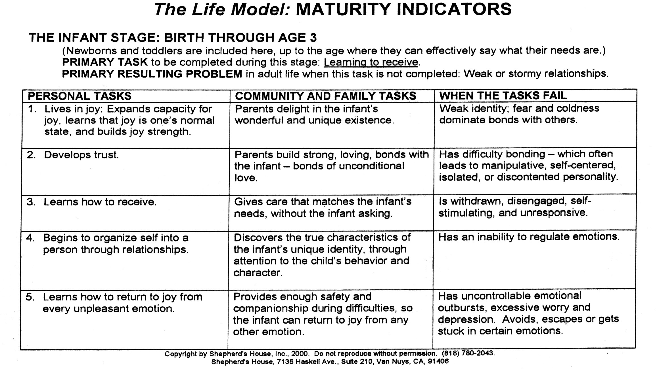

Slide 92
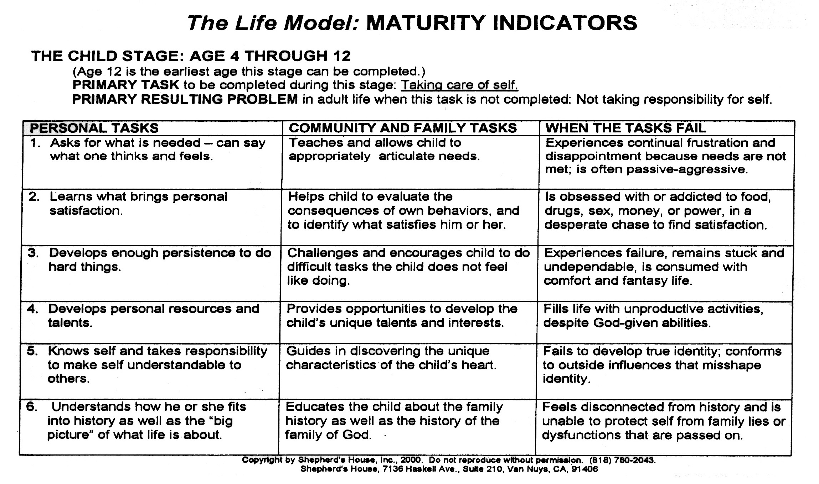

Slide 93
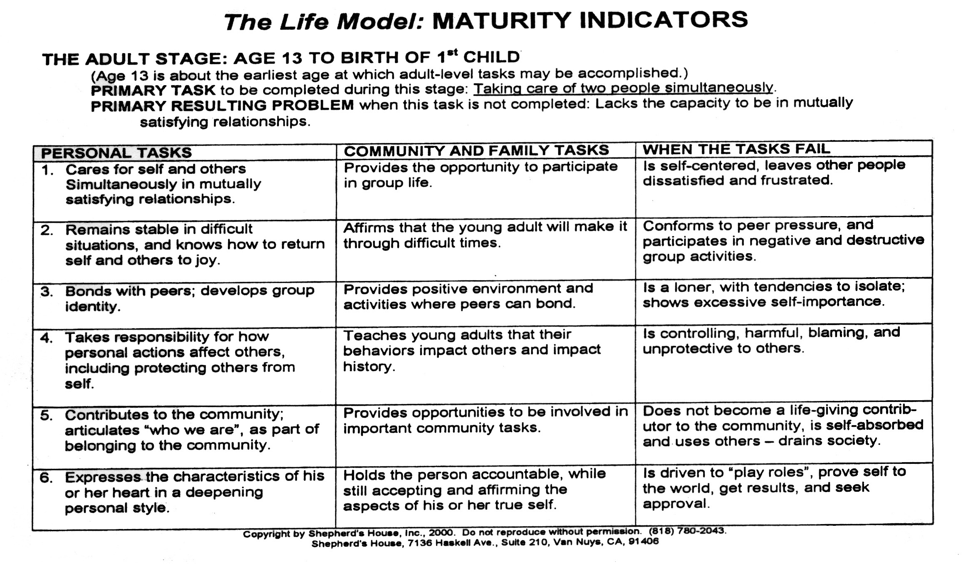

Slide 94
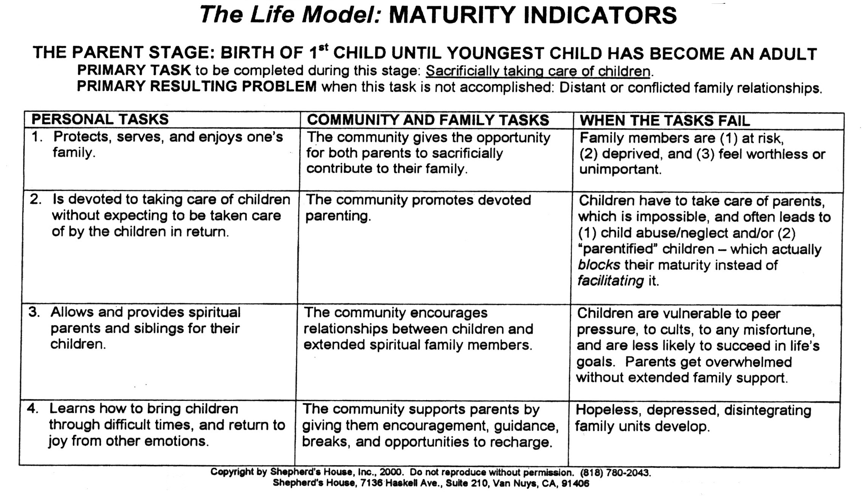

Slide 95
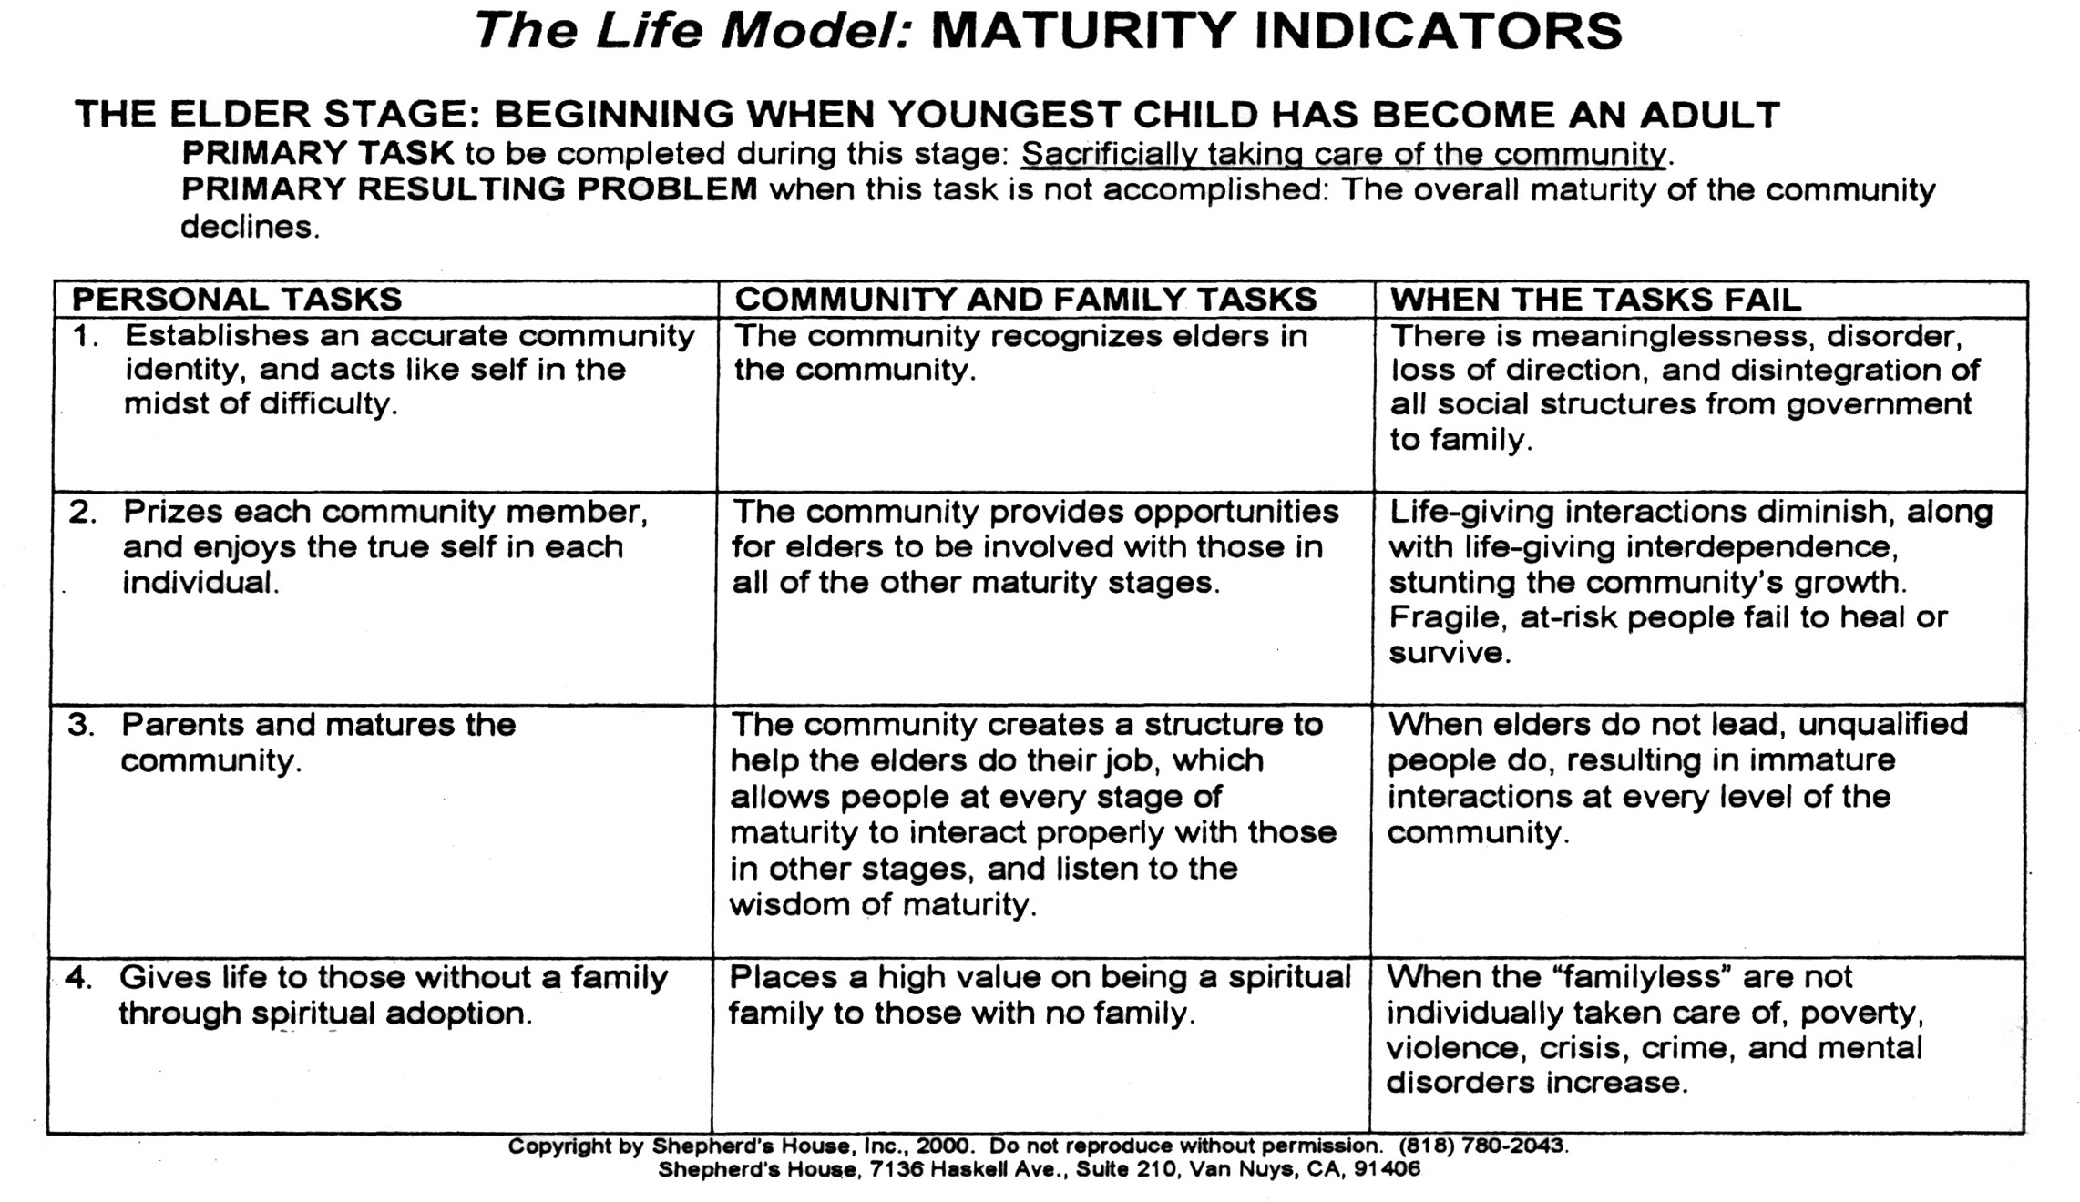

Slide 96
Additional keys to effective aftercare
1. Regular church attendance
2. Daily personal devotions—reading Bible and personal prayer
3. Living with Christian family or friends
4. Have a person of accountability
Have a written contract to spell out details of accountability.

Slide 97
5. A personal ministry—personal evangelism, teaching a class at church, care for the homeless, etc.
6. Have an emergency “tool box” to respond to temptations
7. Have a vision, dream, and a calling for your life
8. Learn how to “return to joy” in daily living

Slide 98
Questions

Slide 99

Contact Information:
Global Teen Challenge
PO Box 511
Columbus, GA 31902 USA
Phone: 706-576-6555
Email: gtc@globaltc.org
Websites:
Training resources: iTeenChallenge.org
Global Teen Challenge: Globaltc.org

