Slide 1

How to Launch the GSNL in Your Ministry

Slide 2
Overview of the Discipleship Training in Teen Challenge
Group Studies for New Life
Personal Studies for New Life
Level 2/Training Phase Group Studies Evangelism, Money Management, Emotional Dependency, etc.
For more info see iteenchallenge.org - Training Phase/Level 2 Group Studies

Slide 3
12 Month Overview
GSNL 1-2 hours a day, 5 days a week
PSNL 2 hours a day, 5 days a week
GSNL First 4-6 months
Continue with training phase group classes
PSNL Entire program

Slide 4
Make time for Classes in Daily Schedule a priority
 | Mon | Tues | Wed | Thurs | Fri | Sat | Sun
6:00 AM | Wakeup | Wakeup | Wakeup | Wakeup | Wakeup | - | -
6:30 AM | Devotions | Devotions | Devotions | Devotions | Devotions | - | -
7:00 AM | Breakfast | Breakfast | Breakfast | Breakfast | Breakfast | Wakeup | Wakeup
7:30 AM | Chores | Chores | Chores | Chores | Chores | Devotions | Devotions
8:00 AM | Chapel | Chapel | Chapel | Chapel | Chapel | Breakfast | Breakfast
9:00 AM | Class Study | Class Study | Class Study | Class Study | Class Study | Work Program | Church
12:00 PM | Lunch | Lunch | Lunch | Lunch | Lunch | Lunch | Lunch
1:00 PM | Work Program | Work Program | Work Program | Work Program | Work Program | Work Program | -
3:00 PM | Work Program | Work Program | Work Program | Work Program | Work Program | Free Time | -
5:30 PM | Dinner | Dinner | Dinner | Dinner | Dinner | Dinner | Dinner
6:00 PM | Chores | Chores | Chores | Chores | Chores | Chores | -
7:00 PM | Study Hall | Devotions | Church | Counseling | Chapel | Free Time | -
9:00 PM | Reading | Reading | Reading | Reading | Reading | - | -
10:00 PM | Lights Out | Lights Out | Lights Out | Lights Out | Lights Out | Lights Out | Lights Out

Slide 5

Group Studies for New Life
1. How Can I Know I'm a Christian?
2. A Quick Look at the Bible
3. Attitudes
4. Temptation
5. Successful Christian Living
6. Growing Through Failure
7. Christian Practices
8. Obedience to God
9. Obedience to Man
10. Anger and Personal Rights
11. How to Study the Bible
12. Love and Accepting Myself
13. Personal Relationships with Others
14. Spiritual Power and the Supernatural

Slide 6
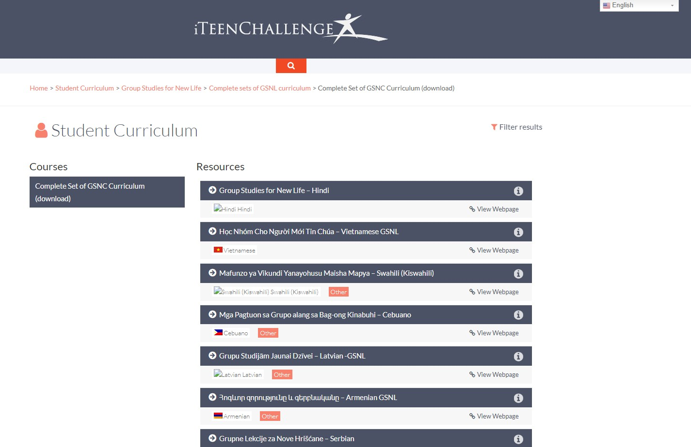
Download the GSNL Curriculum from iteenchallenge.org
17 Language translations available on iteenchallenge.org
For English materials: Outside USA, send a request to gtc@globaltc.org.
For English materials to use in the USA, Purchase from store.teenchallengeusa.org

Slide 7
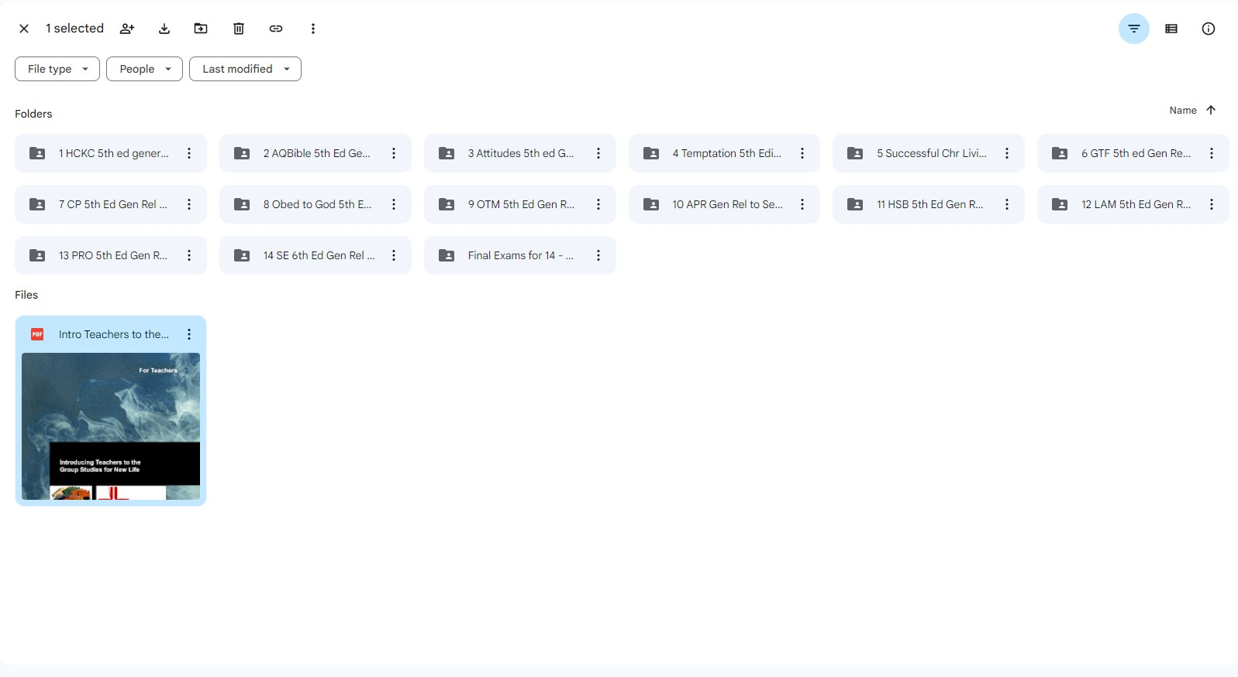
Download the GSNL Curriculum from iteenchallenge.org

Slide 8
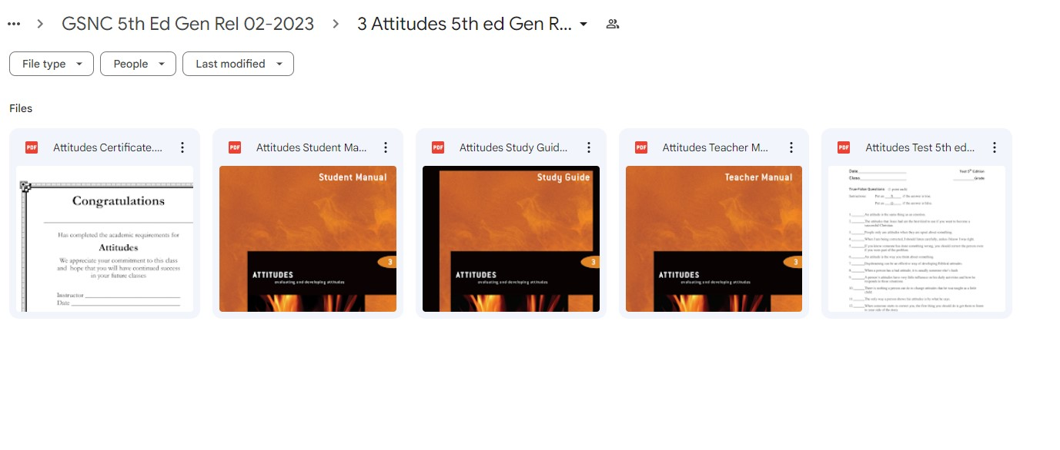
Download the GSNL Curriculum from iteenchallenge.org

Slide 9



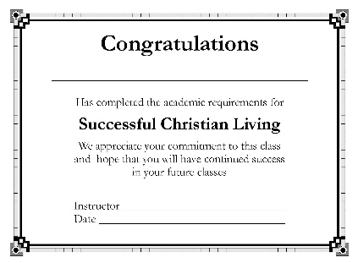
Materials for Each GSNL course
Teacher’s Manual
Student Manual
Study Guide
Test
Course Certificate

Slide 10






Materials for Each GSNL course
PowerPoints are available For all 14 courses in -
English
Spanish
Russian

Slide 11
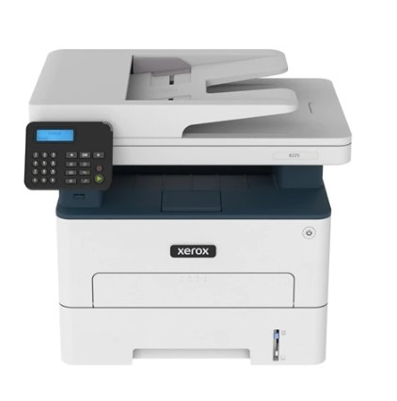
Print your materials
Item
Teachers Manual
Student Manual
Study Guide
Test
Course certificate
Project & Quiz record form
Print
Only 1 needed for each course
1 for each student
1 for each student
1 for each student
1 for each student
1 for course

Slide 12
GSNL Recommended Teaching Sequence Continuous Rotation, new students can start at any time
1. How Can I Know I'm a Christian?
2. A Quick Look at the Bible
3. Attitudes
4. Temptation
5. Successful Christian Living
6. Growing Through Failure
7. Christian Practices
8. Obedience to God
9. Obedience to Man
10. Anger and Personal Rights
11. How to Study the Bible
12. Love and Accepting Myself
13. Personal Relationships with Others
14. Spiritual Power and the Supernatural
Continuous Cycle

Slide 13



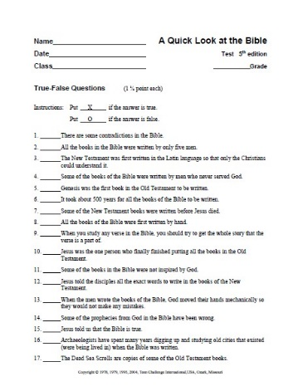

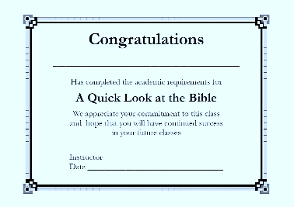
My recommendation: Start with A Quick Look at the Bible
It is the shortest course.
It is one of the easiest to teach

Slide 14
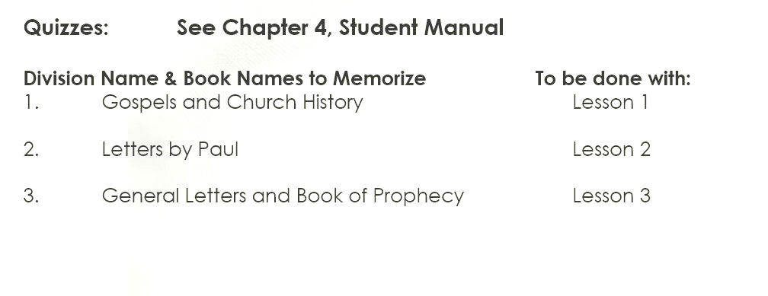

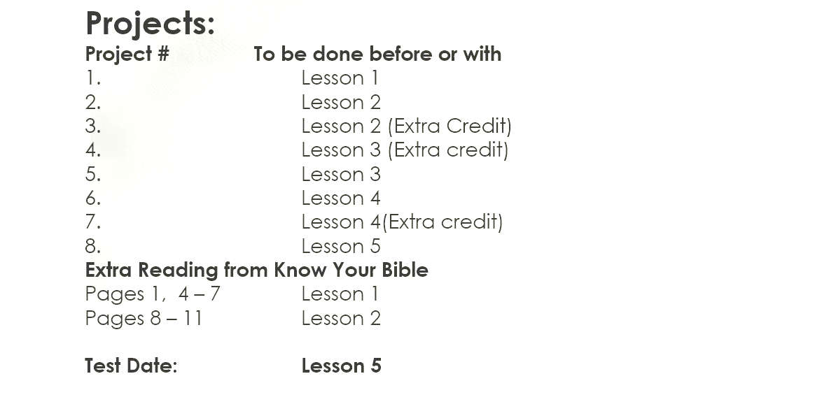

Use Class Assignment List Hand out materials and assignments before class begins. For example: On Friday so they can read and do projects for Monday’s class.

Slide 15
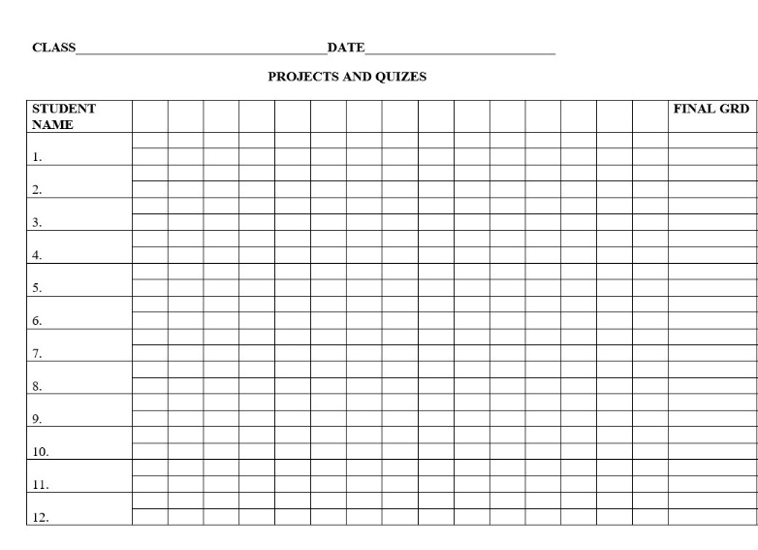
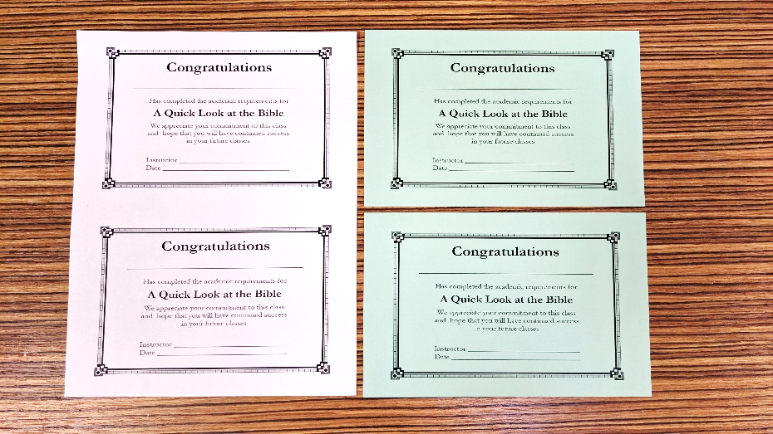
Teach the class
Open with prayer
Give written quizzes at the start of class, (if quiz day).
Prepare and use creative teaching methods.
Collect Study Guides at the end of class. Grade and return to students before evening study time.
Use a record form to track grades.

Slide 16
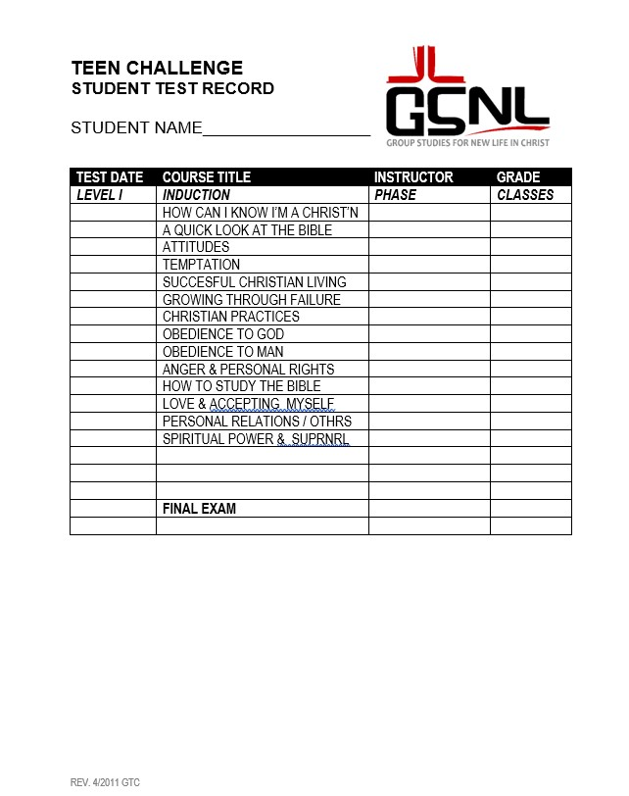
Teach the class
Prepare tests and certificates before test day.
Certificates can be half-size on color paper for a nicer look.
Hand out certificates after the test is graded, reviewed by students, and returned. Do not allow students to keep the test.
Record Grade on Test Record Sheet

Slide 17


Structure for each GSNL course
Most are designed for 5 class sessions, and some have 10 sessions.
Each lesson has a Key Biblical Truth and a Key Verse
Each lesson ends with a personal application.
All courses have quizzes: Scripture memorization, lists, etc.
Use the Class Assignment List in Study Guide

Slide 18

Teacher Training for the GSNL
GSNL/PSNL training on GTC Bridge.
iteenchallenge.org has GSNL training available.
Introducing Teachers to the GSNL has information on teaching the GSNL courses
Has the 2 versions of the Final Exam for the entire GSNL series
Final test answer keys
Certificate of Achievement
Student Test Record

Slide 19
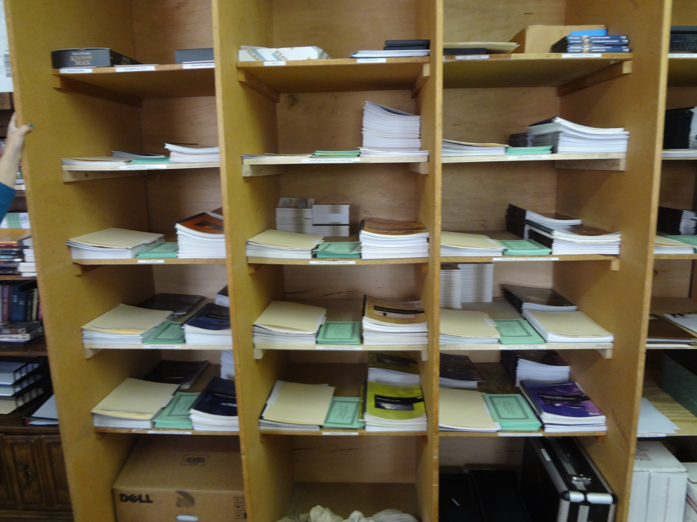
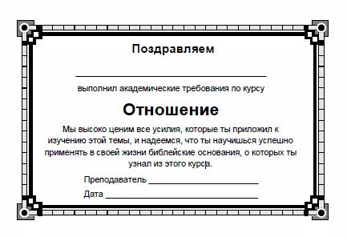
11. Tests in the GSNL Контрольные работы (тесты) в ГЗНХ
B. Use the course certificate. Сертификат об окончании
Г. Final exam for the entire GSNL series Заключительный тест по всей серии курсов ГЗНХ

Slide 20
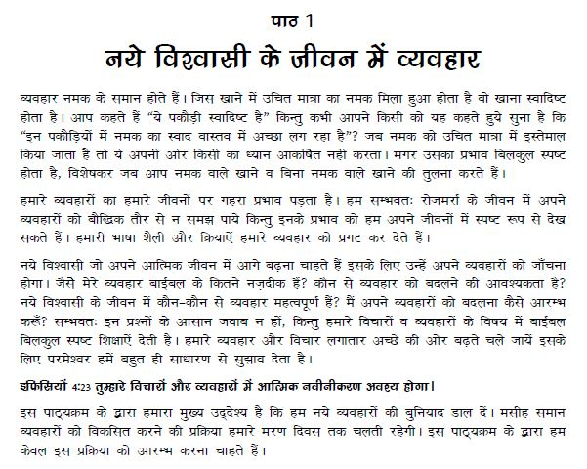
Hindi

Slide 21

For More Information and to Order the GSNL courses:
gtc@globaltc.org
Global Teen Challenge
GlobalTC.org
iTeenChallenge.org
gtc@globaltc.org

