Slide 1
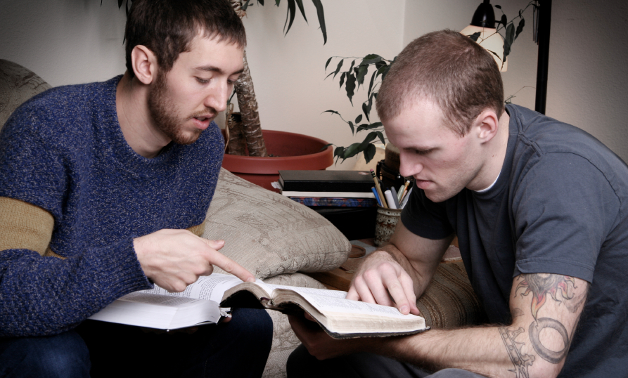
Teen Challenge Counseling
By Duane Henders

Slide 2

The Biblical
Basis for
Counseling

Slide 3
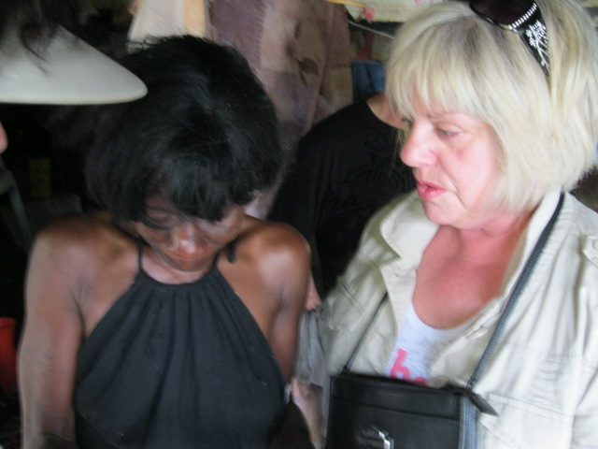
The Biblical Basis for Counseling
Isaiah 9:6
Romans 12:8
Proverbs 11:14
Proverbs 12:15
John 3:16

Slide 4
Basic Assumptions in Biblical Counseling
God is love – 1 John 4:16
Fall of Man – Isa 59:2-3
Personal Relationship with Jesus Christ – Isa 55:7
God hears and answers Prayers – Phil 4:6
The Work of the Holy Spirit – John 14:26

Slide 5
Basic Assumptions in Biblical Counseling
Healthy relationships – 2 Corinthians 6:14
There is complete healing – 2 Corinthians 5:17
Sound Bible teaching – Ps 119:9, 11, 105
Wholeness is a process – Romans 6:6, 11-13
In Christ victory is assured- Romans 8:37

Slide 6

The Goals and
Purpose

Slide 7
Goals of Christian Counseling
Spiritual wholeness
Emotional wholeness
Relational wholeness

Slide 8
Purpose of Christian Counseling
To build relationship and trust
Provide a safe place to express
Provide guidance
Gain Personal Insight

Slide 9
Qualifications of a
Teen Challenge
Counselor

Slide 10
Qualifications of a TC counselor
An absolute assurance of their salvation
A victorious Christian life
Emotional stability
A compassionate, loving heart
An ability to empathize
A basic knowledge of the Bible and its fundamental teachings

Slide 11
Qualifications of a TC counselor
A daily reliance on the Holy Spirit
Some basic training on counseling
An understanding of the value and importance of the “Body of Christ”
A willingness to become a spiritual “father”
Knowledge of TC rules

Slide 12
Three Primary Resources
1. The Word
The truth will set you free.
John 8:32
For the word of God is living and active, sharper than any two-edged sword, piercing to the division of soul and of spirit, of joints and of marrow, and discerning the thoughts and intentions of the heart.
Hebrews 4:12

Slide 13
Three Primary Resources
2. The Spirit
Nevertheless, I tell you the truth: it is to your advantage that I go away, for if I do not go away, the Helper will not come to you. But if I go, I will send him to you. John 16:7
When the Spirit of truth comes, he will guide you into all the truth. John 16:13
When the Spirit of truth comes, he will guide you into all the truth John 16:3

Slide 14
Three Primary Resources
3. The Body of Christ – the Church
Do you not know that you are God’s temple and that God’s Spirit dwells in you?
1 Corinthians 3:16
¹⁵ Rather, speaking the truth in love, we are to grow up in every way into him who is the head, into Christ, ¹⁶ from whom the whole body, joined and held together by every joint with which it is equipped, when each part is working properly, makes the body grow so that it builds itself up in love.
Ephesians 4:15-16

Slide 15

The Body of Christ Provides
Connection
Discipline
and Structure
Accountability
Grace and Forgiveness
Support and Strength

Slide 16
What are
Some ways that Counseling is done at
Teen Challenge?

Slide 17
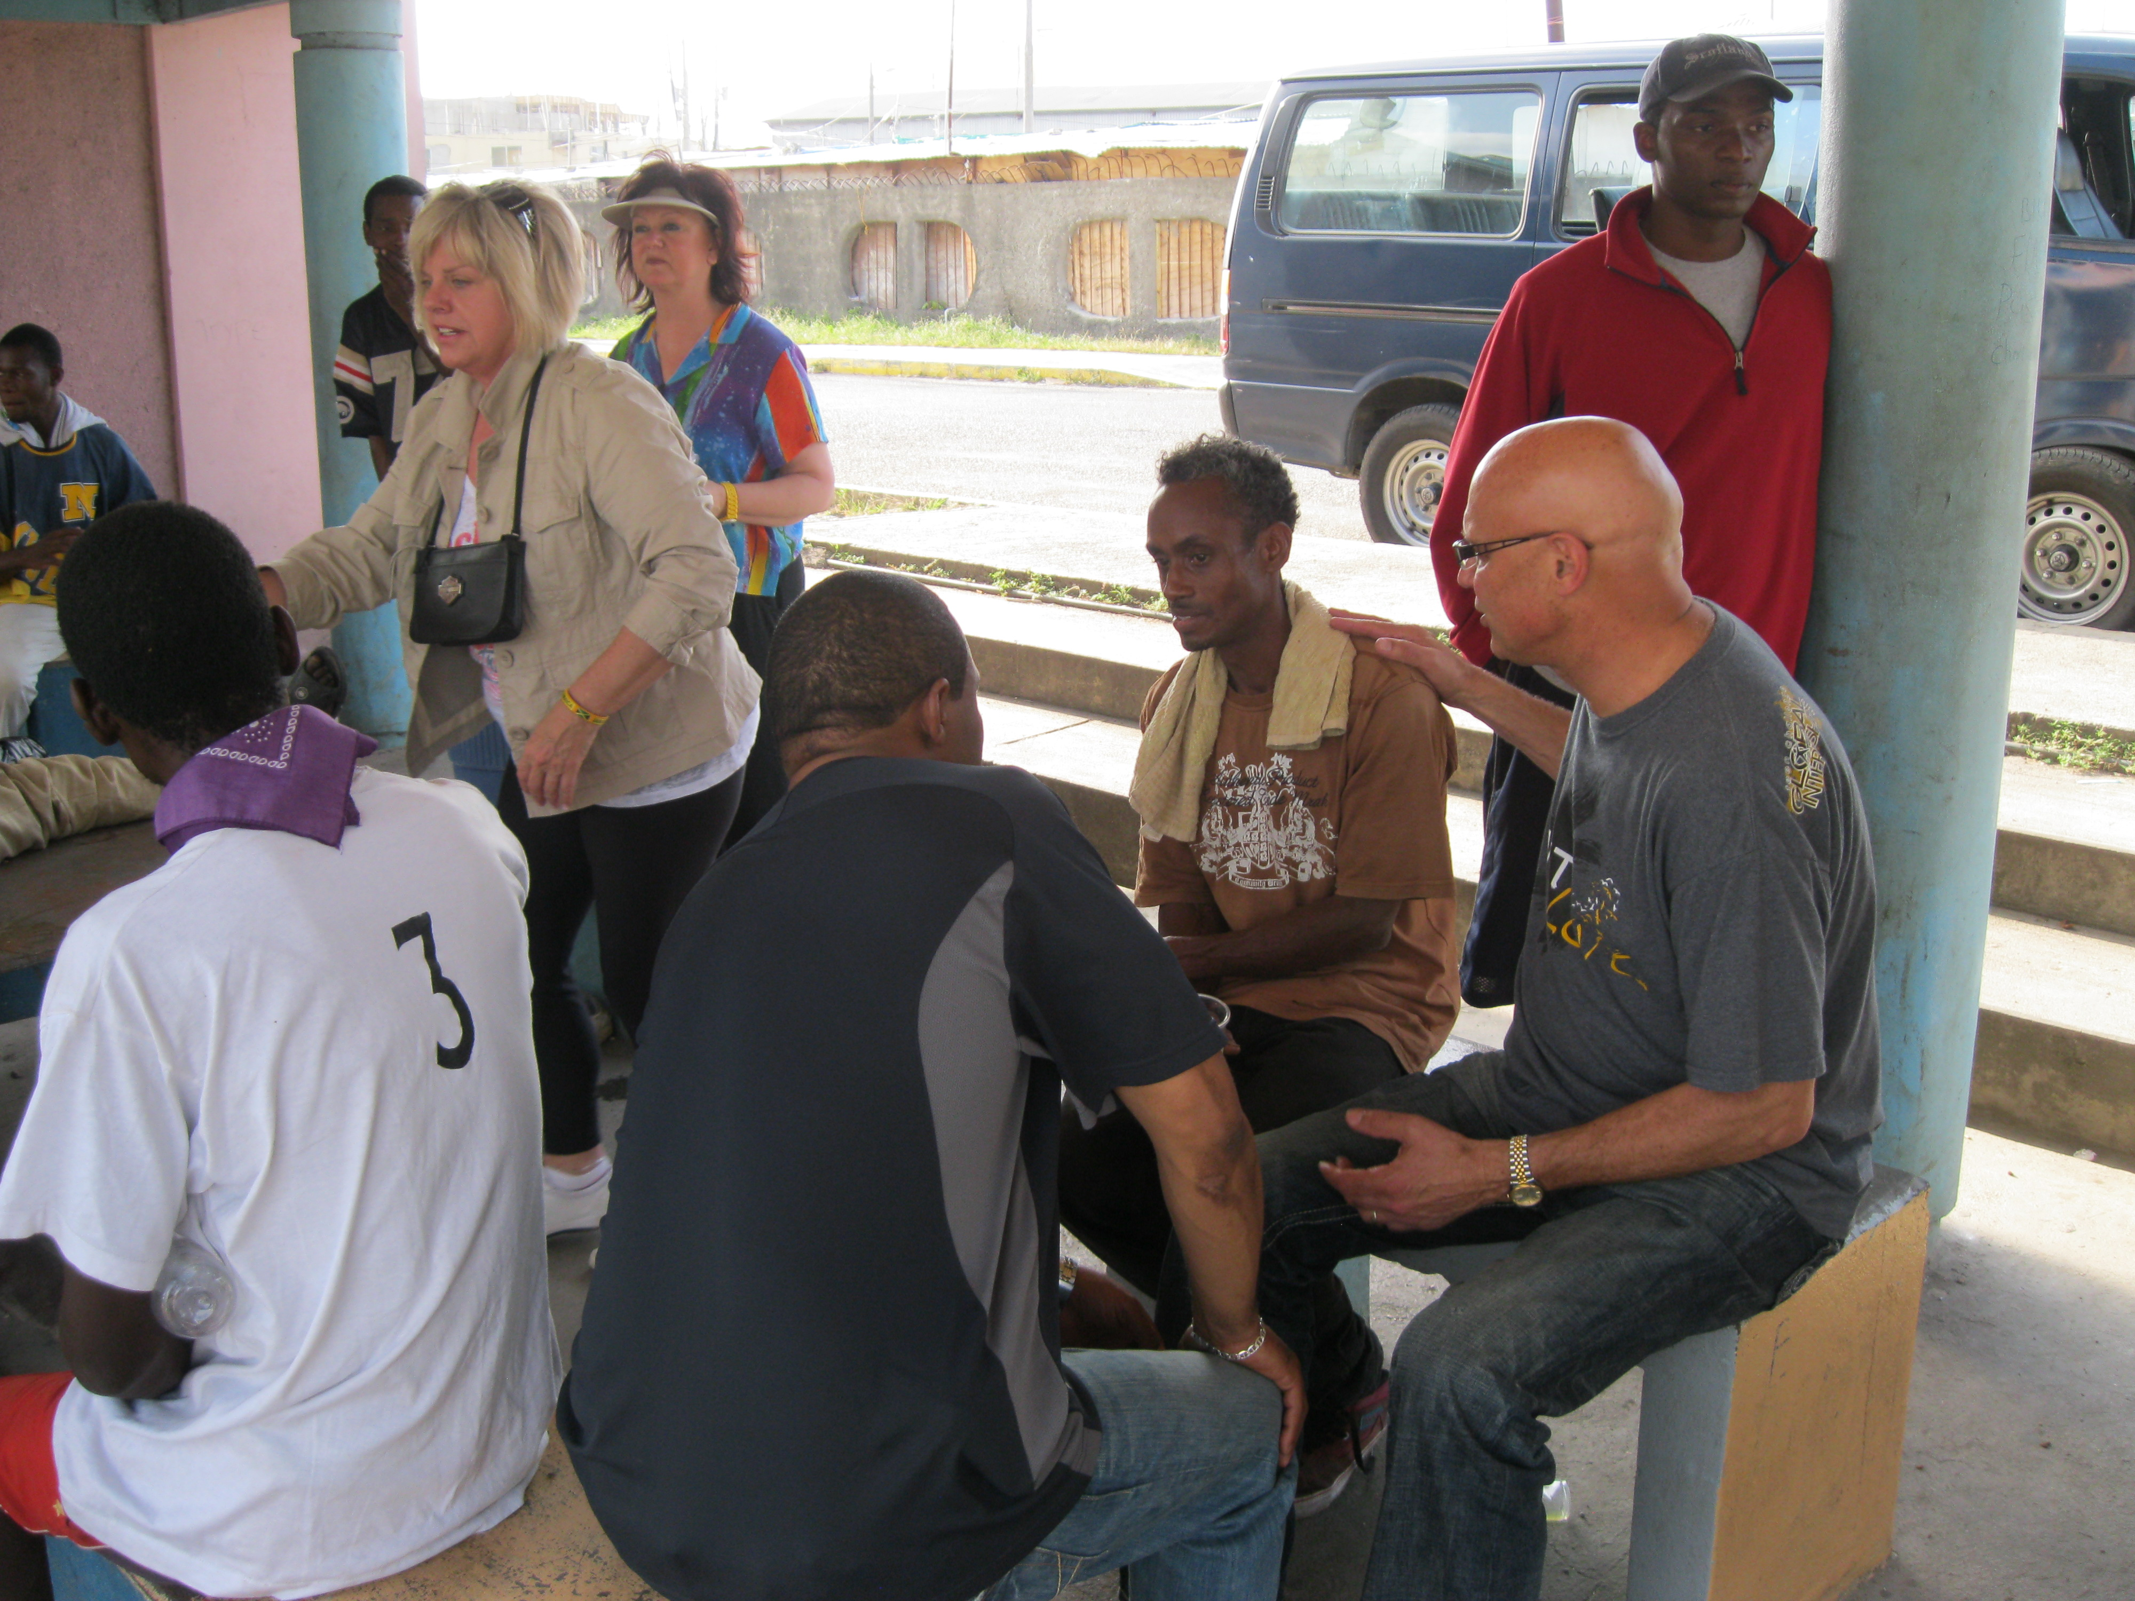
How does
Counseling
Take Place in
Teen Challenge?
Formal Counseling
Informal Counseling
Chapel & Prayer Counseling
“Know Your Sheep” Counseling

Slide 18
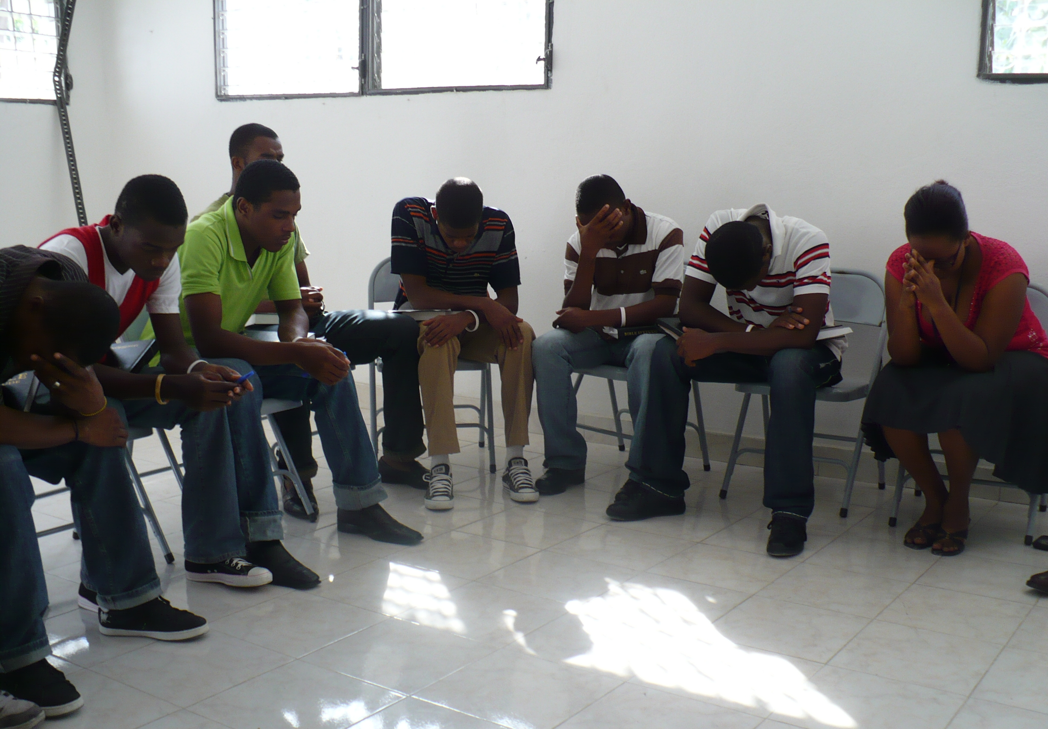
How does
Counseling
Take Place in
Teen Challenge?
5. Crises Counseling
6. Classroom (PSNC) Counseling
7. Counseling through modeling

Slide 19

Techniques for
Effective
Counseling

Slide 20
Techniques for Effective Counseling
Connecting – build relationships
Learn good Listening skills

Slide 21

Learn Good Listening Skills

Slide 22
Effective Listening
Develop a listening ear – not just a big mouth
Listen between the lines – listen for the unspoken
  Listen to what is being said, and what IS NOT being said!
Ask questions, listen, be sensitive and patient
Learn to WAIT during pauses, tears or uncomfortable stories.
  Avoid disapproving or judgmental verbal or non-verbal responses even if shocking or offensive things are said.

Slide 23
Effective Listening
Reflective listening is letting the student know you understand what they are going through. This can be communicated by saying, “You must feel…” or “That must be difficult…”
Listen for “I’m hurting” signals.
  Some people have strange ways to signal that they need help, like breaking the rules, acting out, and rebelling.
  Don’t just deal with the action, but try to determine what is behind it.

Slide 24
Techniques for Effective Counseling
Connecting – build relationships
Learn good Listening skills
Setting boundaries
Learn to ask good questions (open ended)
Use gentle confronting

Slide 25
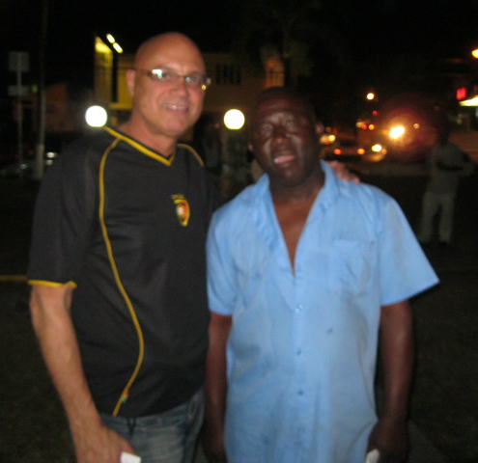
Techniques for Effective Counseling
Teaching -- keep it short!!!
Praying
Goal setting
Affirming
Disengaging

Slide 26

Dangers to Avoid in Counseling

Slide 27
Dangers to avoid in counseling
Don’t make deals with students
Don’t let a student undermine your loyalty
Don’t threaten or try to intimidate students
Don’t entertain “cry babies”
Don’t solve every problem for the student

Slide 28
Dangers to avoid in counseling
Don’t just visit
Don’t get over-involved emotionally
Don’t violate confidentiality
Don’t share intimate details of your life

Slide 29
Tactics that Students Use to Avoid Accountability and to continue their present way of living
(see Handout)

