Slide 1
Writing Student Learning Contracts Escrevendo os contratos de Aprendizado do Aluno
By Por Gregg Fischer

Slide 2
What are Contracts? O que são os Contratos?
1) Contracts are a written plan for student class work. Contratos são um plano por escrito para o trabalho de aula do aluno.
2) A plan for growth. Um plano para crescimento.
3) Personalized outlines for study in the Personal Studies for New Christians Curriculum. Tópicos personalizados para estudo no currículo do EPNC.
4) A specialized tool to help each student. Uma ferramenta especializada para ajudar cada aluno.

Slide 3
What are Contracts? O que são os Contratos?
5) An organized plan to help students study the various units in the PSNC. Um plano organizado para ajudar os alunos estudarem as diversas Unidades no EPNC.
6) A treatment plan that includes Um plano de tratamento que inclui -
- goals for growth -Objetivos para crescimento
- expected outcomes -Resultados esperados
- time limits (3 -5 weeks) -Limites de tempo (3 -5 semanas)

Slide 4
Why Contracts? Por quê Contratos?
1) Focused Study on Major Themes Estudos focados em temas principais
2) Sense of Accomplishment Sentimento de realização (cumprimento)

Slide 5
Why Contracts? Por quê Contratos?
3) Provides Flexibility for different Fornece flexibilidade para alunos diferentes.
- academic abilities -Capacidades acadêmicas
- needs -Necessidades
- interests -Interesses
- levels of spiritual growth -Níveis de crescimento espiritual
4) Complements your counseling Ministry Complementa seu ministério de aconselhamento.

Slide 6
What’s included in a Contract? O que está incluso em um Contrato?
1) Focused Study on Major Themes Estudos em temas principais e temas menores
2) Goals for Growth Objetivos para Crescimento
3) Lessons and Bible Studies Lições e Estudos Bíblicos
4) Scripture Memorization Class Aula de Memorização da Escritura

Slide 7
What’s included in a Contract? O que está incluso em um Contrato?
5) Character Qualities Class Aula de Qualidades de Caráter
6) Personal Reading Class Aula de Leitura Pessoal
Books , CD’s, DVD’s, Articles, etc. ¬ Livros , CD’s, DVD’s, Artigos, etc.
7) Bible Reading Class Aula de Leitura Bíblica
8) Special Projects Projetos Especiais

Slide 8
Writing Contracts Escrevendo Contratos

Slide 9
Develop Tools Desenvolva as ferramentas
PSNC Library Biblioteca do EPNC
- Lessons -Lições
- Books with study guides -Livros com Guias de Estudo
- Videos, DVD’s, Audio tapes, CD’s etc. ---Videos, DVD’s, Fitas de Áudio, CD’s etc.
- Tracts -Artigos

Slide 10
Develop Tools Desenvolva as ferramentas
Contract Questionnaires Questionários do Contrato
Use questionnaires provided or develop your own Use os questionários fornecidos ou desenvolva o seu.
Contract Writing Book Caderno do Contrato

Slide 11
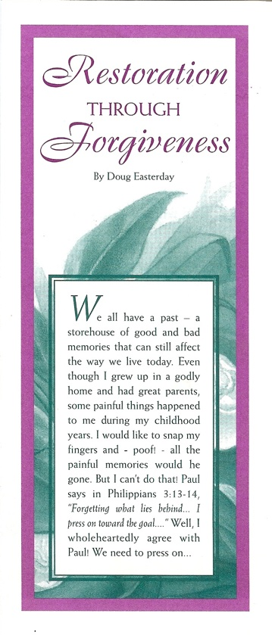
Tracts
LDM
Discipleship
Teachings
Artigos-(Ensinos de Discipulado dos Ministérios nos últimos dias

Slide 12
Unit 1 Salvation Unidade 1 Salvação
-Use Contract form or develop one -Use os questionários fornecidos ou desenvolva o seu.
-Use lesson 301 to get to know the student -Usar lição 301 para conhecer o aluno
-Is a reading test needed? -È necessário um teste de leitura?

Slide 13
Unit 1 Salvation Unidade 1 Salvação
-Introduce Students to the PSNC -Introduza os Alunos ao EPNC
-Lessons– 101, 102, 103* – 106, 108 *(depends on answers in 102 -Lições– 101, 102, 103* – 106, 108 *(depende das respostas do 102)
**-Explain purpose of lessons to student -Explique o propósito das lições para o aluno

Slide 14
Unit 1 Salvation Unidade 1 Salvação
-Character Qualities Class -Aulas de Qualidades de Caráter
-Scripture Memorization Class -Aula de Memorização da Escritura
-Personal Reading Class -Aula de Leitura Pessoal
-Bible Reading Class -Aula de Leitura Bíblica

Slide 15
Overview of Contracts for Units 2 & up Visão Geral dos Contratos da Unidade 2 em diante
1. For all contracts from Unit 2 and higher, we will write a specific contract for each student. Para todos os contratos da Unidade dois em diante, escreveremos um contrato específico para cada aluno.
2. Gather information prior to writing contract Compile informações antes de escrever o contrato
-Use Unit Questionnaire form -Use o modelo do Questionário da Unidade -Feedback from staff, dorm, counselors, work, evaluations
-Feedback (retorno) da equipe, quarto, conselheiros, trabalho, Avaliações

Slide 16
Overview of Contracts for Units 2 & up Visão Geral dos Contratos da Unidade 2 em diante
3. Meet with student Encontre-se com o aluno
4. Pray Ore
5. Write the contract – there are two contract forms Escreva o contrato – há dois modelos de contrato

Slide 17
UNIT II UNIDADE 2 Auto Imagem Contract Questionnaire Questionário do Contrato
*Note: This form is to be filled out by the student prior to the writing of the contract. Amostra do Formulário de Contrato
*Anotação: Este fomulário deve ser preenchido pelo aluno antes de se escrever o contrato
Theme: Self Image Tema: Auto Imagem

Slide 18
UNIT II UNIDADE 2 Auto Imagem Contract Questionnaire Questionário do Contrato
PURPOSE: To come to a clear awareness of how God wants us to see ourselves. To become more aware of how we presently see ourselves. Propósito: Chegar a uma boa percepção de como Deus nos quer para nós mesmos. Se tornar mais ciente de como, presentemente, nos enxergamos a nós mesmos.

Slide 19
UNIT II UNIDADE 2 Auto Imagem Contract Questionnaire Questionário do Contrato
Instructions: Instruções:
1. List five new character qualities that will help you, that you would like to work on. Liste cinco qualidades novas de caráter que o ajudarão, em quais você gostaria de trabalhar
2. Do the circled questions on the self-evaluation worksheet. Faça as perguntas assinaladas na folha de exercícios de auto-avaliação
3. Answer the following questions. Responda as perguntas seguintes.

Slide 20
UNIT II Contract Questionnaire contin’d
1. Where in the area of Self-Image do you need improvement?
2. What struggles or questions do you have with your Self-Image?
3. Where in the area of dealing with authority do you need improvement?
4. What struggles or questions do you have with Authority?
5. In which areas of Relationships with others do you need to improve?

Slide 21
UNIDADE 2 Auto Imagem Questionário do Contrato
1. Onde, na área da auto-imagem, você precisa melhorar?
2. Que conflitos ou questionamentos você têm com sua auto-imagem?
3. Onde, na área de se lidar com autoridade, você precisa melhorar?
4. Que conflitos ou questionamentos você têm em relação à Autoridade?
5. Em quais áreas de relacionamentos com outros, você precisa melhorar?

Slide 22
UNIT II Contract Questionnaire contin’d
6. What questions or struggles do you have with relating to others?
7. In your Relationship with God where do you need to improve?
8. List any questions or problems you have with your Relationship to God.
9. Do you need to improve in the area of forgiveness? How?
10. What questions do you have about forgiveness?

Slide 23
UNIDADE 2 Auto Imagem Questionário do Contrato
6. Que conflitos ou questionamentos você têm em relação a se relacionar com outros?
7. Em seu relacionamento com Deus, onde você precisa melhorar?
8. Liste quaisquer perguntas ou problemas que você tenha em seu relacionamento com Deus?
9. Precisa melhorar na área do perdão? Como?
10. Que questionamentos você tem sobre perdão?

Slide 24
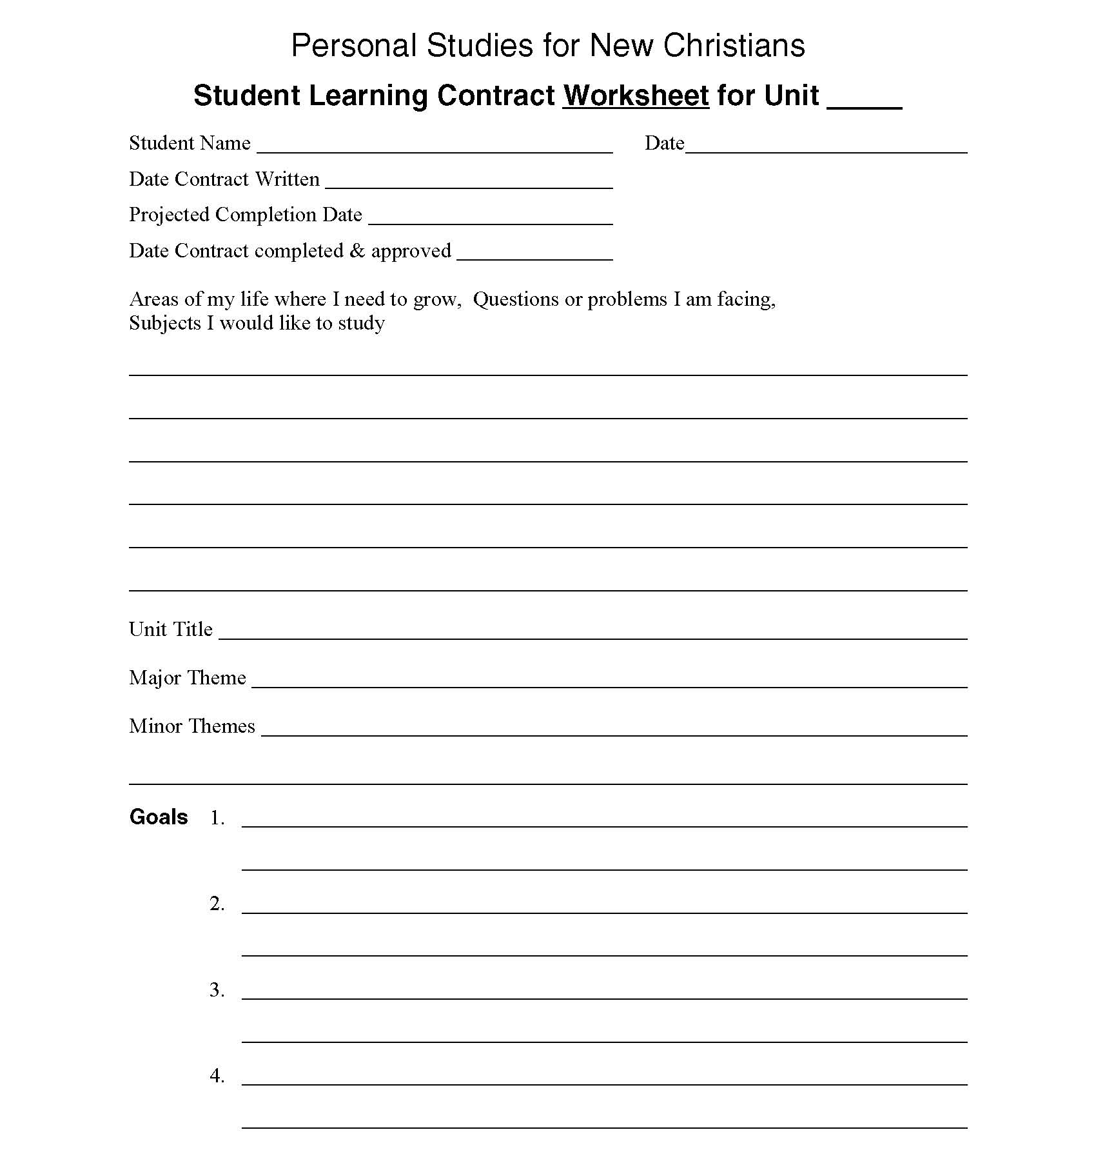

Slide 25
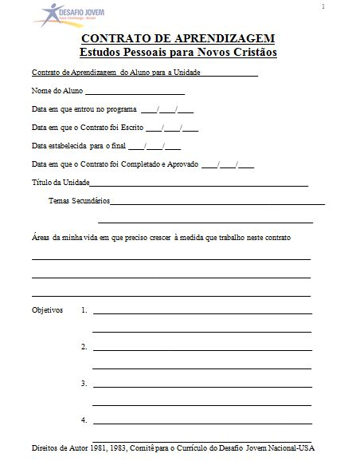

Slide 26
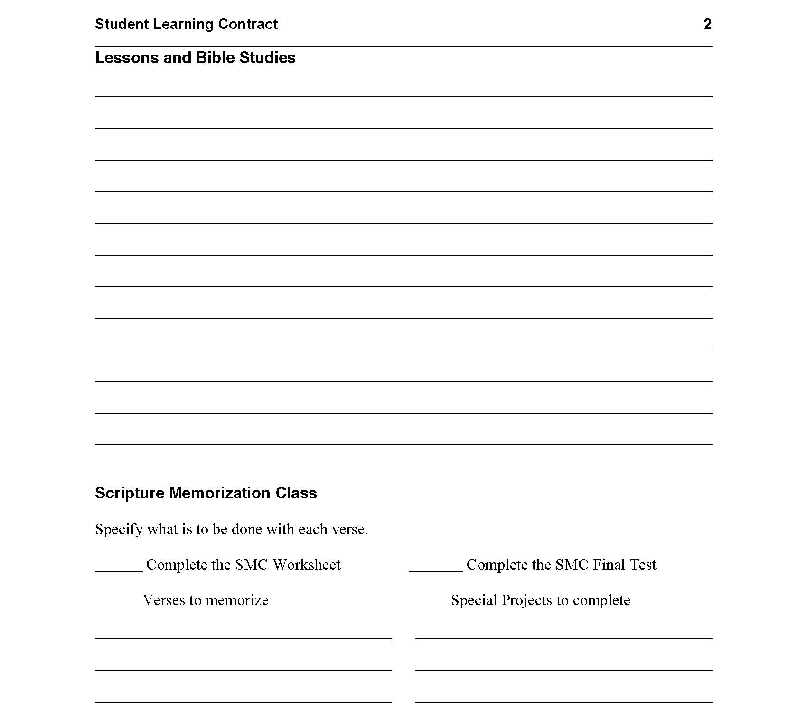

Slide 27
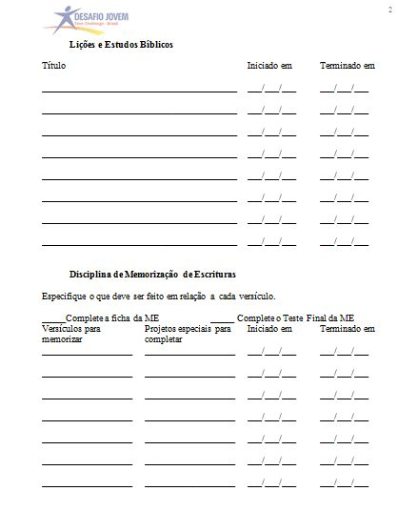

Slide 28
Contract 2 Self Image
Contract Length
Contract should be 4 weeks long
Goals
Set the students goals according to their Contract Questionnaire, Contract Title, and what you have discerned by watching their behavior.

Slide 29
Contrato 2
Auto Imagem
Duração do Contrato
O Contrato deve ser de quatro semanas de duração
Objetivos
Estabelecer os objetivos dos alunos de acordo com os seus Questionários do Contrato, Título do Contrato, e o que você percebeu, conforme assistiu seus comportamentos.

Slide 30
Examples of goals…
I will learn why an independent spirit is an enemy toward God.
I will keep a journal of how I am opening up to others I live with.
I will learn why I fear and do not trust people.
I will begin to develop a sense of God’s approval on my own so I won’t be so sensitive to rejection.
I will learn how to accept criticism better.
I will stop thinking of myself as a “Born-loser” and stop negative comments against myself.
I will begin to see myself as a son of God.
Who am I? Desire to know what it means to be made in the image of God.

Slide 31
Exemplos…
1.Aprenderei por quê um espírito independente é um inimigo diante de Deus.
2.Manterei um diário de como estou me abrindo para outros que convivem comigo.
3.Aprenderei por quê tenho medo e não confio nas pessoas.
4.Começarei a desenvolver um sentimento da aprovação de Deus por mim mesmo, então não ficarei tão sensível à rejeição.
5.Aprenderei como aceitar melhor as críticas.
6.Vou parar de pensar de mim mesmo como um “perdedor-nato” e parar comentários negativos de mim mesmo. Começarei a me enxergar como um filho de Deus.
7. Começarei a confiar em Deus com quem sou e como me enxergo sendo no futuro.

Slide 32
Examples of goals continued…
I will begin to trust God with who I am and what I see myself as being in the future.
I will learn to see and act the way God has designed me.
I will begin to learn that God can use bad childhood experiences and my mistakes to make me His son, a testimony of God’s power.
I will make a list of 50 things that I can thank God for to show myself He has given me something after all.
I will shed my resentful, “tough guy” protective mask by asking forgiveness from those I demonstrate it to.
I will learn that I am a worthy person in the sight of God. I will not put myself down.
I will learn I am useful to God.

Slide 33
Lessons and Bible Studies
Books (choose 1)
Improving your Self Image, by H. Norman Wright
Dare to be Different, by Fred Hartley
Will the Real Phony Please Stand Up?, by Ethel Barrett
Kingdom of Self, by Earl Jabay
See Yourself as God Sees You, by Josh McDowell
Victory Over Darkness, by Neil T. Anderson
Healing For Damaged Emotions, by David A. Seamands

Slide 34
Lições e Estudos Bíblicos
Livros (escolha 1)
1. Improving your Self Image, by H. Norman Wright
2. See Yourself as God Sees You, by Josh McDowell
3. Healing For Damaged Emotions, by David A. Seamands

Slide 35
Lessons
*Personality Plus Test, from by Florence Littauer
*Authority Lesson & Worksheet , from Bill Gothard Book
Worksheets
Check Worksheet file.
PSNC 200’s & 300’s
*Unit II requirement

Slide 36
Lições
Escolha aquelas que você sente serem as mais úteis.
Folhas de Tarefa
Verifique o arquivo das Folhas de tarefa.

Slide 37
Character Qualities
Choose at least two, check students list. - If a student is having major trouble with one in particular area we can choose one for him even though it’s not on his list.

Slide 38
Qualidades de Caráter
Escolha ao menos duas, verifique a lista do aluno. – Se um aluno estiver com um problema maior em uma área particular, podemos escolher esta para ele, mesmo que não esteja na lista.

Slide 39
Scripture Memorization Class
(Choose two or more depending on the students’ ability)
Philippians 1:6 he who has begun a good
Philemon 1:6 pray you will be active
Jeremiah 19:11-13 for I know the plans I have for
1 Corinthians 10:13 no temptation has seized you
Proverbs 4:23 above all else, guard you heart
Romans 12:16 live in harmony with one another
Ephesians 4:22-24 put off the old self
1 Peter 2:13 submit yourselves to every authority
Hebrews 13:17 obey your leaders submit to
Romans 13:1-2 submit because God has ordained
Ephesians 5:21 submit yourselves one to another
James 4:7-8 submit to God, resist the devil
1 Peter 2:16 live as a free man

Slide 40
Aula de Memorização da Escritura
(Escolha duas ou mais, dependendo da capacidade do aluno)
Filipenses 1:6 Aquele que começou a boa
Filemon 1:6 Para que a comunicação da
Jeremias 19:11-13 Porque Eu sei os planos que tenho I Corintios 10:13 nenhuma tentação vos sovreveio
Provérbios 4:23 Acima de tudo, guarde o seu
Romanos 12:16 Vivei em paz uns com os outros
Efesios 4:22-24 Despojai-vos do velho homem
I Pedro 2:13 Sujeitai-vos a toda autoridade
Hebreus 13:17 Obedecei a vossos pastores, e
Romanos 13:1-2 Sujeitai-vos porque Deus ordenou
Efésios 5:21 Sujeitai-vos uns aos outros
Tiago 4:7-8 Sujeitai-vos a Deus, e resisti ao
I Pedro 2:14 Como livres que sois

Slide 41
Personal Reading Class
Books (Choose 1)
*Bruchko, by Bruce Olson
The Tale of Three Kings, by Gene Edwards
The Father Heart of God, by Floyd McClung
Rebel With A Cause, by Franklin Graham
The Cry of the Soul, by Dan B. Allender and Tremper Longman
Tracts-(LDM Discipleship Teachings) (Choose 2 or 3)
Father Heart of God Openness and Honesty
Theater of Your Mind Hurt & Bitterness
Forgiveness: Forgive or Forget It
Restoration through Forgiveness
But I Can’t Forgive Myself
*Unit II requirement

Slide 42
Aula de Leitura Pessoal
*Bruchko, by Bruce Olson
¬The Tale of Three Kings, by Gene Edwards
¬The Father Heart of God, by Floyd McClung
¬Rebel With A Cause, by Franklin Graham
¬The Cry of the Soul, by Dan B. Allender and Tremper Longman
¬
Artigos-(Ensinos de Discipulado dos Ministérios nos últimos dias) (Escolha 2 or 3)
Father Heart of God Openness and Honesty
Theater of Your Mind Hurt & Bitterness
Forgiveness: Forgive or Forget It
Restoration through Forgiveness
But I Can’t Forgive Myself
*Exigência da Unidade 2

Slide 43
CD’s, DVD’s etc.
Restoration Through Forgiveness, by Doug Easterday

Slide 44
Contract 3 Spiritual Growth
Contract Length-Contract should be 4 weeks long. (** Required items for contract.)
Examples of Goals
Set the students goals according to their Contract Questionnaire, Contract Title, and what you have discerned by watching their behavior. Examples are…
I will learn why an independent spirit is an enemy toward God
I will learn why I fear and do not trust people
I will learn that my identity is in Christ Jesus and Him alone
I will stop thinking of myself as a born loser, and realize that I’m “Born Again.”

Slide 45
I will learn to see and act the way God has designed me to
I will learn that who I am depends upon God’s plan of salvation, not other people
I will learn I am useful to God
Lessons & Bible Studies
Books
Anger Workbook, by Les Carter and Frank Minirth (for any student with serious anger issues-One month study)
Bondage Breaker ,book & Study guide, by Neil T. Anderson (for any speedy worker. Two-month study. Read and do work for Ch. 1-8. Student should turn in Two Ch. a week. Check shelf before you assign.)

Slide 46
The Pursuit of Holiness, book & study guide, by Jerry Bridges (for any student-Read Ch. 1-17 and complete Less. 1-12 The student should turn in three Less. a week. One month study)
Experiencing God, with workbook, by Henry T. Blackaby and Claude V. King
**Quiet Time , IVP Press (read booklet and take notes. This is mandatory for all students and they should make it priority upon receiving contract 3.)
Strengthening Your Grip, by Charles Swindoll (read book, take notes and turn the notes in. Prayer Worksheet should be given with this book as a separate work)
Worksheets
Prayer Worksheet (this should be given as separate work when the book Strengthening Your Grip is given because there are no lessons in with this book.
(If student needs more added to their contract, look in worksheet file cabinet.

Slide 47
Scripture Memorization
Proverbs 3:5-6 trust in the Lord with all your heart, lean not
Matthew 3:11 He will baptize you with the Holy Spirit.
Matthew 6:33 but seek first His kingdom and His righteousness
Ephesians 2:8-9 for it is by grace you have been saved
Ephesians 5:15-20 be very careful, then, how you live
Philippians 4:6-8 do not be anxious about any thing
Colossians 3:12-14 as God’s chosen people…clothe yourselves
I Timothy 3:16-17 all scripture is God breathed…useful for teaching
Hebrews 4:12-13 the word of God is living and active
II Peter 1:5-8 add to your faith goodness, and to goodness
I John 1:9 if we confess our sins He is faithful and just
Character Qualities
Choose at least three from the students list. - If a student is having major trouble with one in particular we can choose one for him even though it’s not on his list.

Slide 48
Personal Reading Class Books
Strengthening Your Grip (read book, take notes and turn the notes in. Prayer Worksheet should be given with this book as a separate work)
Lord Teach Us to Pray
Lord Change Me
Possessing The Mind of Christ
Power Through Prayer
Tracts (LDM Discipleship Teachings)
Are You Afraid of what People Think Prayer
Who Will You Deny Restoration Through Forgiveness
Forgiveness: Forgive or Forget It Who Needs Quiet Time
Passion for Jesus Walking in Darkness
Devotions or Devotion Free as a Slave
Meditation Dishonesty in the Little Things
The Heart of a Worshiper But I Can’t Forgive Myself
CD’s & DVD’s
Dying to Self
God’s Way or My Way
Restoration Through Forgiveness (DVD)

Slide 49
Contract 4 Relationships
Contract Length- Contract should be 4 weeks long.
Goals
Set students goals according to their Contract Questionnaire, Unit Title, and what you have discerned by watching their behavior. Examples are…
I will ask my parents to forgive me for my past ingratitude and rebellion.
I will ask God for new friends, and that He would save the old friends.
I will develop a more respectful and submissive attitude toward my parents.
I will make a decision to allow God to reveal my future mate through prayer.
I will not ask anyone out unless God has approved of her after much prayer.
I will look for the good points in my parents, and other family members.
I will talk with others about the good points I see in them.
I will learn how to respond to bad language from others.

Slide 50
Father’s Goals
Discover ways of improving my father role by being a good example.
Learn how to become a good spiritual leader in my home.
I will give my family a chance to talk about the hurt I’ve caused.
I will seek God in raising children
Lessons & Bible Studies
Books & Lessons
**Lesson 109
**Lesson 305
Honesty, Morality & Conscience ,by Jerry White (Read book and do study guide. One month study.)
Continue Bondage Breaker (Read and do work for Ch. 9-15) turn in “two” Ch. a week. Check with the student to be sure he has completed Ch.1-8.)
Every Man’s Battle, by Stephen Arterburn (3-month study. Read Ch. 1-7 and do lessons 1-3. Student should turn in one lesson a week. (Check with student to see where they are as far as sexual addictions go. You may want to see counselor for help.)

Slide 51
Every Young Man’s Battle, by Stephen Arterburn, (3-month study. Read Ch. 1-8 and do lessons 1-3. Student should turn in one lesson a week. (Check with student to see…)
At the Altar of Sexual Idolatry, by Steve Gallagher Book & study guide (3-month study. Do Ch. 1-6. Turn in Two Ch. a week. Check with student: book is for sexually immoral men with deep addictions.)
Worksheets
Authority Worksheet
Responsibility as a Husband
Judgment Worksheet
Jealousy Worksheet
Understanding Your Role as a Mate
Criminal Concepts of God

Slide 52
Scripture Memorization Class
Mark 11:25 forgive him so that your Father in Heaven
Philippians 2:14-15 do everything without complaining
Proverbs 15:1-2 a gentle answer turns away wrath
Psalm 15 Lord who may dwell
Joshua 24:15 As for me and my household
Ephesians 6:1-3 Honor your father and mother
Ephesians 5:25-28 Husbands love your wives
Ephesians 5:31 for this reason a man will leave his
Proverbs 1:8-9 listen, my son to your father’s
Romans 12:16-18 live at peace
Galatians 6:10 let us do good to all people
Ephesians 4:28 He who has been stealing
Proverbs 17:17 a friend loves at all times
Romans 12:10-11 be devoted to one another
James 1:19-20 quick to listen, slow to speak
Character Qualities
Choose at least three from the students list. -If a student is having major trouble with one area in particular choose one for him.

Slide 53
Personal Reading Class
Books (take notes on all books and turn them in)
Building Your Mates Self Esteem, by Dennis Rainey
Dad the Family Coach, by Dave Simmons
Strong Men In Tough Times, by Edwin Louis Cole
Dropping Your Guard, by Charles Swindoll
Tracts (LDM Discipleship) (1 ½ Pg. Report on all tracts)
In Search for Mr. Right
Love vs. Romance
Taming the Tongue
Why You Shouldn't Marry or Date an Unbeliever
CD’s, DVD’s etc.
Spiritual Parenting
**Required Material for this unit

Slide 54
Internet resources Recursos da Internet
www.iTeenChallenge.org --free staff training materials --materiais grátis de treinamento da equipe
www.lastdaysministries.com --free small booklets/tracts -- Pequenos livretos/artigos
www.ywampublishing.com

Slide 55
For more information about this course and other training resources: Contact Global Teen Challenge at GTC@Globaltc.org Or visit our training website at iTeenChallenge.org

