Slide 1

Achievement,
Grading & Testing
  By Dave Batty

Slide 2
Achievement in the PSNC classes
We are more than an academic school.
Most important lessons learned must change the life of the student.
What are God’s achievement standards for each student?
How can we influence each student to become a life-long learner?

Slide 3
A close look at the grading procedures in the PSNC
Each student works at his own desk, at his own speed.
STOP POINTS—At certain points in his daily studies he must stop and discuss his progress with his teacher.
The student uses his flag to let the teacher know he is needing to talk.

Slide 4
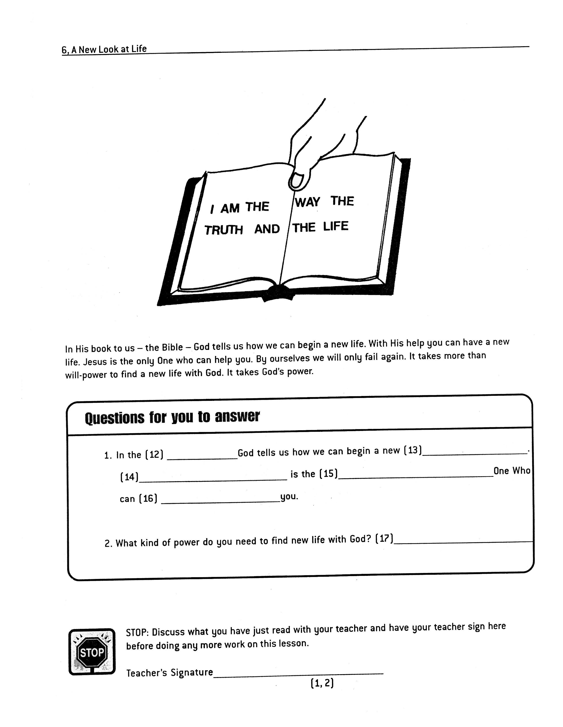

Slide 5
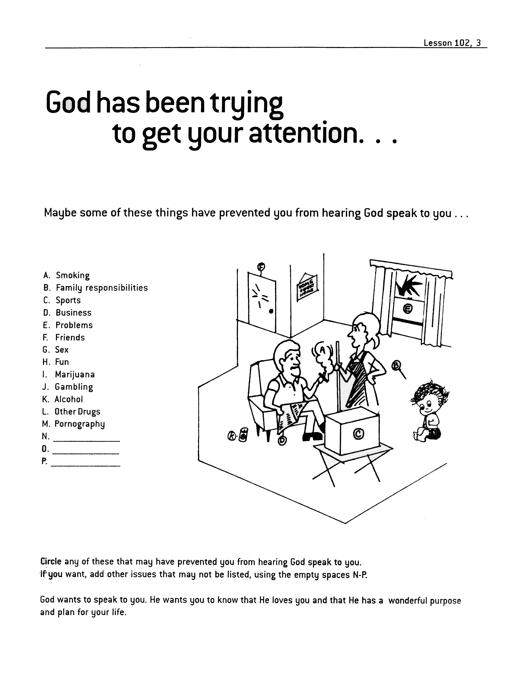
(1)

Slide 6
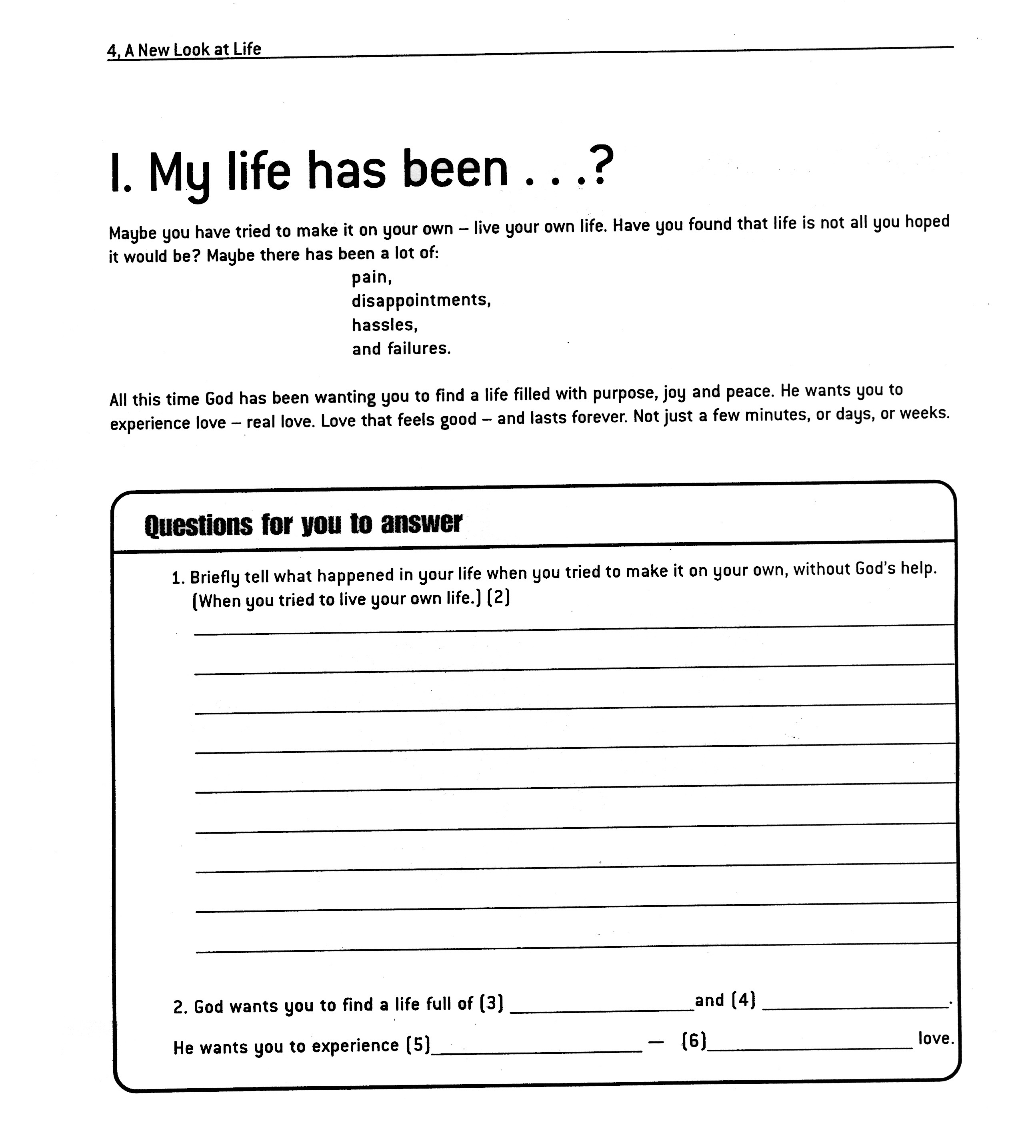

Slide 7
Teacher responsibilities at each STOP POINT
Check to make sure they have completed all questions.
--one word in each answer—fill-ins
Questions which require a personal answer
--numbers under teacher signature at STOP POINT.

Slide 9
Teacher responsibilities at each STOP POINT for the
Personal answer questions
“Would you read your answer out loud to me and then explain it in a little more detail?”
Especially for new students, give them time to share.
Don’t try to get them to give you “right” personal answers.

Slide 10
More Teacher responsibilities at each STOP POINT
Give the student your full attention.
After you have discussed their answers, sign the line at the STOP POINT and allow them to continue their work.
At the next STOP POINT, cover the new material covered since the last STOP POINT.

Slide 11
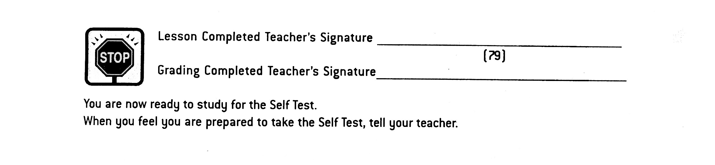
At the end of the lesson
Discuss the last section of the lesson they have completed. Then sign the line for “Lesson Completed.”

Slide 12
At the end of the lesson—cont.
Next have the student grade the whole lesson—using the Answer Key books.
Include pix of Student Lesson Answer Key page

Slide 13
Page from answer key book

Slide 14
At the end of the lesson—cont.
Then sign the “Grading Completed” line and explain the tests to be taken.

Slide 15
The tests for each lesson
The SELF TEST is a trial run for the student.
The FINAL TEST should be taken the next day.
The teacher will grade the FINAL TEST and discuss the results with the student, especially the personal answers.

Slide 16
The recognition for each lesson successfully completed
Give the student words of encouragement when discussing the final test results.
Give the student a “Congratulations Slip.”

Slide 17
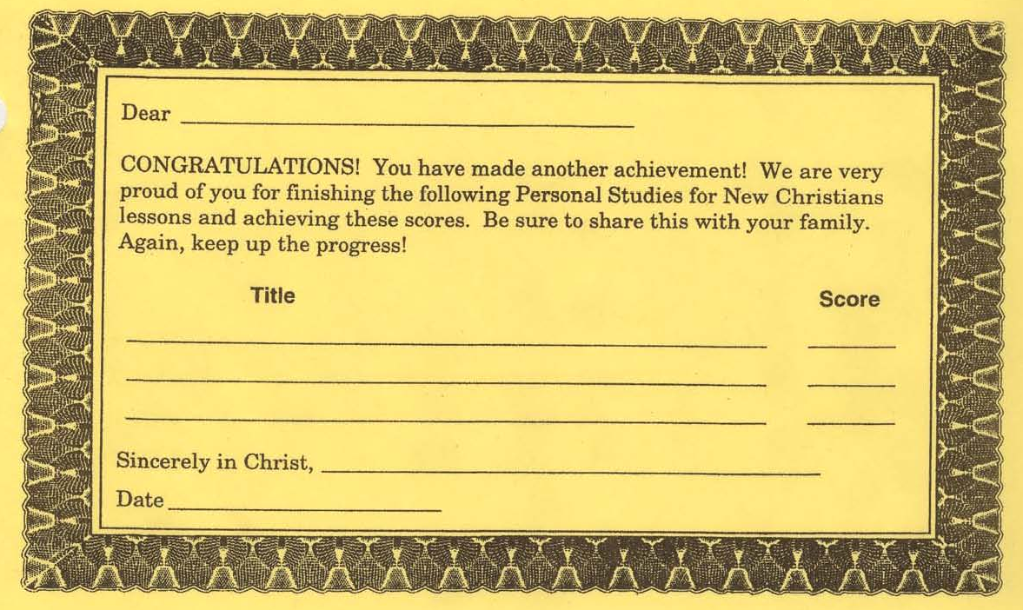
The recognition for each lesson successfully completed

Slide 18
The recognition for each lesson successfully completed
Give the student words of encouragement when discussing the final test results.
Give the student a “Congratulations Slip.”
Have the student record their grade on their “Achievement Record.”

Slide 19
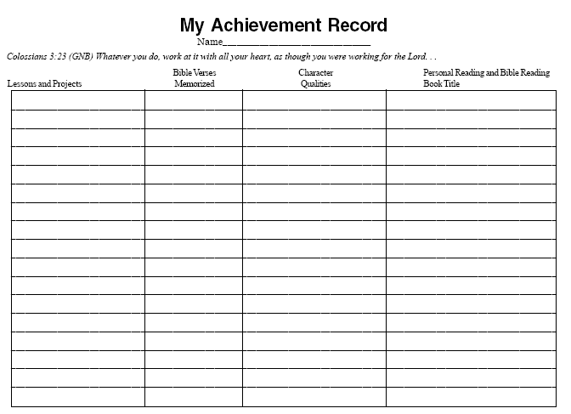

Slide 20
Grading their Scripture Memorization work
Each student fills out the Scripture Memorization Worksheet.
When he has memorized the verse, he first does an oral test, and quotes it to the teacher.
The student takes the written test on the verse the day after completing the oral test. Use the SMC Final Test Form.

Slide 21
Grading their Scripture Memorization work
The final test includes writing the verse from memory and giving a written evaluation of how they have put at least one of their goals into action.
The student receives a Congratulations Slip after successfully completing the verse. He also enters this verse on his Achievement Record.

Slide 22
Grading their Character Qualities classwork
Each student completes the 8 required learning activities for the character quality.
When he has memorized the definition of the character quality, he takes a quiz.
The three tests related to each character quality cannot be taken the same day.

Slide 23
Grading their Character Qualities classwork
Take time to discuss with the student their answers on the final test, stressing the need to continue to use this character quality in their daily living.
The student receives a Congratulations Slip after successfully completing the final written test.

Slide 24
Grading their Character Qualities classwork
The student also enters this character quality on his Achievement Record.

Slide 25
Grading their Personal Reading classwork
When the book is assigned to the student, there should be specific goals, questions or issues that the student will seek as he reads the book.
Each student completes the Daily Summaries on the book they are reading.
When he has completed the book, he writes a book report. This should address the goals identified at the beginning.

Slide 26
Grading their Personal Reading classwork
You may want to have the student give an oral report on this book to the whole class, telling what they learned from reading this book.
The student receives a Congratulations Slip after successfully completing the book.
The student also enters this book on his Achievement Record.

Slide 27
The purpose of the tests in PSNC
The test is a tool to help the student take seriously what we are expecting them to learn.
More important than the test score is that the student personally apply in his life the lessons he is studying.
The test becomes another opportunity for the teacher to discuss the progress of the student. Not spelling of words, but life issues.

Slide 28
Motivating your students to achieve through positive reward
What has been the “success factor” in the life of each student?
Your style of teaching can have a major impact on motivating your students.
--Who was the worst teacher in your life?
--Who was the best teacher in your life?
Take time to write encouraging comments on the work papers of your students.

Slide 29
Motivating your students to achieve through positive reward
Award the Congratulations Slips publicly
Give each student a star or sticker to put on their Achievement Record.
Share good examples of their work with their family and other staff.
Include excellent examples in your sample class work in a notebook in the classroom.

Slide 30
Contact information
Global Teen Challenge
706-576-6555
www.GlobalTC.org
www.iTeenChallenge.org

