Slide 1
An Introduction to the DNA of Teen Challenge Ministry
By Dave Batty
Teen Challenge Staff Training Course T503.05
iTeenChallenge.org

Slide 2
A. What brings real success to Teen Challenge Ministry?
DNA is our identity
DNA is who we are at the depths of our heart and soul and spirit
DNA is what brings life to our ministry

Slide 3
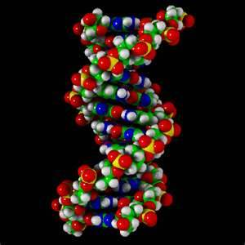
B. What is the basic DNA of Teen Challenge?
What are the essential ingredients that bring “real life” into this ministry?
What is the DNA that God wants in this ministry?

Slide 4
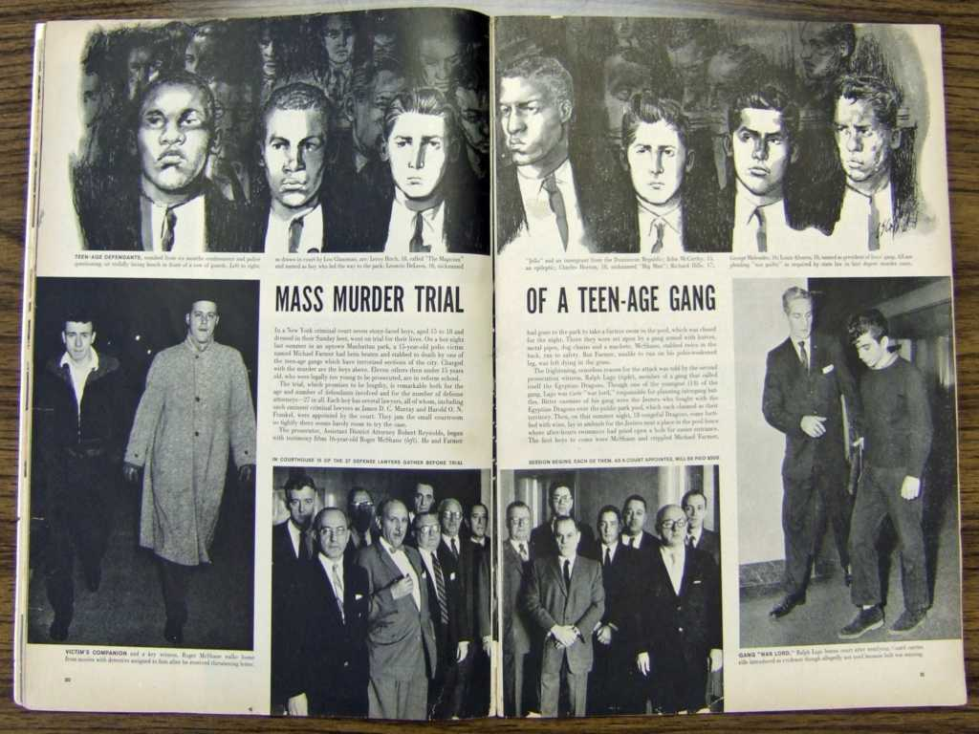
B. What is the basic DNA of Teen Challenge?
Prayer

Slide 5
B. What is the basic DNA of Teen Challenge?
Prayer
Psalm 126:5-6
Hebrews 11:6
Hebrews 4:15-16
Matthew 21:22

Slide 6
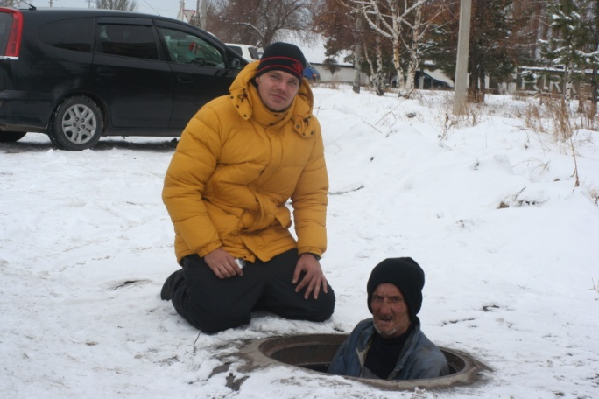
B. What is the basic DNA of Teen Challenge?
Evangelism Love for the lost

Slide 7
B. What is the basic DNA of Teen Challenge?
Evangelism Love for the lost
Jeremiah 29:11
2 Peter 3:9
John 3:16-17

Slide 8
B. What is the basic DNA of Teen Challenge?
Dependence on the Holy Spirit
Acts 1:8
John 15:5

Slide 9
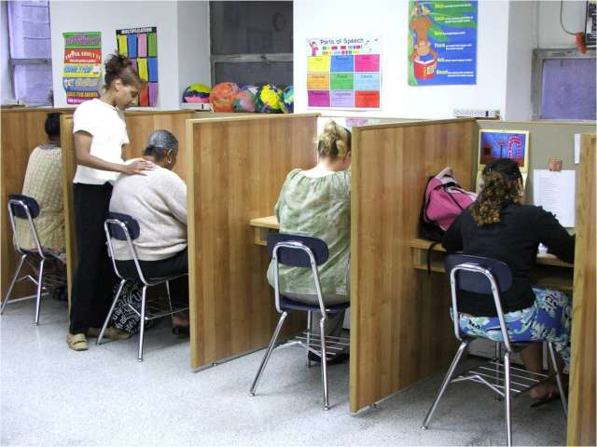
B. What is the basic DNA of Teen Challenge?
Jesus is the program
The structure is discipleship

Slide 10
B. What is the basic DNA of Teen Challenge?
Jesus is the program
The structure is discipleship
John 14:6
John 8:36
2 Corinthians 5:17

Slide 11
B. What is the basic DNA of Teen Challenge?
Lead like Jesus
Servant leadership

Slide 12
B. What is the basic DNA of Teen Challenge?
Lead like Jesus
Servant leadership
John 5:19
1 Corinthians 4:16
1 Corinthians 11:1
Philippians 3:17

Slide 13
B. What is the basic DNA of Teen Challenge?
A culture of personal responsibility

Slide 14
B. What is the basic DNA of Teen Challenge?
A culture of personal responsibility
Psalm 51:6
2 Corinthians 5:15
2 Corinthians 7:1

Slide 15
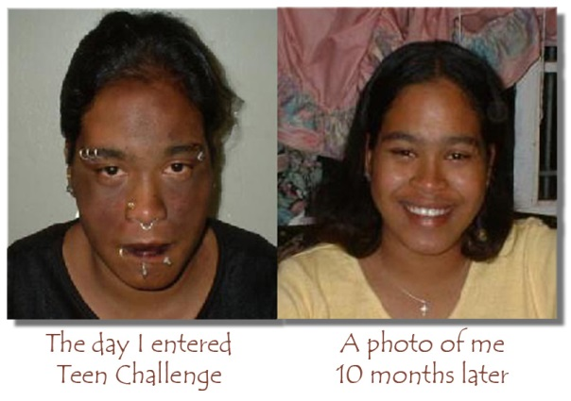
B. What is the basic DNA of Teen Challenge?
Faith
A power from God that always leads to action!

Slide 16
B. What is the basic DNA of Teen Challenge?
Faith
A power from God that always leads to action!
John 11:40
1 Kings 18:16-45
James 2:14-17
Hebrews 12:1-2

Slide 17
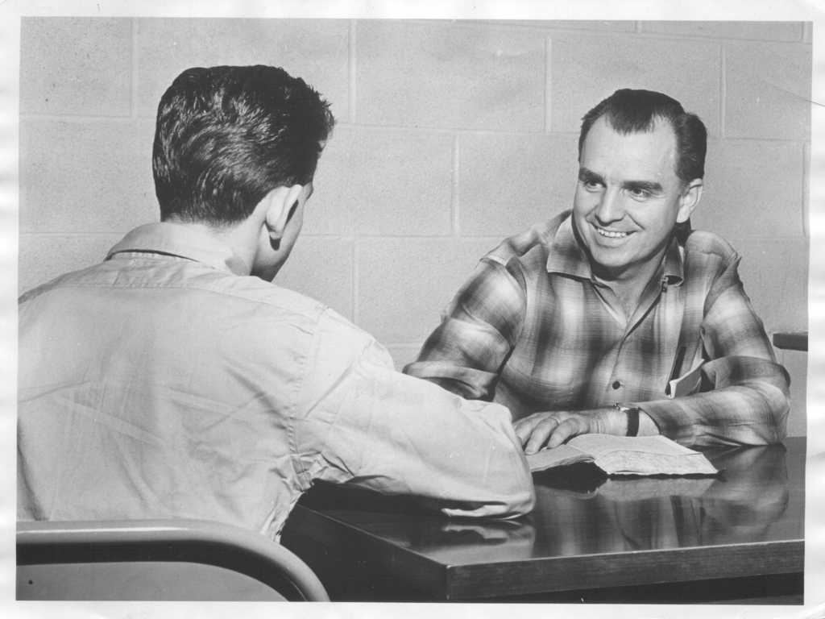
C. How can I make the DNA of TC part of my ministry?
How did the pioneers of Teen Challenge develop the DNA of this ministry?
These godly DNA characteristics were already part of their life and ministry before they came to work at Teen Challenge.

Slide 18
They applied this DNA to their ministry in Teen Challenge, which led to God’s blessing on the ministry.
They continued to grow the longer they worked in Teen Challenge.

Slide 19
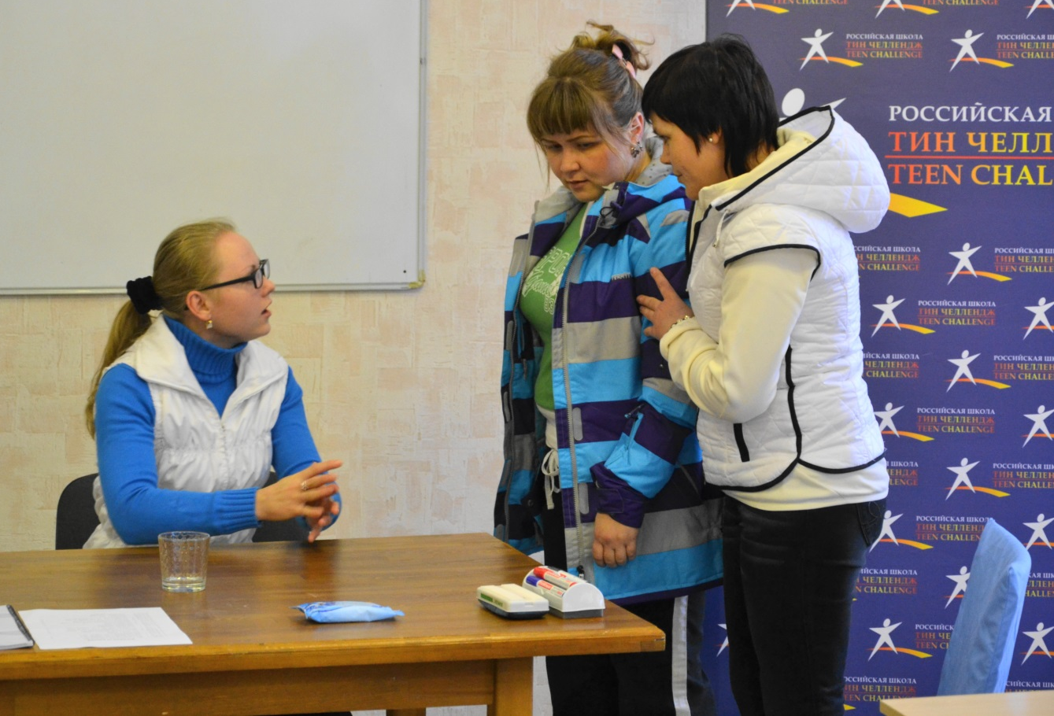
2. How would you assess your strength or weakness in applying these seven characteristics of the DNA of Teen Challenge?

Slide 20
3. What are some recent stories that show the presence of the DNA of Teen Challenge today?

Slide 21
4. How can you begin to take steps and develop these DNA characteristics into your daily ministry?
Proverbs 3:5-6

Slide 22
Questions for discussion

Slide 23
Contact us
www.Globaltc.org
www.iTeenChallenge.org

