Slide 1
새 신자를 위한 그룹 학습소개

Slide 2
Overview of the Discipleship Training given to our Students 학생들에게 주어진 크리스챤 제자훈련방식
Group Studies for New Christians 새신자를 위한 그룹학습
Personal Studies for New Christians 새신자를 위한 개인학습
Other special classes—Evangelism, AIDS, Emotional Dependency, etc.
다른 특별수업 – 전도, 에이즈, 감정의존, 기타등등

Slide 3
12 Month Overview 12개월 overview
GSNC 1 hour a day, 5 days a week 그룹학습–매주 5일하루에한시간
PSNC 2 hours a day, 5 days a week 개인학습매주 5일하루에두시간
GSNC First 4 months
그룹학습첫 4개월간
Continue with training phase group classes훈련단계그룹학습은계속지속한다.
PSNC Entire program 개인학습전체프로그램

Slide 4
Group Studies for New Christians
1. How Can I Know I'm a Christian?
2. A Quick Look at the Bible
3. Attitudes
4. Temptation
5. Successful Christian Living
6. Growing Through Failure
7. Christian Practices
8. Obedience to God
9. Obedience to Man
10. Anger and Personal Rights
11. How to Study the Bible
12. Love and Accepting Myself
13. Personal Relationships with Others
14. Spiritual Power and the Supernatural

Slide 5
새신자를위한그룹학습
나는크리스챤인가?
성경개론
태도
유혹
성공적인크리스챤의삶
실패를통한성장
크리스챤의관습
하나님께대한순종
사람에게대한순종
분노의개인의권리
성경을어떻게공부할것인가?
나자신을사랑하고받아들이는법
개인적인대인관계
개인적인대인관계

Slide 6
Group Studies for New Christians
1. How Can I Know I'm a Christian?
2. A Quick Look at the Bible
3. Attitudes
4. Temptation
5. Successful Christian Living
6. Growing Through Failure
7. Christian Practices
8. Obedience to God
9. Obedience to Man
10. Anger and Personal Rights
11. How to Study the Bible
12. Love and Accepting Myself
13. Personal Relationships with Others
14. Spiritual Power and the Supernatural
Continuous Cycle

Slide 7
새신자를위한그룹학습
나는크리스챤인가?
성경개론
태도
유혹
성공적인크리스챤의삶
실패를통한성장
크리스챤의관습
하나님께대한순종
사람에게대한순종
분노의개인의권리
성경을어떻게공부할것인가?
나자신을사랑하고받아들이는법
개인적인대인관계
개인적인대인관계

Slide 8
Felt Needs vs. Unfelt needs Heart issues Head Issues
1. How Can I Know I'm a Christian?
2. A Quick Look at the Bible
3. Attitudes
4. Temptation
5. Successful Christian Living
6. Growing Through Failure
7. Christian Practices
8. Obedience to God
9. Obedience to Man
10. Anger and Personal Rights
11. How to Study the Bible
12. Love and Accepting Myself
13. Personal Relationships with Others
14. Spiritual Power and the Supernatural

Slide 9
마음의필요와머리의필요의차이
나는크리스챤인가?
성경개론
태도
유혹
성공적인크리스챤의삶
실패를통한성장
크리스챤의관습
하나님께대한순종
사람에게대한순종
분노의개인의권리
성경을어떻게공부할것인가?
나자신을사랑하고받아들이는법
개인적인대인관계
개인적인대인관계

Slide 10
Felt Needs vs. Unfelt needs Heart issues Head Issues
1. How Can I Know I'm a Christian?
2. A Quick Look at the Bible
3. Attitudes
4. Temptation
5. Successful Christian Living
6. Growing Through Failure
7. Christian Practices
8. Obedience to God
9. Obedience to Man
10. Anger and Personal Rights
11. How to Study the Bible
12. Love and Accepting Myself
13. Personal Relationships with Others
14. Spiritual Power and the Supernatural

Slide 11
마음의필요와머리의필요의차이
나는크리스챤인가?
성경개론
태도
유혹
성공적인크리스챤의삶
실패를통한성장
크리스챤의관습
하나님께대한순종
사람에게대한순종
분노의개인의권리
성경을어떻게공부할것인가?
나자신을사랑하고받아들이는법
개인적인대인관계
개인적인대인관계

Slide 12
Felt Needs vs. Unfelt needs Heart issues Head Issues
1. How Can I Know I'm a Christian?
2. A Quick Look at the Bible
3. Attitudes
4. Temptation
5. Successful Christian Living
6. Growing Through Failure
7. Christian Practices
8. Obedience to God
9. Obedience to Man
10. Anger and Personal Rights
11. How to Study the Bible
12. Love and Accepting Myself
13. Personal Relationships with Others
14. Spiritual Power and the Supernatural

Slide 13
마음의필요와머리의필요의차이
나는크리스챤인가?
성경개론
태도
유혹
성공적인크리스챤의삶
실패를통한성장
크리스챤의관습
하나님께대한순종
사람에게대한순종
분노의개인의권리
성경을어떻게공부할것인가?
나자신을사랑하고받아들이는법
개인적인대인관계
개인적인대인관계

Slide 14
Primary Goals for Each GSNC course 각그룹학습의근본적인목표
Introduce basic Biblical principles for life for new Christians (milk, not meat) 새신자로살기위한삶에필요한기본적인성경적원칙들을소개한다.
Start them on the path to personal application 개인적으로적용할수있는길로인도한다.
Provide broad foundation for Christian living 크리스챤의삶을위한광범위한기초를제공한다.

Slide 15
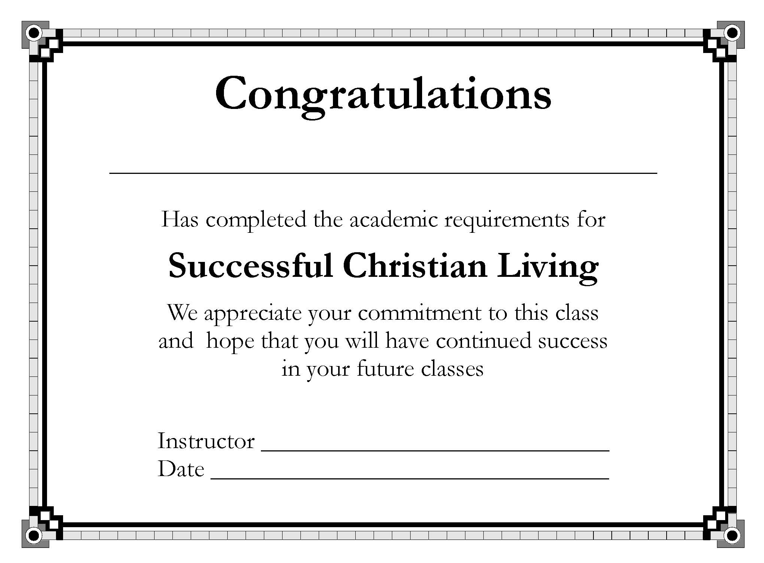
Materials for Each GSNC course
Teacher’s Manual
교사메뉴얼
Student Manual 학생메뉴얼
Study Guide 학습가이드
Test 시험
Course Certificate 자격증

Slide 16
Benefits of GSNC approach 가르칠때그룹학습과정의접근방식의유익점
Positive peer pressure 긍정적인피어프레셔
Teacher can organize it and carry it out as planned 교사가계획대로준비할수있고가르칠수있다.
Provides immediate feedback 순간적인피드백을제공할수있다.
Students interact with questions and learning activities 학생들이질문이나배움의활동들을통해서로상호작용할수있다.
Some subjects best covered in a group setting anger, attitudes, friendships, etc. 그룹세팅에서더활용하기좋은주제들–분노, 태도, 우정, 기타등등.

Slide 17
Possible Limitations of GSNC approach 그룹학습과정접근방식의제한점들
It can be is one-way communication 많은경우일방적인의사소통이될수있음
It’s hard for some students to be open with strangers 많은경우일방적인의사소통이될수있음
Opens people up to ridicule 조롱할여지를줄수있음
Students are at different levels of spiritual maturity 학생들의영적인성숙함이다다른정도일수있음

Slide 18
Structure for each GSNC course 학생들의영적인성숙함이다다른정도일수있음
Most designed for 5 class sessions 5 세션으로만들어짐
Each lesson has a Key Biblical Truth and a Key Verse 각세션은핵심성경진리와핵심구절이있다
Each lesson ends with a personal application 각세션은개인적인적용으로마친다.
Scripture memorization 성경구절암송
Class Assignment List 성경구절암송

Slide 19
Lesson Plans in the Teacher’s Manual 교사메뉴얼의
► Key Biblical Truth and a Key Verse
핵심성경진리와주요구절
► Lesson Warm-up activity
준비활동
► Specific activities and instructions for covering each part of the lesson
각과을위한구체적인활동이나가르침
► Personal Application
개인적인적용
► Assignments
과제

Slide 20
Teacher Training for the GSNC
Introducing Teachers to the Group Studies for New Christians 새신자를위한그룹학습을교사들에게소개하는것
Has the 2 versions of the Final Exam for the entire GSNC series 전체적인그룹학습시리즈를위한두개의다른기말고사버젼
Final test answer keys 기말고사정답
Certificate of Achievement 자격증
Student Test Record 학생성적기록

Slide 21
Portuguese
Portugal,
Brazil

Slide 22
Khmer
Used in
Cambodia Teen Challenge

Slide 23
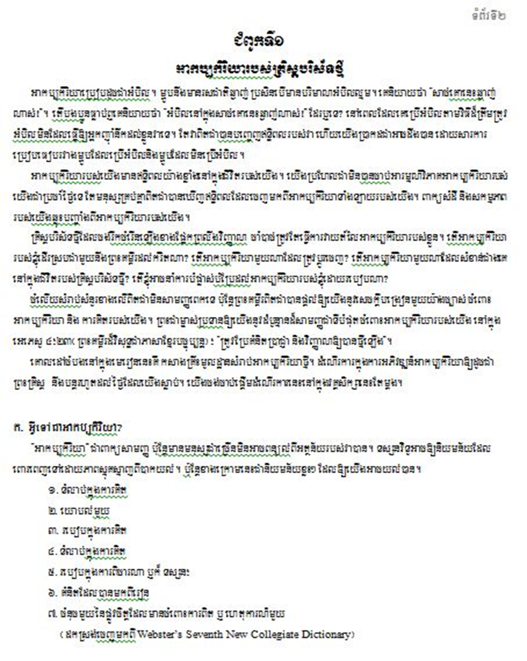
Khmer
Used in
Cambodia Teen Challenge

Slide 24
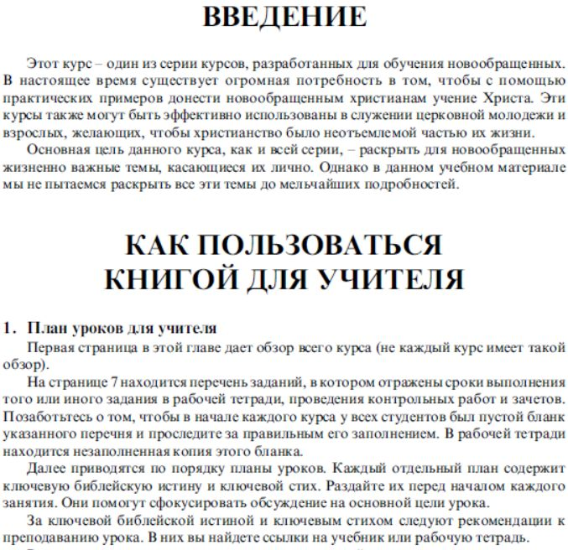
Russian

Slide 25
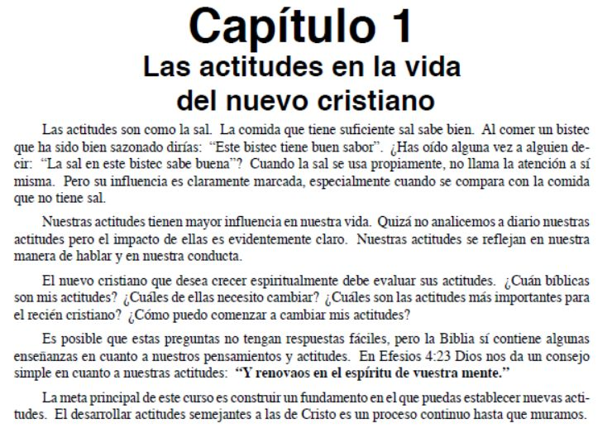
Spanish

Slide 26
성경공부의 예
Korean
이 태도의 문제를 당신의 성경공부에 연결시켜 해보라. 태도를 다루는 구절들을 연구해 보라
매일의 목표를 세우라. 하루에 지킬수 있는 목표를 하나씩세워서 그것을 지키도록 한다.
결과를 평가해 본다.

Slide 27
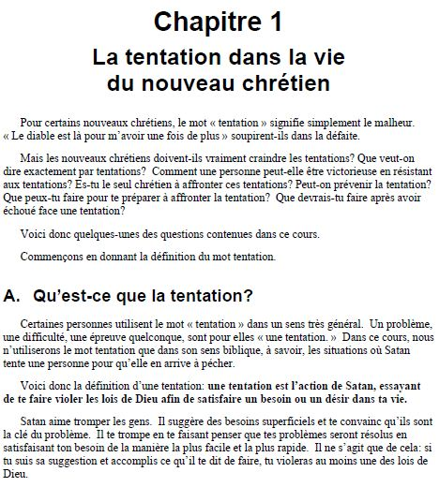
French

Slide 28
For More Information :
iteenchallenge.org

Slide 29
Teen Challenge USA teenchallengeusa.com
Contact Information
Global Teen Challenge
GlobalTC.org
iTeenChallenge.org

