Slide 1
Living Free Ministry

Slide 2
Living Free Ministry
Intro:
At church and work, people are smiling outside--hurting inside. Keeping up appearances.

Slide 3
Living Free Ministry
But something has its hooks in them. Threatens to take them under. Depression, Anxiety, Anger, Broken Relationships, Caregiving Responsibilities, Addictions, Eating Disorders, Money Problems, Compulsive Sex, A Loved-one's Problems.

Slide 4
Living Free Ministry
Do you want to be able to help them? Maybe is a neighbor or a friend. Maybe a family member and you are not sure what to say or what to do.
Living Free gives you that opportunity.

Slide 5
Living Free Ministry
Many people in our churches want to minister to others. In many of our churches ministry is reserved to the “professional ministers”. People are hurting and God has a ministry for you.
What’s holding you back?

Slide 6
What is Living Free?
Living Free is a small group strategy that has helped over one million people learn to face life's struggles and move toward freedom and wholeness in Christ.

Slide 7
What is Living Free?
It is people helping and caring for people.
The Living Free small groups discover God’s way of growing through life’s struggles through studying God’s word together.

Slide 8
Some of the topics discussed are:
Anger: Our Master or Our Servant , A Passionate Pursuit of God, Authentic Living in an Artificial World, Committed Couples, Completely Free, Insight Group, Concerned Persons Group, Godly Parenting, Free to Grow, Godly Heroes, Handling Loss and Grief, Peacemaking, Restoring Families, Seeing yourself in God’s Image, Stepping into Freedom, The Ten Commandments and Understanding Depression

Slide 9
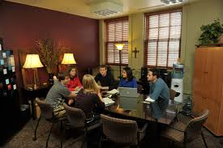
How can Living Free Groups help your Ministry?
Living Free is being used all over the world in a variety of ways.

Slide 10
How can Living Free Groups help your Ministry?
As an Outreach to the local church. Living Free provides practical training for churches to minister to people struggling with life –controlling problems.

Slide 11
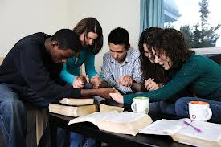
How can Living Free Groups help your Ministry?
As an Outreach to the local community.

Slide 12
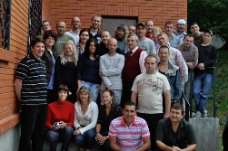
How can Living Free Groups help your Ministry?
As a means to start new Teen Challenge programs.

Slide 13
How can Living Free Groups help your Ministry?
Ministry to families of students in the program.
5. As a ministry to graduates of the TC program.

Slide 14
How can Living Free Groups help your Ministry?
Use as a small group curriculum in the program such as in a group counseling setting or as an advanced Group Studies class.
Use as a lesson for Personal Studies Contracts. Anger, Godly Self Image and many others.

Slide 15
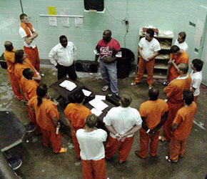
How can Living Free Groups help your Ministry?
Living Free Groups are the basis of many prison ministries.

Slide 16
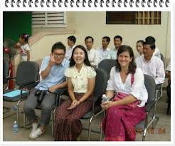
How can Living Free Groups help your Ministry?
Use a way to find volunteers,
staff and advocates in the
community for Teen Challenge.

Slide 17
How do you begin a Living Free Ministry?
There is an eight –step process to start a Living Free Ministry. See flow chart.

Slide 18
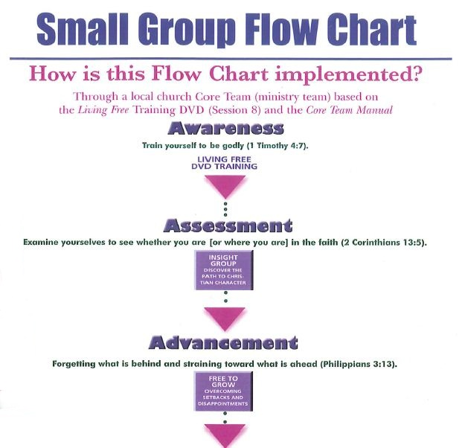

Slide 20
For More Information
iteenchallenge.org
Livingfree.org

