Slide 1
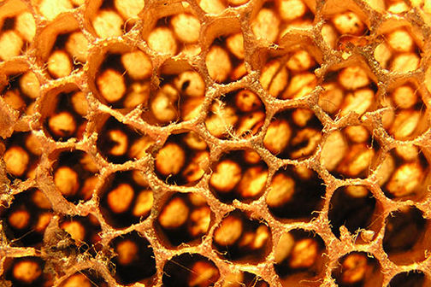
Seraphimovka, Kyrgyzstan Bee Keeping Started April, 2009

Slide 2
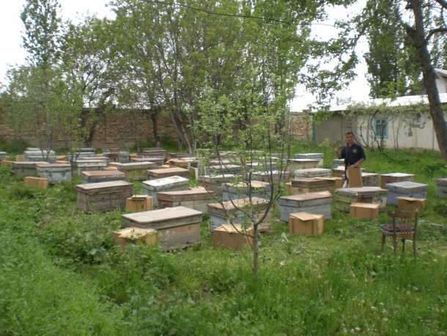
Project Overview
60 families of bees (Bee Hives)
Each produce around 80 pounds of honey a year

Slide 3
Continued…
Honey is a natural sweetener that is high demand here in Kyrgyzstan. Many honey producers will dilute their honey with sugar yielding poorer quality. Our goal is to produce natural, pure honey and sell it at a median price to gain market share and then increase production as we are able to increase sales. The profits from honey sales go to the operations budget of the program.

Slide 4
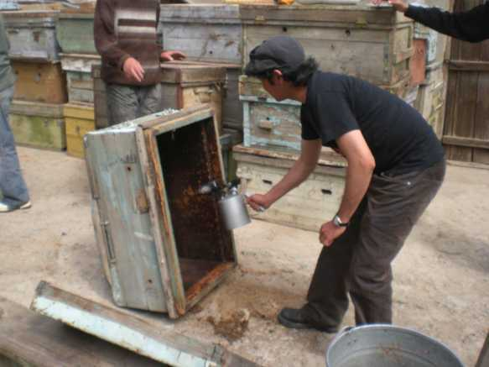
Key Roles
Role of Staff:
Our Staff member who oversees work time and facilities assigns workers as need. When honey is taken from the hives, it is a labor intensive task that takes about six full work days.
Role of Students:
It requires one skilled worker, two semi skilled workers, and one unskilled workert)

Slide 5
Time Requirements
How many hours of work per week are required in production/labor?
average of 40 man hours per week. From late April through early September it requires one half time skilled worker and one helper. The work can be done in half day blocks except when harvesting honey from the hives.

Slide 6
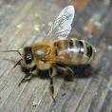
Continued…
How many hours of work per week are required in sales/distribution?
10 hours per week

Slide 7
Start-up Specs
Initial Set-up Time:
Two months
How long it took to produce a net profit:
has not yielded a net profit yet.
What is the estimated set-up or start-up cost?
$13,000

Slide 8
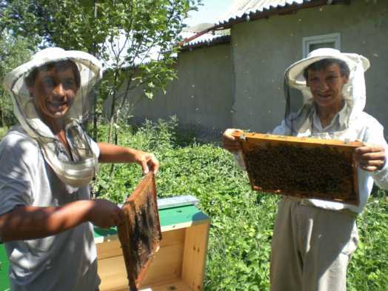
Supplies and Maintenance
Basic Equipment and Supplies
Bees, be hives, trailer, frames, basic wood working equipment to service and maintain hives, pasteurizer, honey harvesting tools

Slide 9
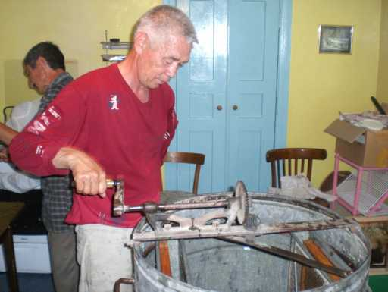
Continued…
Ongoing Maintenance Requirements:
During the summer, there is work to be done weekly. During the winter the hives need to be opened and checked every two weeks and syrup to feed the bees.

Slide 10
Testimony
Throughout the start up and first summer of this project God has strategically placed people to help us begin well.
Having new hives constructed, purchasing used hives to be able to expand next year, having a student who has worked with bees previously, purchasing the original 53 families of bees… all of this has been an experience that has increased our faith as we have seen God move and work.
In particular it was so encouraging to see our students embrace the project as they realized that they could learn new skills that would make them employable. This project provides real vocational training for students who want to learn the trade of bee keeping while yielding real profit that will help the operations budget to be met.

Slide 11
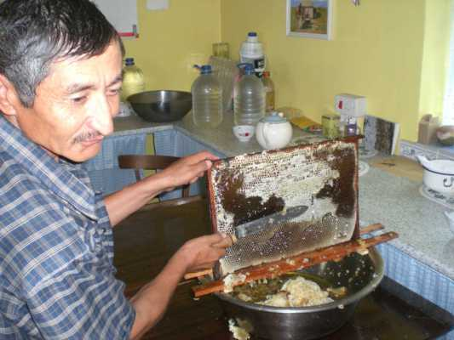
Things to consider before starting…
Location, breed of bees available, availability of other skilled bee keepers who are willing to help get the project started by providing instruction in one or two day blocks at appropriate phases of honey production, local market issues.

Slide 12
Problems with this project…
The educational challenge. It is imperative that the project director be able to put there hands to the work. There are decisions that are made through the season that must be made by the director and not students or junior staff. If you really don’t understand or aren’t willing to learn about bees, then you should not attempt this project. The project director must be able to do each phase of the work, and if needed be an active participant in the work.

Slide 13
What we’d do differently…
I would gather all the necessary accessories two months prior to purchasing new families of bees- which happens at the end of April, first of May.

Slide 14
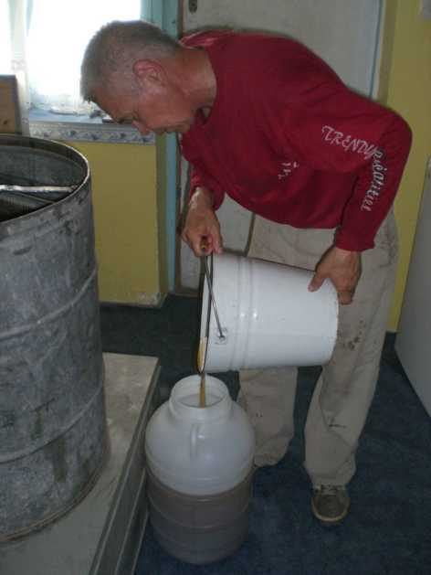
Marketing Strategy
To sell quality honey at a median price in a package that is a little bit nicer than others are using. Also we are working to develop a reputation for honest measure and pure, undiluted honey.

Slide 15
For more information on this project…
Contact:
Lewis Johnson
lewisdjohnson@swissmail.org

Slide 16
Global Teen Challenge
Sustainable Funding Solutions
PO Box 511
Columbus, GA 31902 USA
Phone: 1-706-576-6555
www.iTeenChallenge.org
Email: gtc@globaltc.org

