Slide 1
Delegating Tasks and Developing People Moving From Addition to Multiplication by EQUIP Ministries founded by John Maxwell
1

Slide 2
Delegating Tasks and Developing People Moving From Addition to Multiplication
“Then the twelve summoned the multitude of the disciples and said, 'It is not desirable that we should leave the word of God and serve tables. Therefore, brethren, seek out from among you seven men of good reputation, full of the Holy Spirit and wisdom, whom we may appoint over this business.'”
(Acts 6:2-3)

Slide 3
Delegating Tasks and Developing People Moving From Addition to Multiplication
When ministers decide to become leaders, they take an important stand. They make a revolutionary decision in the way they perform their ministry. They no longer evaluate themselves only by what they can do themselves. Their value now depends on what they can get done through others! This is what we call the “Jethro Principle.”

Slide 4
Delegating Tasks and Developing People Moving From Addition to Multiplication
The Day Moses Became a Leader
In Exodus 18:17-27 Jethro introduces this principle to Moses. “And Moses’ father-in-law said to him, ‘The thing that you are doing is not good.You will surely wear out, both yourself and these people who are with you, for the task is too heavy for you; you cannot do it alone.’” Jethro proceeded to give Moses wise counsel as to how he could delegate the work load to others and multiply the amount of service being rendered to others. The Scripture says: “So Moses listened to his father-in-law and did all that he said...” Many times in leadership it is easy for the leader to feel as if he or she must accomplish everything alone. However, as Jethro points out, that will cause one to wear out. So as a result, Moses made changes and began to equip others and share the responsibilities.

Slide 5
Delegating Tasks and Developing People Moving From Addition to Multiplication
Seven Changes Moses Made to Become a Leader: (Exodus 18)
He became a man of _________. (v. 19)
“Now listen to me: I shall give you counsel, and God be with you. You be the people's representative before God, and you bring the disputes to God.”
He committed himself to _____________. (v. 20)
“Then teach them the statutes and the laws, and make known to them the way in which they are to walk, and the work they are to do.”
prayer
communication

Slide 6
Delegating Tasks and Developing People Moving From Addition to Multiplication
Seven Changes Moses Made to Become a Leader: (Exodus 18)
He laid out the ______. (v. 20)
“Then teach them the statutes and the laws, and make known to them the way in which they are to walk, and the work they are to do.”
He developed a ____. (v. 20)
“Then teach them the statutes and the laws, and make known to them the way in which they are to walk, and the work they are to do.”
vision
plan

Slide 7
Delegating Tasks and Developing People Moving From Addition to Multiplication
Seven Changes Moses Made to Become a Leader: (Exodus 18)
He ________ and trained the leaders. (v. 21)
“Furthermore, you shall select out of all the people able men who fear God, men of truth, those who hate dishonest gain; and you shall place these over them, as leaders of thousands, of hundreds, of fifties and of tens.”
He released them to _____ based on their gifts. (v. 22)
“And let them judge the people at all times... every minor dispute they will judge.”
selected
serve

Slide 8
Delegating Tasks and Developing People Moving From Addition to Multiplication
Seven Changes Moses Made to Become a Leader: (Exodus 18)
He only did what ____ could not do. (v. 22)
“…and let it be that every major dispute they will bring to you…”
In verse 23, we see the results of Moses' change: strength for Moses and peace for the people.
“If you will do this thing and God so commands you, then you will be able to endure, and all these people also will go to their place in peace.”
they

Slide 9
Delegating Tasks and Developing People Moving From Addition to Multiplication
From Minister to Leader - There is a difference between a minister and a leader. While every leader is also to be a minister, not every minister is a leader. Look at how they differ:
Minister
Leader
Serves people.
Directly meets the needs of people.
Draws fulfillment from doing the work.
Plays defense to survive.
Reacts to needs that arise from moment to moment.
Focuses on immediate needs.
Shepherds others.
Serves people.
Empowers others to meet the needs of people.
Draws fulfillment from equipping others to do the work.
Plays offense to make progress.
Creates opportunities to mentor others.
Focuses on long-term vision.
Equips others.

Slide 10
Delegating Tasks and Developing People Moving From Addition to Multiplication
Why Leaders (Pastors) Fail to Develop People
They realize that equipping people is hard work.
They are insecure or have a poor self-image.
They feel they are the only one that is qualified to do it.
They don't trust others.
They have bad habits and an unbiblical perspective.
They have a low belief in people.
They don't know how to train others.
It is easier to lead followers than leaders.

Slide 11
Delegating Tasks and Developing People Moving From Addition to Multiplication
Developing others will take energy, time, and careful planning. It is a proactive way of leading, rather than the reactive way many leaders unfortunately run their organization.
It will also mean that, as a leader, you will need to allow others to share ownership of the work you are doing. This requires a belief and trust in others and the ability to relinquish control. However, if you commit to equipping people, you will find Jethro’s promise to be true in your life and leadership.

Slide 12
Delegating Tasks and Developing People Moving From Addition to Multiplication
Question: Do you find it difficult to equip other people and delegate tasks? Why?
______________________________________________________________________________________________________
Question: In what areas could you release control and equip someone to lead?
______________________________________________________________________________________________________

Slide 13
Delegating Tasks and Developing People Moving From Addition to Multiplication
How Do We Select People to Whom We Can Delegate Work?
This is an important question. Whom do we choose to equip? The answer may be found in Acts 6:1-4.
“Now in those days, when the number of the disciples was multiplying, there arose a complaint against the Hebrews by the Hellenists, because their widows were neglected in the daily distribution. Then the twelve summoned the multitude of the disciples and said, ‘It is not desirable that we should leave the word of God and serve tables. Therefore, brethren, seek out from among you seven men of good reputation, full of the Holy Spirit and wisdom, whom we may appoint over this business; but we will give ourselves continually to prayer and to the ministry of the word.’”

Slide 14
Delegating Tasks and Developing People Moving From Addition to Multiplication
How Do We Select People to Whom We Can Delegate Work?
Good leadership responds effectively to the need for more leaders and workers. In the early church, no one took a vote to determine the identity of these people. The apostles had specific qualifications in mind for the leaders they wanted; they chose men who were...
Known from their sphere of influence – “seek out from among you.”
Fellow believers – “brothers.”
People who could serve on a team – “seven men.”
Trusted among the people – “of good reputation.”
Empowered for the task – “full of the Holy Spirit.”
Competent and intelligent – “full of... wisdom.”
Responsible – “whom we may appoint over this business.”

Slide 15
Delegating Tasks and Developing People Moving From Addition to Multiplication
How Do We Develop Others While We Delegate the Ministry?
Know yourself. (Be familiar with the strengths you pass on to others in the work.)
Know the person you wish to develop. (Identify his or her strengths and weaknesses.)
Clearly define the assignments. (Don't leave anything in question; write it down.)
Teach the “why” behind the assignment. (Let them know why it is important.)
Discuss their growth process as you go. (Talk about how they will grow from it.)
Spend relational time with them. (Invest time when you are not talking about work.)
Allow them to watch you minister. (Let them observe and get feedback from you.)
Give them the resources and authority they need. (Provide the tools to do the job.)
Encourage them to journal during the process. (Help them interpret their growth.)
Hold them accountable for their ministry. (Get permission to keep them in line.)
Give them the freedom to fail. (Communicate that they can learn as they go.)
Debrief and affirm regularly. (Encourage them all along the way as they succeed.)

Slide 16
Delegating Tasks and Developing People Moving From Addition to Multiplication
What Would Jesus Do? (Luke 9:1-2)
“Then He called His twelve disciples together and gave them power and authority over all demons, and to cure diseases. He sent them to preach the kingdom of God and to heal the sick.”
We see in this passage that Jesus shared both responsibility and authority. To succeed in our mission, we must share both our work and power with a team. Jesus aimed to develop the disciples as He shared the work. He did not spend the majority of His time with the masses. He focused on training the disciples. By not spending equal time with everyone, but more time with those who were ready to be trained, Jesus was able to multiply His ministry in about three years.

Slide 17
Delegating Tasks and Developing People Moving From Addition to Multiplication
The Development Process
I do it while you watch.
We do it together.
You do it while I watch.
We evaluate.
You do it while another watches.

Slide 18
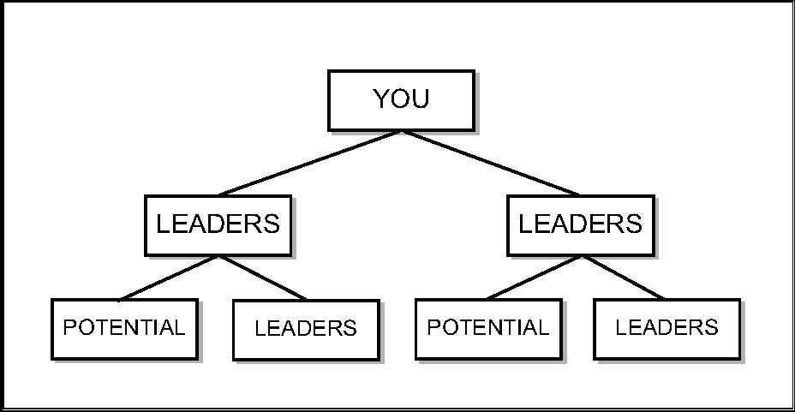
Delegating Tasks and Developing People Moving From Addition to Multiplication
ADDITION LOOKS LIKE THIS: 1 + 1 = 2 MULTIPLICATION LOOKS LIKE THIS:
The Truth about Developing People
Nearly every lasting movement in history endured because the first group of leaders
reproduced their leadership and values into a second generation of leaders. It became a
movement because it was about multiplication and not addition.

Slide 19
Delegating Tasks and Developing People Moving From Addition to Multiplication
Developing Others While Delegating Work
There are several distinctions between a leader of leaders and a leader of followers.
_____________
Leaders who develop Followers… _________________________.
Leaders who develop Leaders… __________________________.
_____________
Leaders who develop Followers… Focus on the _______________ of people.
Leaders who develop Leaders… Focus on the _______________ of people.
Desire
need to be needed
want to be succeeded
Focus
weaknesses
strengths

Slide 20
Delegating Tasks and Developing People Moving From Addition to Multiplication
Developing Others While Delegating Work
There are several distinctions between a leader of leaders and a leader of followers.
_____________
Leaders who develop Followers… devote effort to those with the most___________.
Leaders who develop Leaders… devote effort to those with the most____________.
_____________
Leaders who develop Followers… are _______________ leaders.
Leaders who develop Leaders… are _______________ leaders.
Priorities
needs
potential
Abilities
good
great

Slide 21
Delegating Tasks and Developing People Moving From Addition to Multiplication
Developing Others While Delegating Work
There are several distinctions between a leader of leaders and a leader of followers.
_____________
Leaders who develop Followers… life up _________________________.
Leaders who develop Leaders… lift up __________________________.
_____________
Leaders who develop Followers… _______________ time with people.
Leaders who develop Leaders… _______________ time with people.
Attitude
themselves
others
Time
spend
invest

Slide 22
Delegating Tasks and Developing People Moving From Addition to Multiplication
Developing Others While Delegating Work
There are several distinctions between a leader of leaders and a leader of followers.
______________
Leaders who develop Followers… ask for _________________ commitment.
Leaders who develop Leaders… ask for _____________________ commitment.
_____________
Leaders who develop Followers… lead everyone the _______________ .
Leaders who develop Leaders… lead everyone _______________ .
Expectations
little
much
Leadership
same
differently

Slide 23
Delegating Tasks and Developing People Moving From Addition to Multiplication
Developing Others While Delegating Work
There are several distinctions between a leader of leaders and a leader of followers.
_____________
Leaders who develop Followers… impact ___________________ generation.
Leaders who develop Leaders… impact ______________________ generation.
Impact
this
this next

Slide 24
Delegating Tasks and Developing People Moving From Addition to Multiplication
ASSESSMENT: Am I spending my time developing followers or leaders? How am I cultivating a leadership environment?
APPLICATION: Who am I developing at this time? Who can I begin to develop? What is my plan for that person?

Slide 25
Delegating Tasks and Developing People Moving From Addition to Multiplication
“Then the twelve summoned the multitude of the disciples and said, 'It is not desirable that we should leave the word of God and serve tables. Therefore, brethren, seek out from among you seven men of good reputation, full of the Holy Spirit and wisdom, whom we may appoint over this business.'”
(Acts 6:2-3)
Next Session: Teamwork Makes the Dream Work

Slide 26
For more information about this course and other training resources: Contact Global Teen Challenge at GTC@Globaltc.org Or visit our training website at iTeenChallenge.org

