Slide 1



Christ the Great Communicator Improving Your Communication Skills by Imitating the Master by EQUIP Ministries founded by John Maxwell
1

Slide 2
Christ the Great Communicator Improving Your Communication Skills by Imitating the Master
“Death and life are in the power of the tongue, and those who love it will eat its fruit.”
(Proverbs 18:21)

Slide 3
Christ the Great Communicator Improving Your Communication Skills by Imitating the Master
The success of your leadership, your marriage and your relationships with others depends a great deal on your ability to communicate.
Many of the best thinkers are not leaders.Why? They cannot communicate.
Your leadership rests on your ability to connect with people, share your ideas and vision, and motivate them to partner with you. One former world leader said, “If I could start all over again, I would go back to school and learn to communicate.”

Slide 4
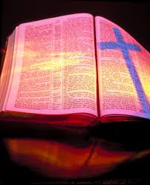
Christ the Great Communicator Improving Your Communication Skills by Imitating the Master
Matthew 13
Jesus is the greatest communicator who ever walked the earth. In John 1, He is called “the Word.” In Matthew 13 we see an example of His effective style. Christ, the Great Communicator, teaches us how to relate truth to our people today.

Slide 5
Christ the Great Communicator Improving Your Communication Skills by Imitating the Master
IMPROVING YOUR COMMUNICATION SKILLS
______________________(Matthew 13:3, 10-13)
Our lesson: It's not just what you say, but how you say it.
Jesus shared most of His message through stories. He shared seven of them in this chapter. He used the power of simple, familiar narratives. The educator takes something simple and makes it complicated.The communicator takes something complicated and makes it simple. He gave them a point for their head and a picture for their heart.
Jesus' rules of communication:
Strong beginning -- One theme
Simple language -- Familiar pictures
Clear objectives -- Heart response
Simply the message

Slide 6
Christ the Great Communicator Improving Your Communication Skills by Imitating the Master
IMPROVING YOUR COMMUNICATION SKILLS
______________________(Matthew 13:1-2, 9)
Our lesson: It's not just what you say, but how they hear it.
Jesus saw the people and perceived their needs. It is difficult to effectively communicate with an audience without knowing something about them. Most learning takes place in the arena of a person's familiarity or interest. Jesus identified with people.
To become more like Him we'll have to become more “people-oriented” and less “lesson-oriented.”
Public speakers teach lessons; communicators teach people.
Know the people

Slide 7
Christ the Great Communicator Improving Your Communication Skills by Imitating the Master
Public Speaker
Communicator
Puts the message before the people
Asks “what do I have?”
The key is techniques
Content-oriented
Goal is to complete the message
Puts the people before the message
Asks “what do they need?”
The key is atmosphere
Change-oriented
Goal is to complete the people

Slide 8
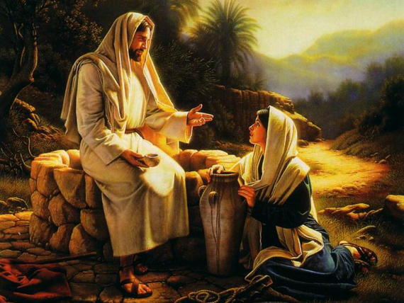
Christ the Great Communicator Improving Your Communication Skills by Imitating the Master
Jesus used what was cultural to say what is timeless. He connected with them where they were in order to lead them to where they needed to be.
Paul did the same thing in Acts 17 when he spoke at Mars Hill.
So did Peter when he spoke at Pentecost, Acts 2.
These men all communicated truth, but did so from the perspective of their listeners.

Slide 9
Christ the Great Communicator Improving Your Communication Skills by Imitating the Master
IMPROVING YOUR COMMUNICATION SKILLS
______________________(Matthew 13:2, 14-17, 57-58)
Our lesson: It's not just what you say, but when you say it.
At times, Jesus was conspicuously silent when it was tempting to speak out.
At other times, He spoke when it was in His selfish interest to stay quiet. He understood timing.
The Scripture says when the people came, Jesus spoke (v.2).The Scripture also says when the people rejected the message, He withdrew (v.57-58). Effective leaders know when to relay a message for best results. Early on, Jesus said: “The time has not yet come.” Later, He said, “My time has come.” God is a master at timing. Galatians 4:4 says, “When the fullness of time had come, God sent His Son.”
Seize the moment

Slide 10
Christ the Great Communicator Improving Your Communication Skills by Imitating the Master
Questions to ask about timing
Who is my audience?
What are their questions and needs right now?
What needs to be accomplished most?
What's God's answer to their questions and needs?
Are they ready to receive it?
How can I build a bridge of relationship that will bear the weight of truth?

Slide 11
Christ the Great Communicator Improving Your Communication Skills by Imitating the Master
IMPROVING YOUR COMMUNICATION SKILLS
______________________(Matthew 13:54)
Our lesson: It's not just what you say, but how you show it.
“And coming to His home town, He began teaching them in their synagogue, so that they became astonished and said, 'Where did this man get His wisdom and these miraculous signs?'”
Jesus‘ credibility came not only from His words, but also from His life. He modeled His teaching. It was show and tell. He said “Follow Me,” not just “listen to Me” (Matthew 4:19).
Show the truth

Slide 12
Christ the Great Communicator Improving Your Communication Skills by Imitating the Master
Every time you speak, your audience is quietly asking:
Why should I listen to you?
Can I trust you?
Do you care for me?
Do you know your subject?

Slide 13
Christ the Great Communicator Improving Your Communication Skills by Imitating the Master
Author Charles Allen describes Jesus this way:
“He might have preached lengthy sermons on the dignity of labor, temptation, how to enjoy life, the immortality of the soul, the worth of children, and the fact that God answers prayer.
Instead, He worked in a carpenter's shop, He met and conquered temptation in the wilderness, He went to parties and laughed with other happy people, He raised the dead, He stopped to love little children, and after He prayed, the power of the Lord was present.

Slide 14
Christ the Great Communicator Improving Your Communication Skills by Imitating the Master
“He might have talked long and loud about the need of man for human sympathy, the worth of womanhood, the blessing of humility, and the equal worth of all men.
Instead, He wept at the grave of a friend, He treated all women with deep respect, He took a towel and washed His disciples' feet, He gave His time to the poor and outcasts.”
“Instead of talking about how He could transform lives, He took a harlot and made her the first herald of the resurrection.

Slide 15
Christ the Great Communicator Improving Your Communication Skills by Imitating the Master
Instead of preaching that people need bread, He fed the multitude.
Instead of arguing the spirit is stronger than matter, He walked
on water.
Instead of telling people how bad it is to be crippled, He said, 'Arise, take up your bed and walk.'
Instead of merely telling people they should forgive, while
He was dying and being spit on He prayed, 'Father, forgive them.'”

Slide 16
Christ the Great Communicator Improving Your Communication Skills by Imitating the Master
IMPROVING YOUR COMMUNICATION SKILLS
______________________(Matthew 13:53-57)
Our lesson: It's not just what you say, but why you say it.
Jesus spoke from His convictions. His convictions enabled Him to conclude that a prophet is not without honor except in his own country (v.57). His words were from His heart. He spoke with passion and demonstrated obedience to His heavenly Father. He had nothing to prove, nothing to lose and nothing to hide. He didn't speak out of routine or obligation. When He spoke, His words always had great meaning.
There are no boring subjects-only boring speakers.
There are no small audiences-only small speakers.
If you are interested in your audience, they will be interested in you.
Share the passion

Slide 17
Christ the Great Communicator Improving Your Communication Skills by Imitating the Master
Tips on speaking with passion
Speak on themes that you own for yourself.
Be impact-conscious rather than image-conscious.
Be authentic. Lock on to a pair of eyes with each point.
Paint pictures in their hearts.
Know what your goal is when you speak.
Prepare with prayer and let God build a fire inside you.

Slide 18
Christ the Great Communicator Improving Your Communication Skills by Imitating the Master
IMPROVING YOUR COMMUNICATION SKILLS
______________________(Matthew 13:51)
Our lesson: It's not just what you say, but how they respond to it.
After Jesus taught, He asked, “Have you understood these things?” He was probing to make sure they could apply the truth. Jesus always spoke with a goal in mind. There was something for the audience to know, something for them to feel, and something for them to do. A good message always includes all three of these ingredients. This will require us to research our audience, not just our message.
The fact is:
20% of most audiences will act on their own.
80% of most audiences will not act on their own.
Share the passion

Slide 19
Christ the Great Communicator Improving Your Communication Skills by Imitating the Master
Tips on helping people to respond to truth
Have a clear objective for your listener to act on.
Reduce it to a simple phrase and write it down.
Use a “hook” the listener can grasp and remember.
Give them a point for their head and a picture for their heart.
Provide a vehicle for them to use to respond.
Ask for what you want them to do.

Slide 20
Christ the Great Communicator Improving Your Communication Skills by Imitating the Master
Steps to Reduce Your Anxiety as a Communicator
Prepare extensively. (The more ready you are, the more relaxed you'll be.)
Memorize your first burst. (Know your first three sentences or opening story.)
Speak to friendly eyes. (To get comfortable, focus on faces that are interested.)
Dress comfortably for the audience. (If you don't, you may get preoccupied.)
Take deep breaths before you begin. (This keeps you from nervously rushing.)

Slide 21
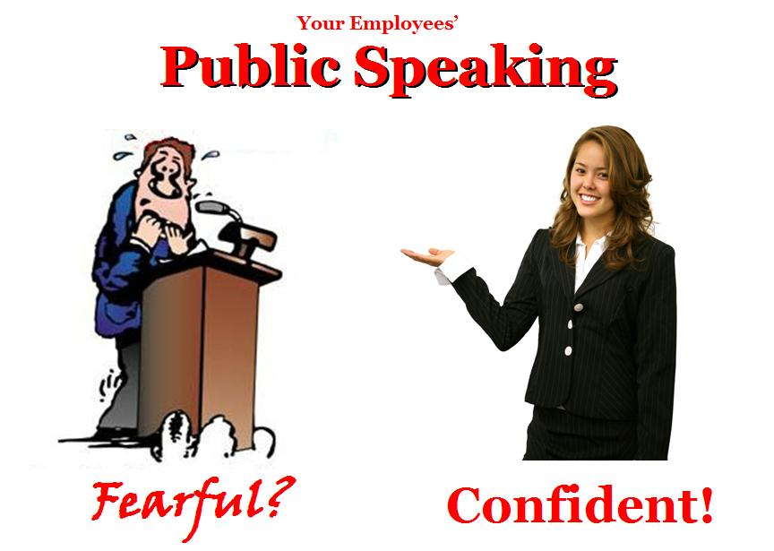
Christ the Great Communicator Improving Your Communication Skills by Imitating the Master
You must:
Believe in your God.
Believe in your message.
Believe in yourself.
Believe in your audience.

Slide 22
Christ the Great Communicator Improving Your Communication Skills by Imitating the Master
Question:
What is it you desire your listeners to do when you speak to them?
Question:
How can you best encourage them to take that step of obedience?

Slide 23
Christ the Great Communicator Improving Your Communication Skills by Imitating the Master
Steps to Reduce Your Anxiety as a Communicator
Visualize yourself being effective. (See God using you to impact your audience.)
State your goal to yourself before you begin. (Be clear on what your target is.)
Use visual aids. (This can make the message memorable and keep the attention off you.)
Come to the meeting room early. (Arrive fifteen minutes early to remove surprises.)
Pray, pray, pray! (Lean on God to communicate His vision through you.)

Slide 24
Christ the Great Communicator Improving Your Communication Skills by Imitating the Master
“Be anxious for nothing, but in everything, through prayer and supplication, with thanksgiving, make your requests known to God. And the peace of God, which passes all understanding shall keep your hearts and minds in Christ Jesus.” (Philippians 4:6-7)

Slide 25
Christ the Great Communicator Improving Your Communication Skills by Imitating the Master
ASSESSMENT: Jesus demonstrated six principles of communication. Which of these six do you already effectively practice? On which do you need to improve?
APPLICATION: What action will you take to become a better communicator? How will you communicate differently this week when you speak to people?
“The words of the wise are like goads, and the words of scholars are like well-driven nails, given by One Shepherd.” (Ecclesiastes 12:11)

Slide 26
Christ the Great Communicator Improving Your Communication Skills by Imitating the Master
“Death and life are in the power of the tongue, and those who love it will eat its fruit.”
(Proverbs 18:21)
Next Session: Leading When Times Are Tough

Slide 27
For more information about this course and other training resources: Contact Global Teen Challenge at GTC@Globaltc.org Or visit our training website at iTeenChallenge.org

