Slide 1

How to Renew Your Mind
By Dave Batty

Slide 2

1. What are the battles that people have in this area of the mind?

Slide 3
2. The concept of Christian discipleship is at the core of dealing with this issue
Three stages of overcoming an addiction
Addict [ Ex-Addict [ Non-Addict
Behavior Using Not using Not Using
Inside Thinking Thinking Not Thinking like an addict like an addict like an addict
Rehabilitation Transformation
A Renewed mind

Slide 4
2. The concept of Christian discipleship is at the core of dealing with this issue
A. Three stages of overcoming an addiction
B. How renewing the mind fits in with discipleship as a whole

Slide 5
3. Closer look at renewing the mind
A. What we must do Romans 12:1-2
What is God’s part in renewing your mind?
What is your part in renewing your mind?

Slide 6
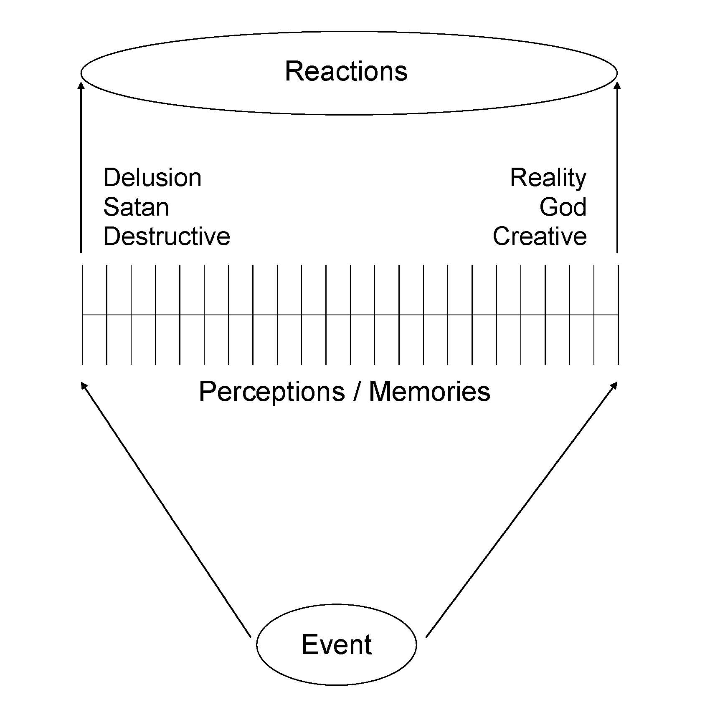

Slide 7

B. How do you renew your mind?
Memorizing scripture is the foundation for renewing your mind
Psalm 119:11

Slide 8
B. How do you renew your mind?
1. Eight Plus One Strategy – Philippians 4:8-9
1. Whatever is true
2. Whatever is noble
3. Whatever is right
4. Whatever is pure
5. Whatever is lovely
6. Whatever is admirable
7. Whatever is excellent
8. Whatever is praiseworthy
PLUS 1—Put it into practice!

Slide 9
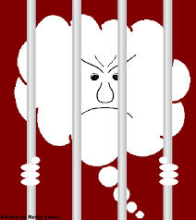
2. Demolition strategy
2 Corinthians 10:5 We demolish arguments and every pretension that sets itself up against the knowledge of God, and we take captive every thought to make it obedient to Christ.

Slide 10
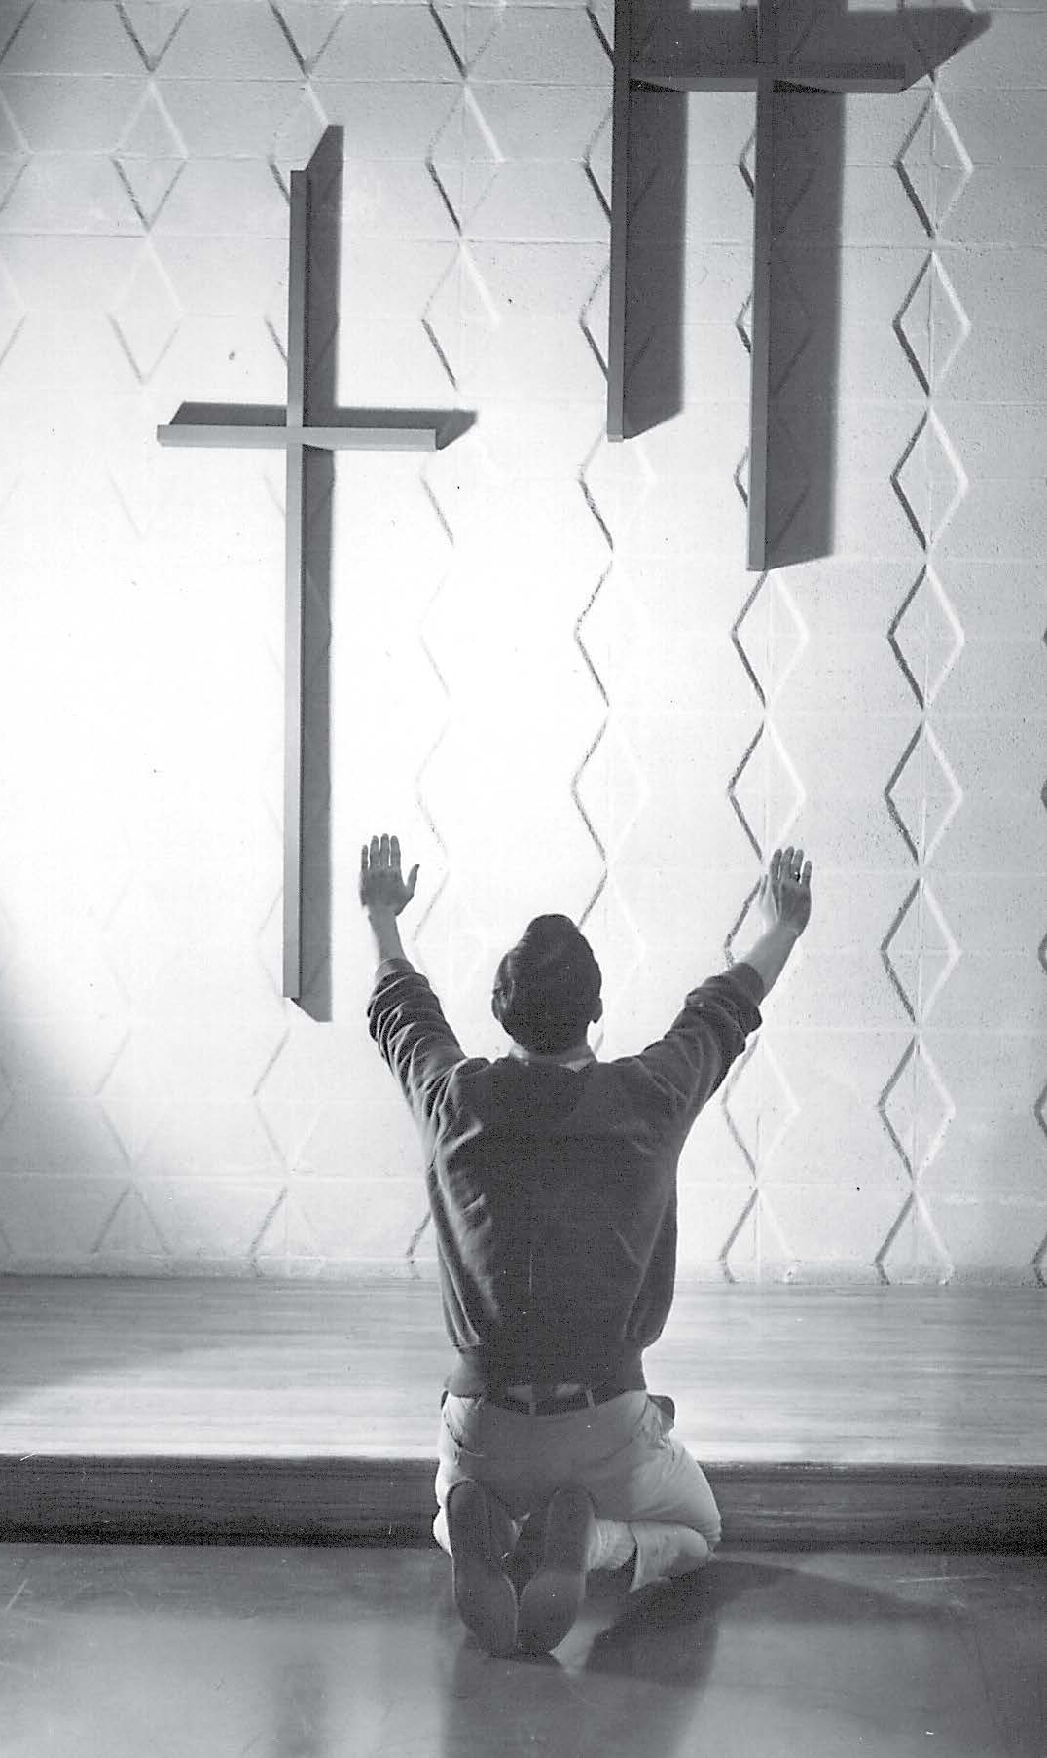
3. Fixing your thoughts on Jesus strategy
Hebrews 3:1 Therefore, holy brothers, who share in the heavenly calling, fix your thoughts on Jesus, the apostle and high priest whom we confess.

Slide 11

4. Put off / put on strategy
Colossians 3:1-17
Who does the putting off?
Who does the putting on?

Slide 12
Contact us
www.Globaltc.org
www.iTeenChallenge.org

