Slide 1
What does a healthy disciple look like? Signs of healthy living
By Dave Batty

Slide 2
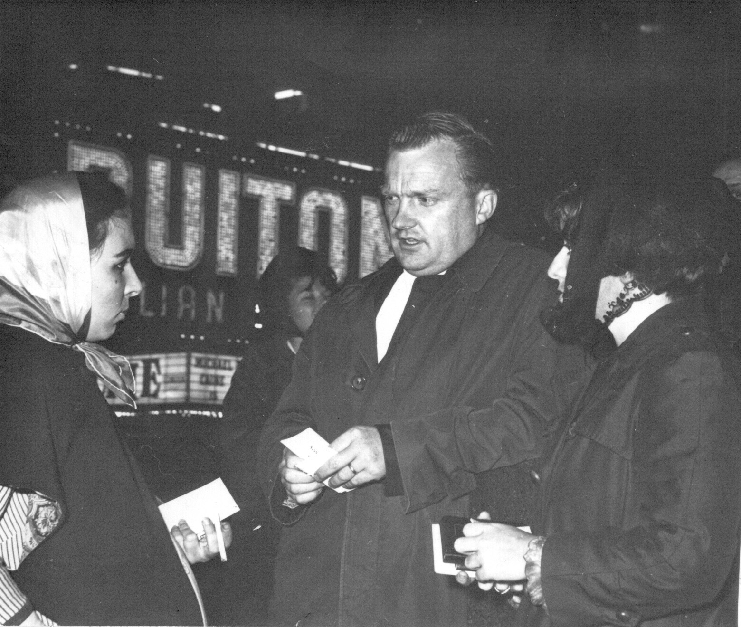
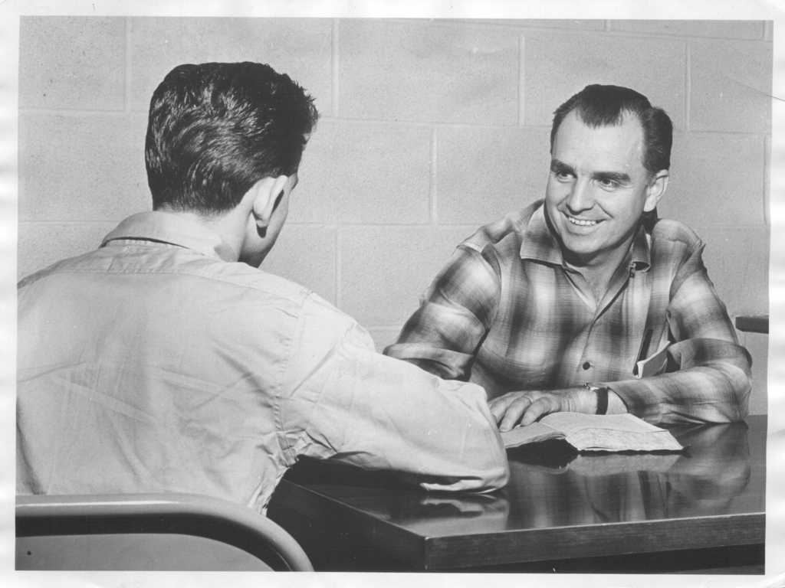
Early failures of seeing drug addicts find freedom from addiction.
They realized the need for both evangelism and discipleship

Slide 3
Salvation does not automatically or instantly turn you into a healthy Christian disciple.
Dysfunctional
sinner + Salvation = Dysfunctional Christian
How does one become a healthy Christian?
Christian discipleship!

Slide 4
How do you reach the full potential in life that God desires for you?
Jeremiah 29:11 NIV
“For I know the plans I have for you,” declares the Lord, “plans to prosper you and not to harm you, plans to give you hope and a future.”
What are the plans that God has for you specifically?

Slide 5
How do you reach the full potential in life that God desires for you?
Jesus from the Parable of the Sower
Matthew 13:23 NIV
But the one who received the seed that fell on good soil is the man who hears the word and understands it. He produces a crop, yielding a hundred, sixty or thirty times what was sown.
What would your life look like if you were producing a “hundred times” what was sown?

Slide 6
What does God look for to determine if a person is a healthy disciple?
What does the Bible say?
Psalm 1:1-3 NIV
Blessed is the man who does not walk in the counsel of the wicked or stand in the way of sinners or sit in the seat of mockers. ² But his delight is in the law of the Lord, and on his law he meditates day and night. ³ He is like a tree planted by streams of water, which yields its fruit in season and whose leaf does not wither. Whatever he does prospers.

Slide 7
How do you measure the progress of a new Christian’s growth? How do you know if this person is on a path to healthy spiritual growth?

Slide 9
Stages of Life / Indicators of Maturity
1. The Infant Stage Birth to 3
2. The Child Stage Age 4 - 12
3. The Adult Stage Age 13 – to birth of 1st child
4. The Parent Stage Birth of 1st child until youngest child has become an adult
5. The Elder Stage Beginning when youngest child has become an adult

Slide 10
1. Infant Stage: Birth through 3 yrs.
Primary Task: Learning to Receive
Primary Resulting Problem if personal task is not completed:
Weak or stormy relationships
(This is what you will see in their adult life if they have failed to master the personal tasks at this stage.)

Slide 11
1. Infant Stage: Birth through 3 yrs.

Slide 12
Personal Tasks are not a self help path to health. How do I master these personal tasks as a healthy disciple of God?
How do I “follow Jesus” in each of these areas of my life?
What is God’s path for me to master each of these areas in my life?

Slide 13
Personal Tasks
Personal Task #1 | Bible Verses | Action Steps
Lives in joy. Expands capacity for joy. Learns that joy is one’s normal state. Builds joy strength. | 1 Thessalonians 5:16 Nehemiah 8:10 Psalm 118:24 Luke 10:20 John 15:11 John 16:24 Romans 15:13 2 Corinthians 7:4 | Wake up in the morning and quote Psalm 118:24 to myself. Look for things today that I can be thankful for and rejoice in them. Choose to be joyful as I do the work that I must do today.

Slide 14
Personal Tasks
Personal Task #2 | Bible Verses | Action Steps
Develops trust | Proverbs 3:5-6 Psalm 143:8 Psalm 40:4 Proverbs 11:28 1 Corinthians 13:7 Proverbs 28:26 Matthew 25:21 | How can I trust in the Lord with all my heart today? How does my love for this person relate to my ability to trust this person? What has this person done to cause me to not trust them?

Slide 15
Personal Tasks
Personal Task #5 | Bible Verses | Action Steps
Learns how to return to joy from every unpleasant emotion. | 1 Thessalonians 5:16 Nehemiah 8:10 Psalm 118:24 2 Corinth. 12:7-11 James 1:2-5 2 Kings 18:5 John 16:21-22 Psalm 103:19 Romans 8:28 | How can I apply each of these verses in my life today? James 1:2 says I need to face the problems in my life. What problem do I need to face today instead of ignoring it or running from it? How will I return to joy from: Anger Depression Fear

Slide 16
Infant Stage: Birth through 3 yrs.
By age 3 a person has the potential to master all these tasks—to be a mature, healthy person.
You can go through life never mastering some of these personal tasks.
You can begin today to master any one of these tasks.

Slide 17
1. Infant Stage: Birth through 3 yrs.

Slide 18
2. Child Stage: age 4-12 yrs.
Primary Task: Taking care of self
Primary Resulting Problem if personal task is not completed:
Not taking responsibility for self
(This is what you will see in their adult life if they have failed to master the personal tasks at this stage.)

Slide 19
2. Child Stage: Age 4 - 12 yrs.

Slide 20
Personal Tasks
Personal Task #2 | Bible Verses | Action Steps
Learns what brings personal satisfaction.

Slide 21
Contact us
www.Globaltc.org
www.iTeenChallenge.org

